Slide 1

Exploring and visualizing data subsets using the vtree package
Nick Barrowman, PhD
useR!2026

Slide 2
Prologue

Slide 3
About me
My name is Nick Barrowman and I'm a statistician at the Children's Hospital of Eastern Ontario (CHEO) Research Institute in Ottawa, Canada and Associate Professor at the University of Ottawa.
I'm part of a team called the Clinical Research Unit (CRU). The CRU collaborates with clinicians and investigators by providing comprehensive support throughout all stages of research. We help design and analyze studies and also contribute to writing manuscripts.

Slide 4
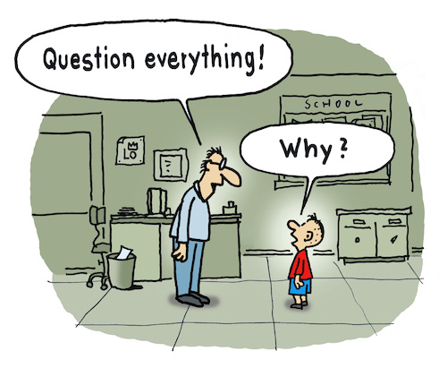
Please ask questions at any point

Slide 5
Let's customize this workshop!
Although I have prepared lots of material to share, I am happy to adapt the workshop to what interests you.

Slide 6

A quick poll
Who has used vtree before?
Has anyone brought a data set they would like to explore with vtree?
Does anyone have a burning question?

Slide 7
Outline
Part I
  What is a variable tree?
  Enhancements in the vtree package
  Real examples from my work
  Using the vtree function
  Worked examples
  A survey
  Variable trees vs bar graphs
  Diagnostic test properties
  Study flow diagram
Break
Part II
  Data set exploration with vtree
  Traffic stops
  FIFA World Cup matches 1930 to 2022
  WHO indicators

Slide 8
Part I

Slide 9
Think of the many different ways to display a data set
What types are...
commonly used?
more (or less) flexible?
over-used? (why?)
Each way of displaying a data set has its strengths and weaknesses, depending on what your goals are.
Today I will
show that vtree is a flexible alternative to some over-used data displays
highlight where it can be especially useful

Slide 10
What is a variable tree?

Slide 11
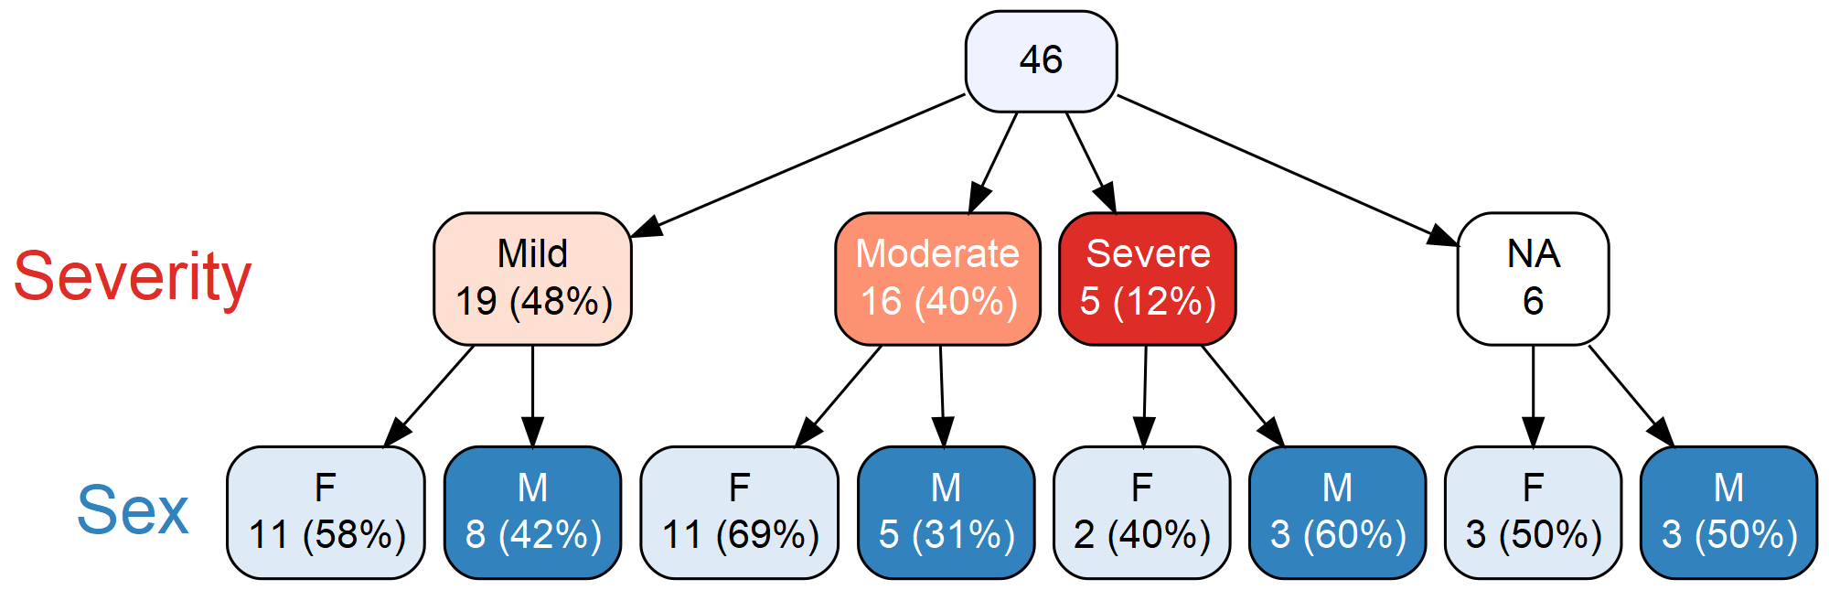
What is a variable tree?
Here is a variable tree with two layers.
Variable trees can have many layers.
Notes:
vtree is a tool for exploring subsets of data.
Here's a very simple variable tree, produced by vtree. It is for a made-up dataset of 46 patients. Here nested subsets for two variables are shown. Both variables are discrete. Severity represents the severity of illness (Mild, Moderate, or
Severe). Sex is shown as M (male) or F (female).
For each variable, the nodes of the three are coloured in darker or lighter shades. This makes it easy to distinguish the nodes, and when you're working with someone, this makes it easy to identify which node you're talking about.

Slide 12
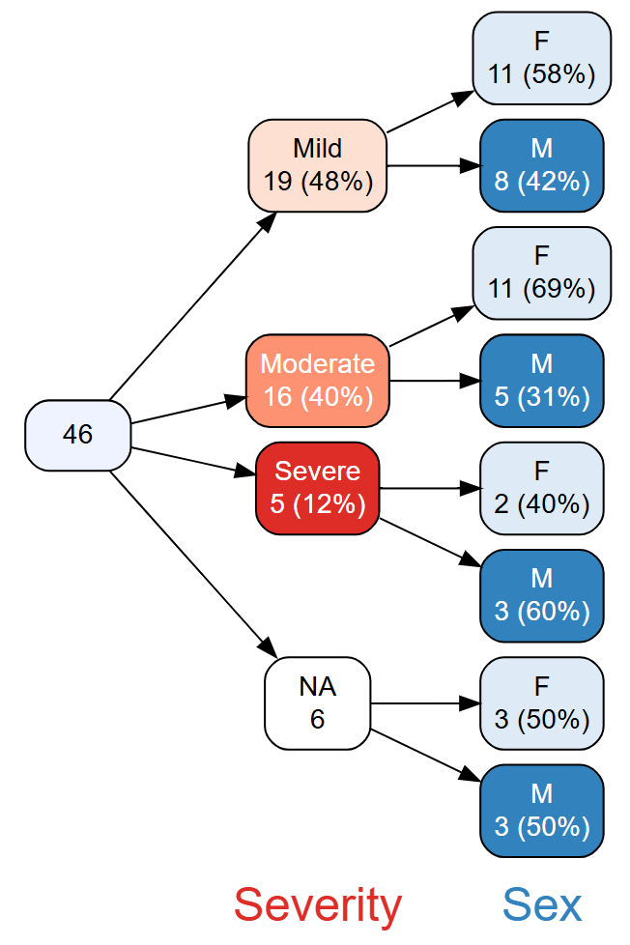
Sometimes it is convenient to show a variable tree horizontally

Slide 13
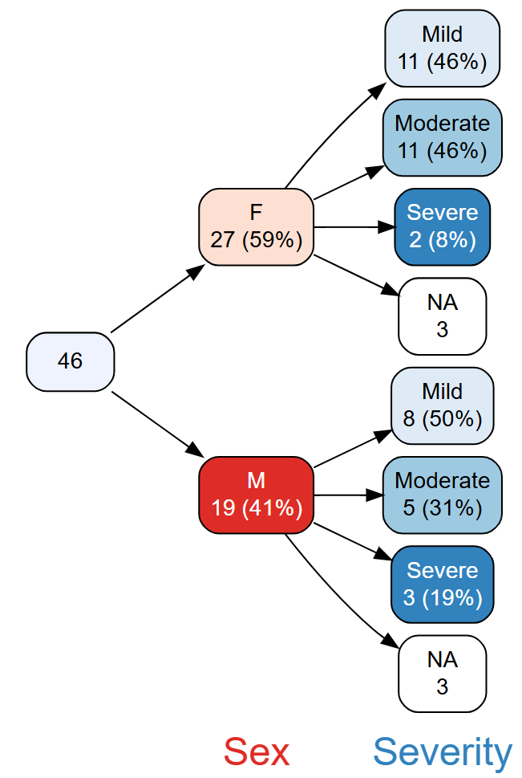
It is often helpful to change the order of variables.

Slide 14
variable trees address two basic (and related) points in data analysis
What is the denominator?
What about missing values?
Notes:
It is remarkable is that these basic points are often ignored or misrepresented.

Slide 15

What is
the denominator?

Slide 16
What about missing values?
There are (at least) two reasons why missing values are a problem.
Excluding records with missing values:
reduces statistical power.
can generate selection bias.
#1 is not desirable. #2 can be disastrous.

Slide 17
By default, most data analysis and graphing functions in R will run even when there are missing values in the data.
Typically, only complete cases are used.
In many cases there is no warning message: e.g. lm, table, chisq.test, plot, ...
At least ggplot gives a warning.
Warning message:
Removed 1 row containing missing values or values outside the scale range (`geom_point()`).

Slide 18
How does vtree handle missing values?
vtree always shows missing values
By default, when vtree calculates percentages, it calculates the denominator as the total number of non-missing values. These are called valid percentages.
Note:
When valid percentages are shown, no percentage is calculated for the missing values.
If you specify vp = FALSE, percentages are calculated using the total number of observations. Additionally, percentages will be calculated for the missing values.
Notes:
Interestingly gtsummary::tbl_summary uses the vp = TRUE style, but gtsummary::tbl_cross uses the vp = FALSE style

Slide 19
Enhancements in the vtree package

Slide 20
Enhancements
The vtree package enhances the basic idea of variable trees in several ways:
pruning to remove nodes that are not of interest,
summary information in the nodes
specifications to control how variables appear (e.g. dichotomization of continuous variables)
"legends" showing marginal counts for variables
"pattern trees" that show combinations
Note: In addition to the above, vtree has lots of other customization options.
Notes:
Note: The vtree package has lots of other "bells and whistles", but the enhancements listed here are the major ones.
Note: Some people have suggested other kinds of enhancements, like graphics within nodes, or statistical modeling within nodes. These seem to me to go too far.

Slide 21
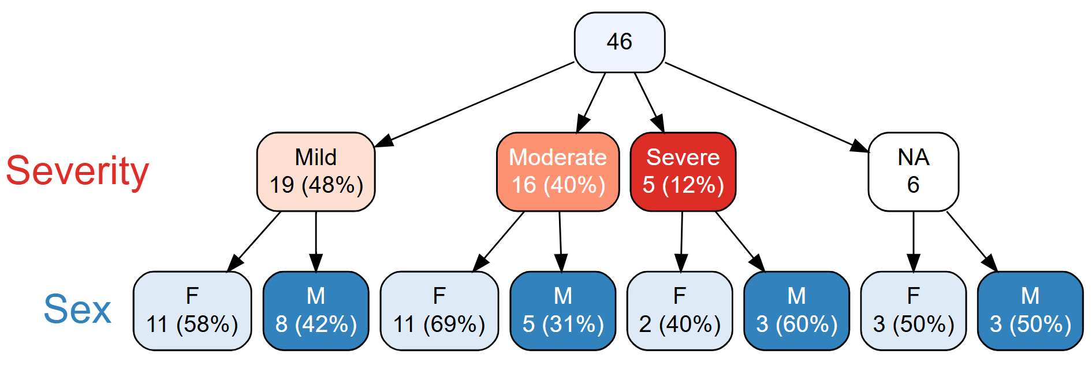
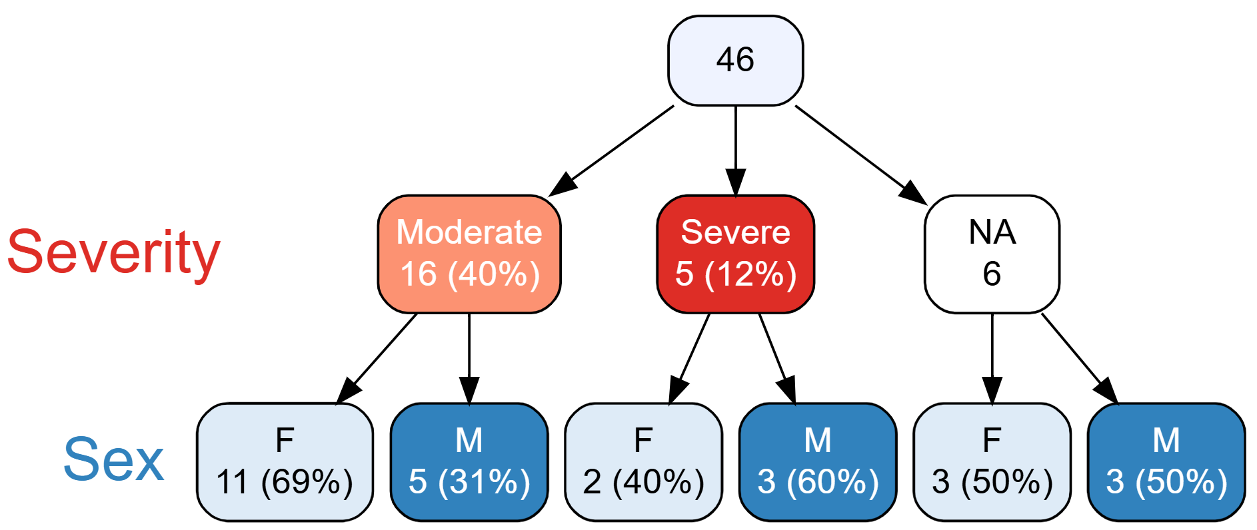
pruning to remove nodes that are not of interest
Original
Pruned
Notes:
Note: You can't prune

Slide 22
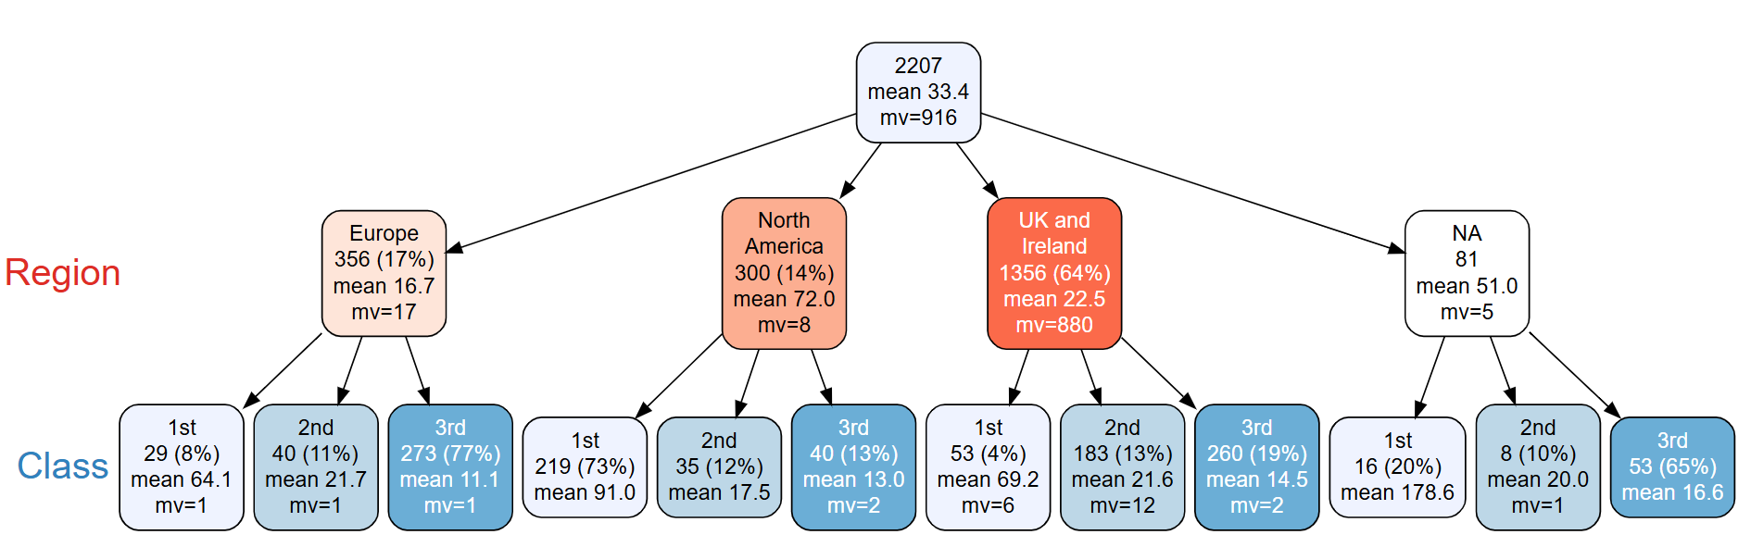
summary information in the nodes
Here is a variable tree based on a Titanic data set.
Each node of the tree shows summary information about the fare paid by passengers.
In this example, the mean and number of missing values are shown.
This is one way that vtree supports continuous variables.
Notes:
I think the fares are in British pounds.

Slide 23
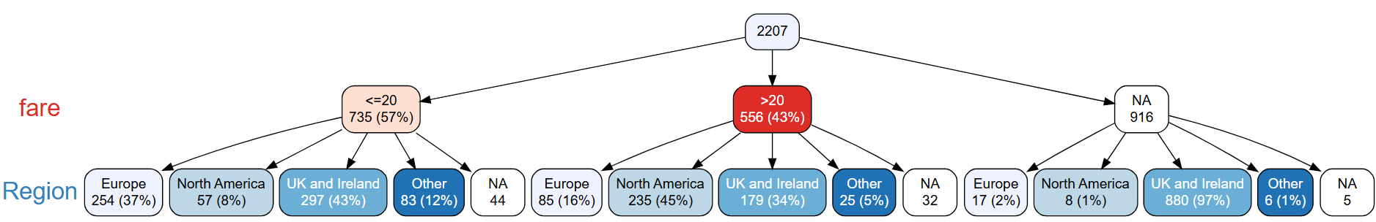
specification of variables
Another way that vtree supports continuous variables is through dichotomization.
In the example below, the fare variable was dichotomized into <= 20 and > 20.
To do this, you specify fare < 20
vtree provides several other variable specifications.
Notes:
I think

Slide 24
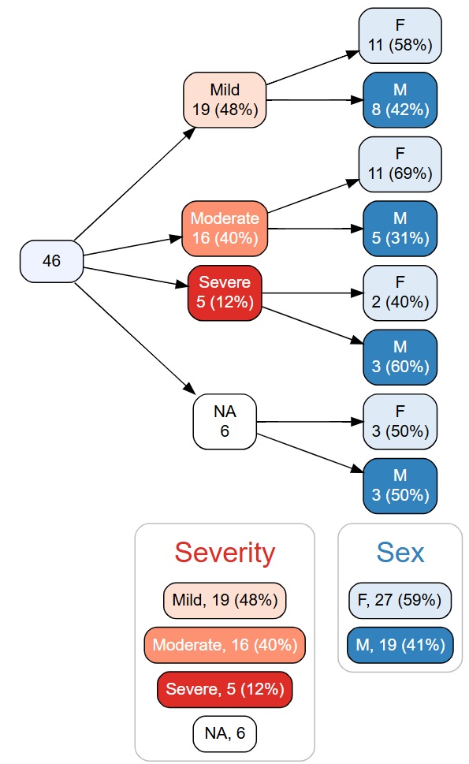
legends
Legends provide marginal counts for variables.
In other words, they show the overall counts and percentages for each variable.
Notes:
Note that the marginal counts for Severity don't add anything.

Slide 25
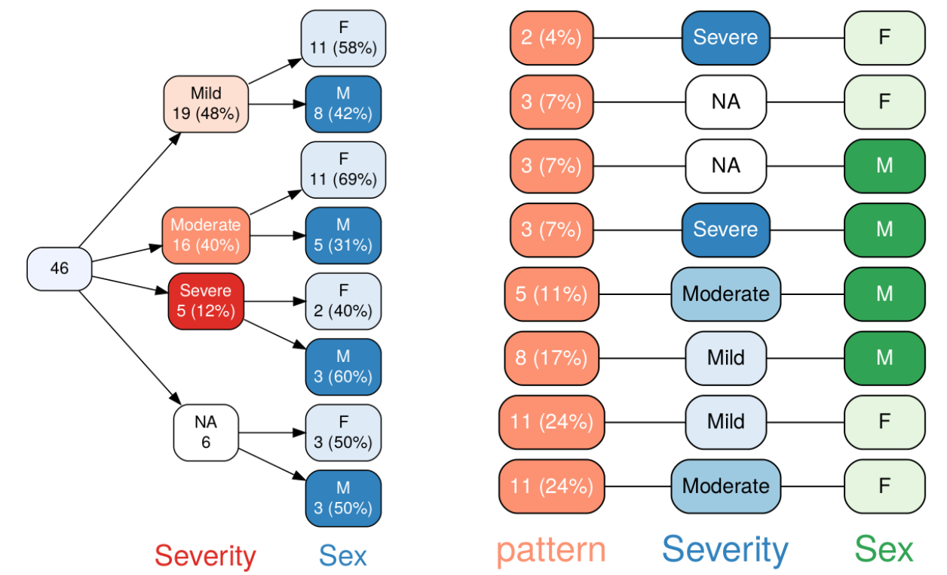
pattern trees
Notes:
Note1. Pattern trees show the most common combination at the bottom.

Slide 26
Real examples from my work

Slide 27
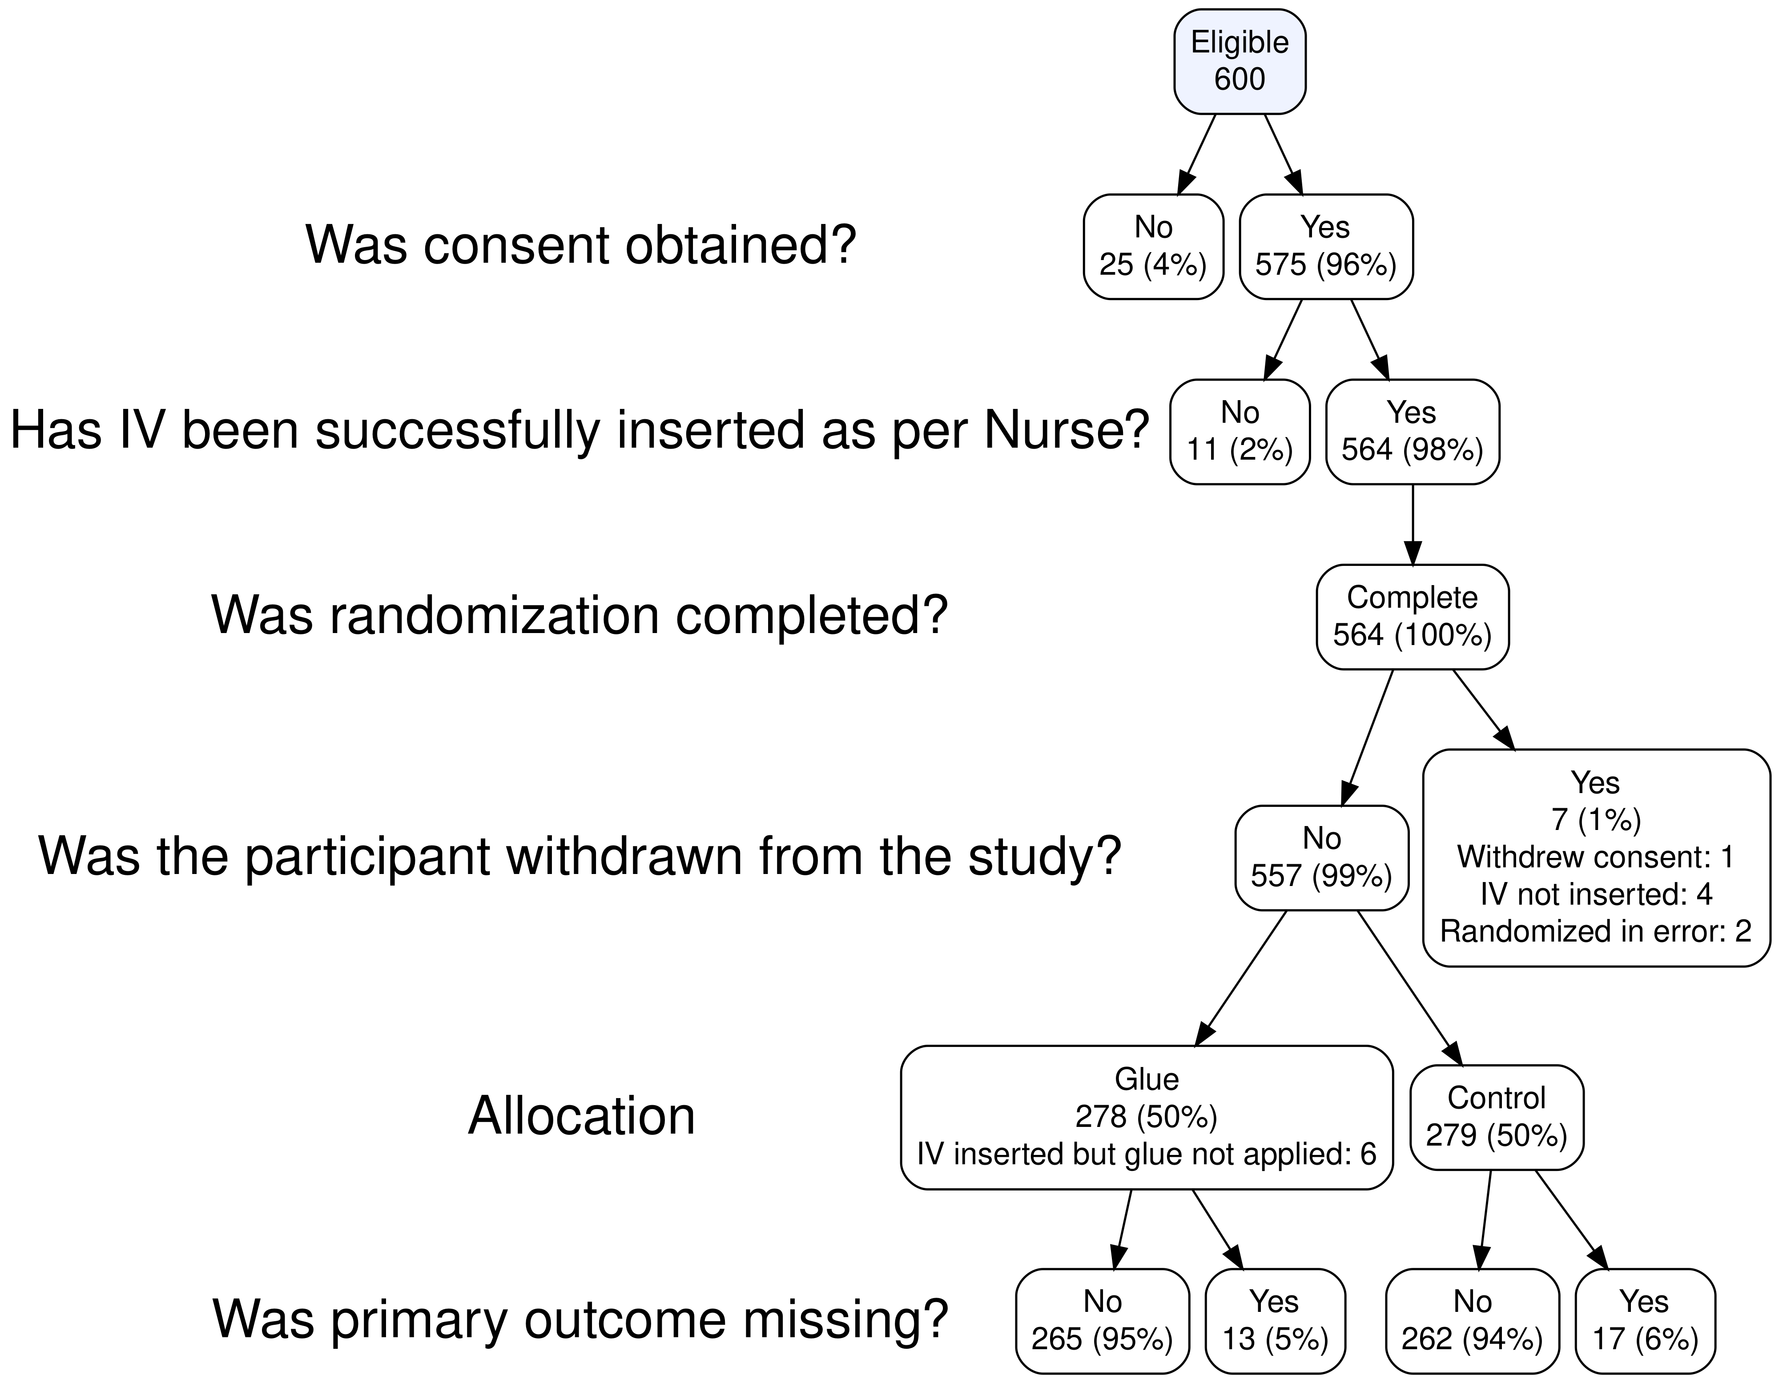
Notes:
20170280-Plint-Skin glue to reduce IV failure rate: A randomized controlled trial
Notes: RCT, CONSORT, pruning, no color

Slide 28
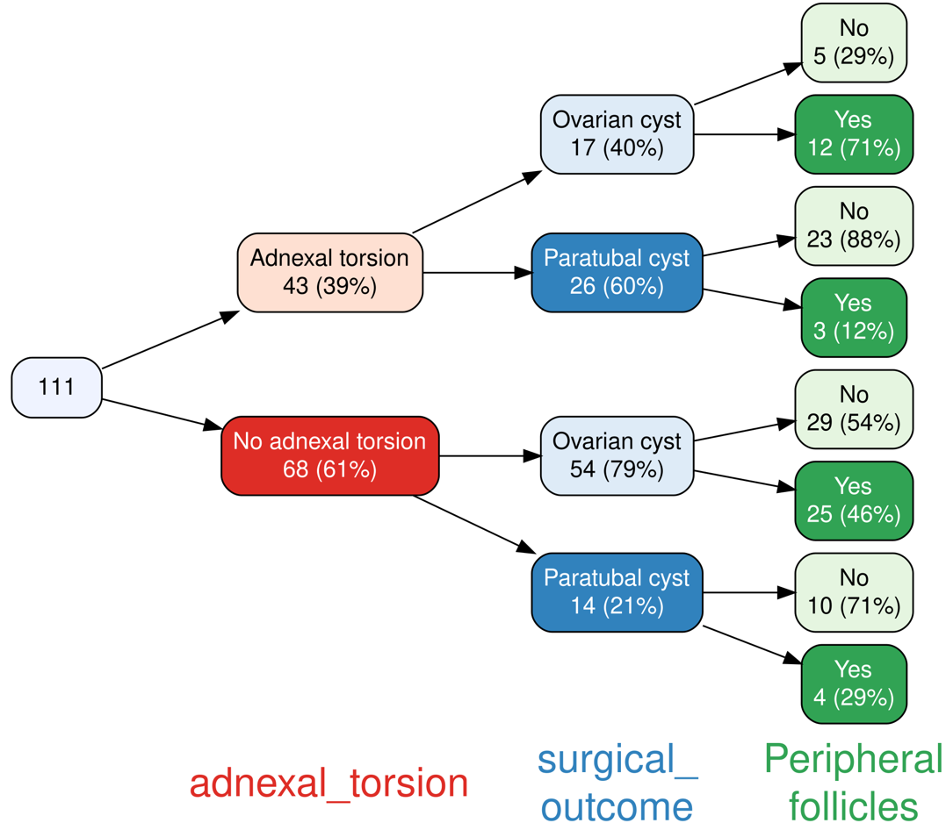
Notes:
20240116 Paratubal cysts

Slide 29
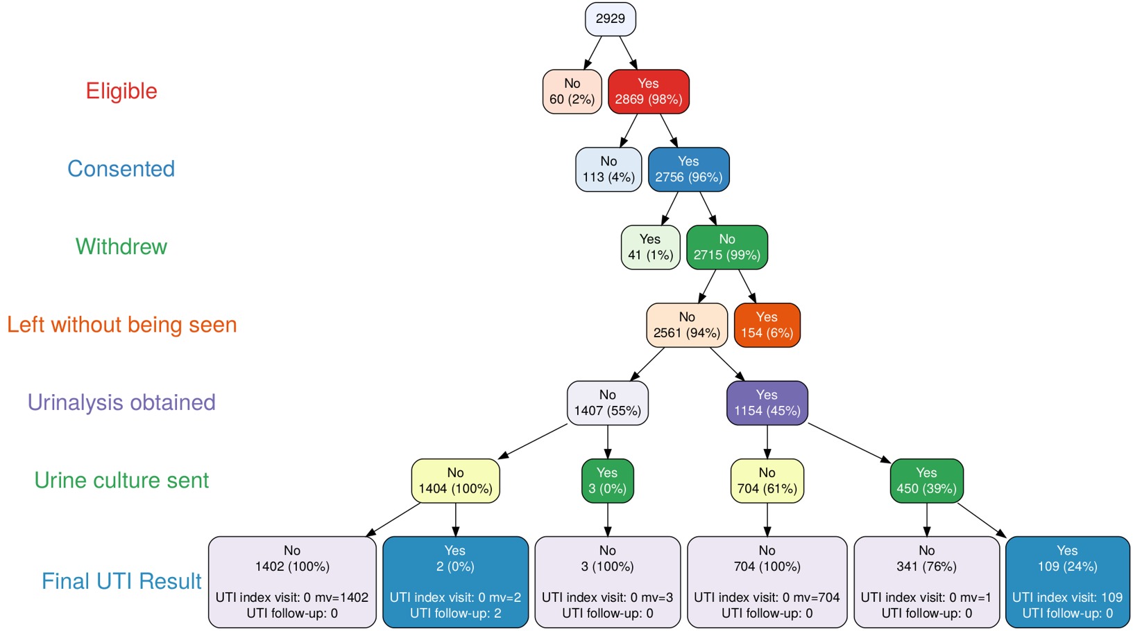
Notes:
UTICalc 20170280
Note: pruning. Summary info in leaf node

Slide 30
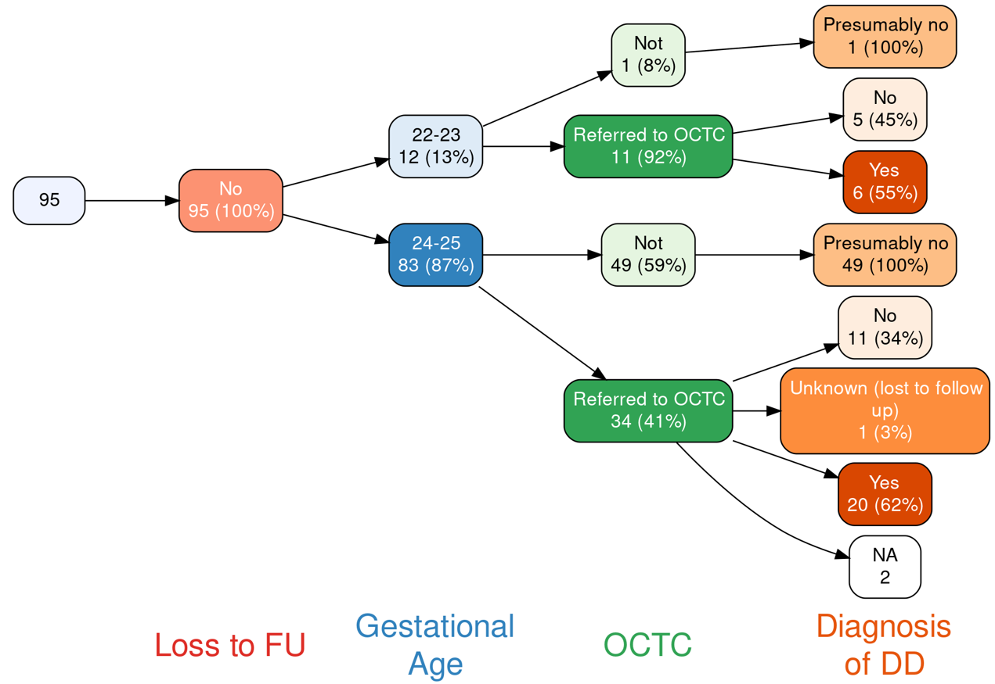
Notes:
Outcomes of ELGA 20220001

Slide 31
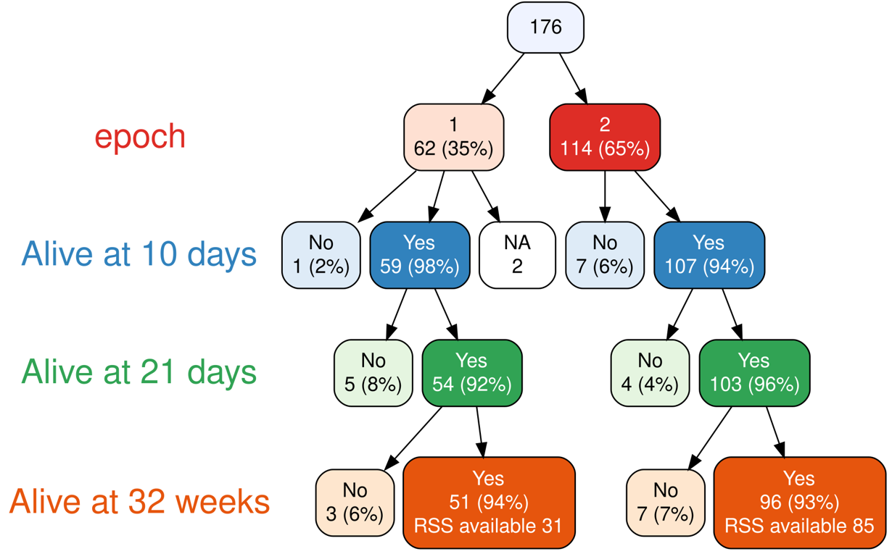
Notes:
20240158 ELGA-HFOV

Slide 32
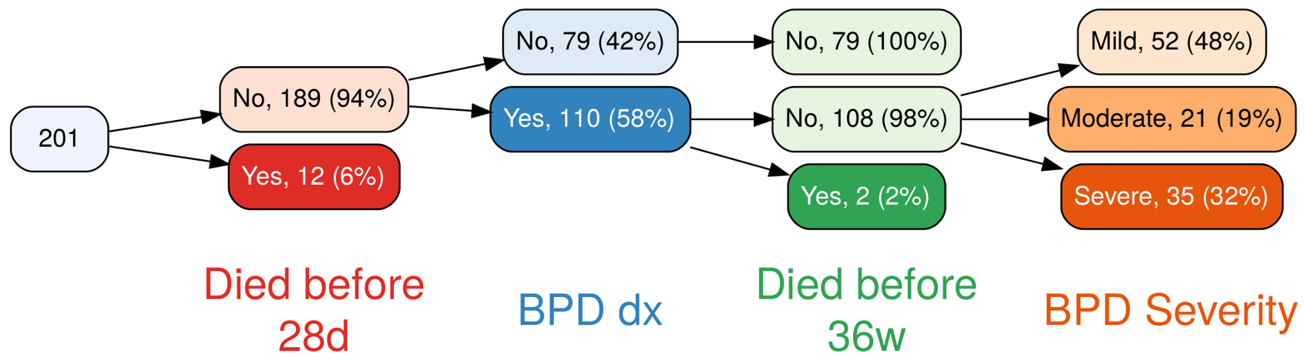
Notes:
20170257 Chronic Pulmonary Hypertension in Preterm Infants with BPD
Note: pruning after death

Slide 33
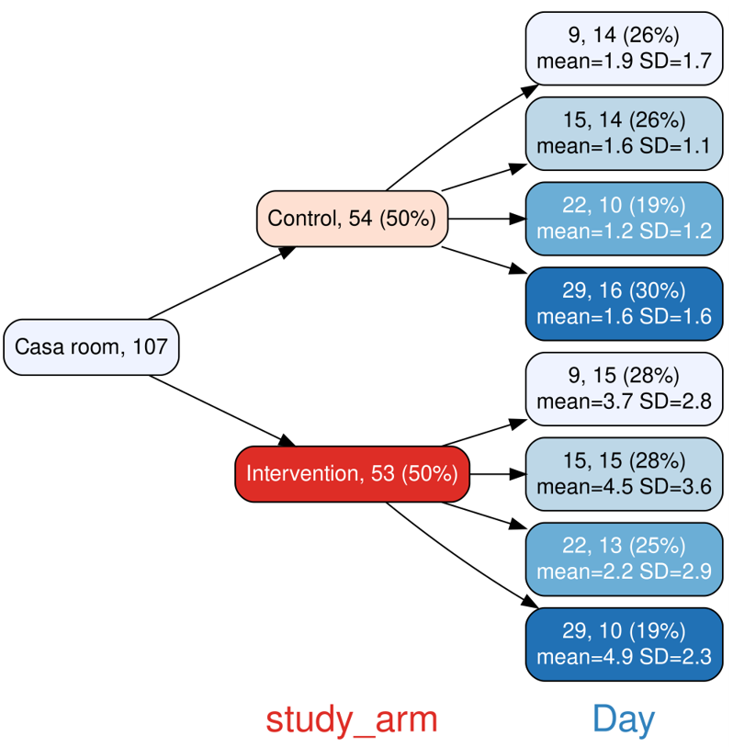
Notes:
202400062 Teaching hand hygiene technique
Note: mean and SD in Day nodes

Slide 34
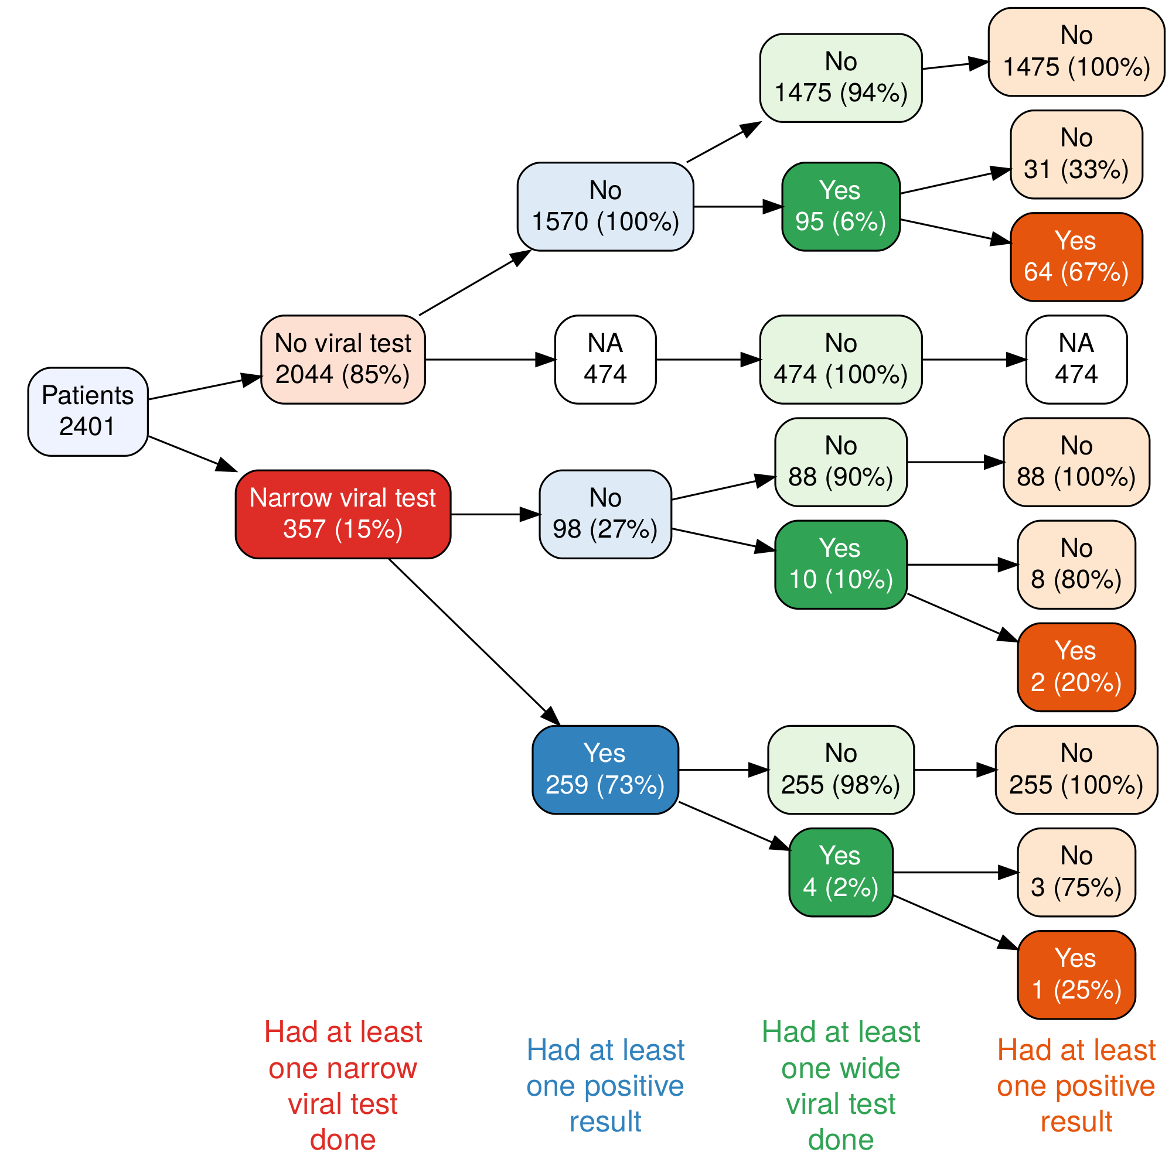
Notes:
20230078-Drouin-CareBEST-retrospective

Slide 35
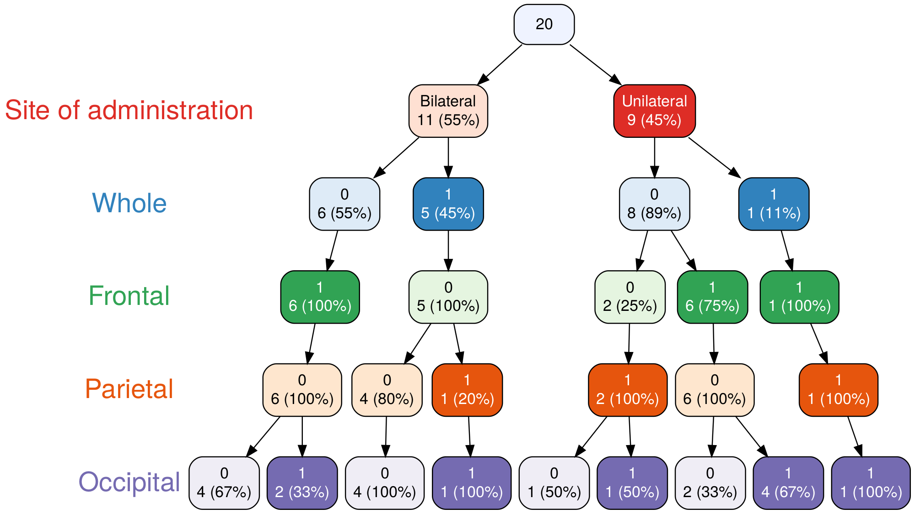
Notes:
20240005- RAPPIDLY- Relief and prevention of post-traumatic headache using intranasal delivery of lidocaine for youth
Note: Site of administration and headache location

Slide 36
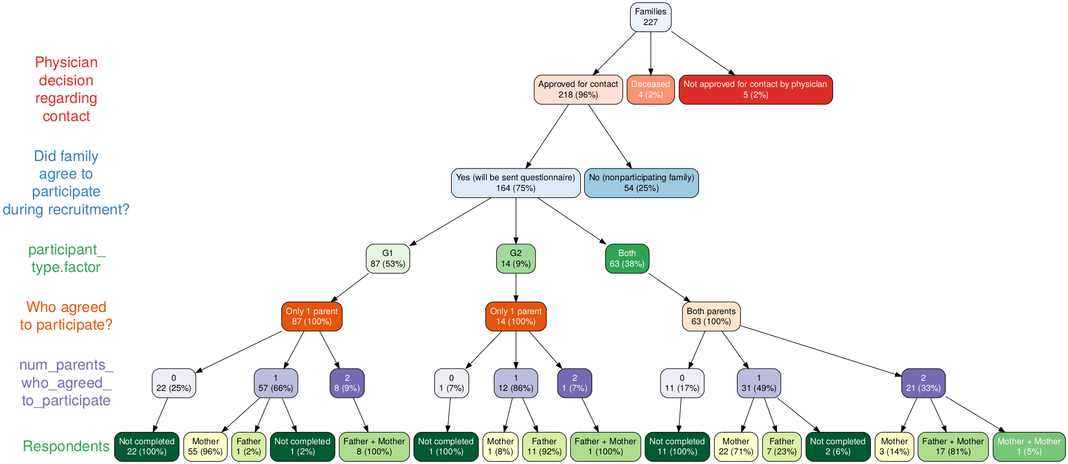
Notes:
20220054 Genetic Testing in Children with Epilepsy: Family Experiences

Slide 37
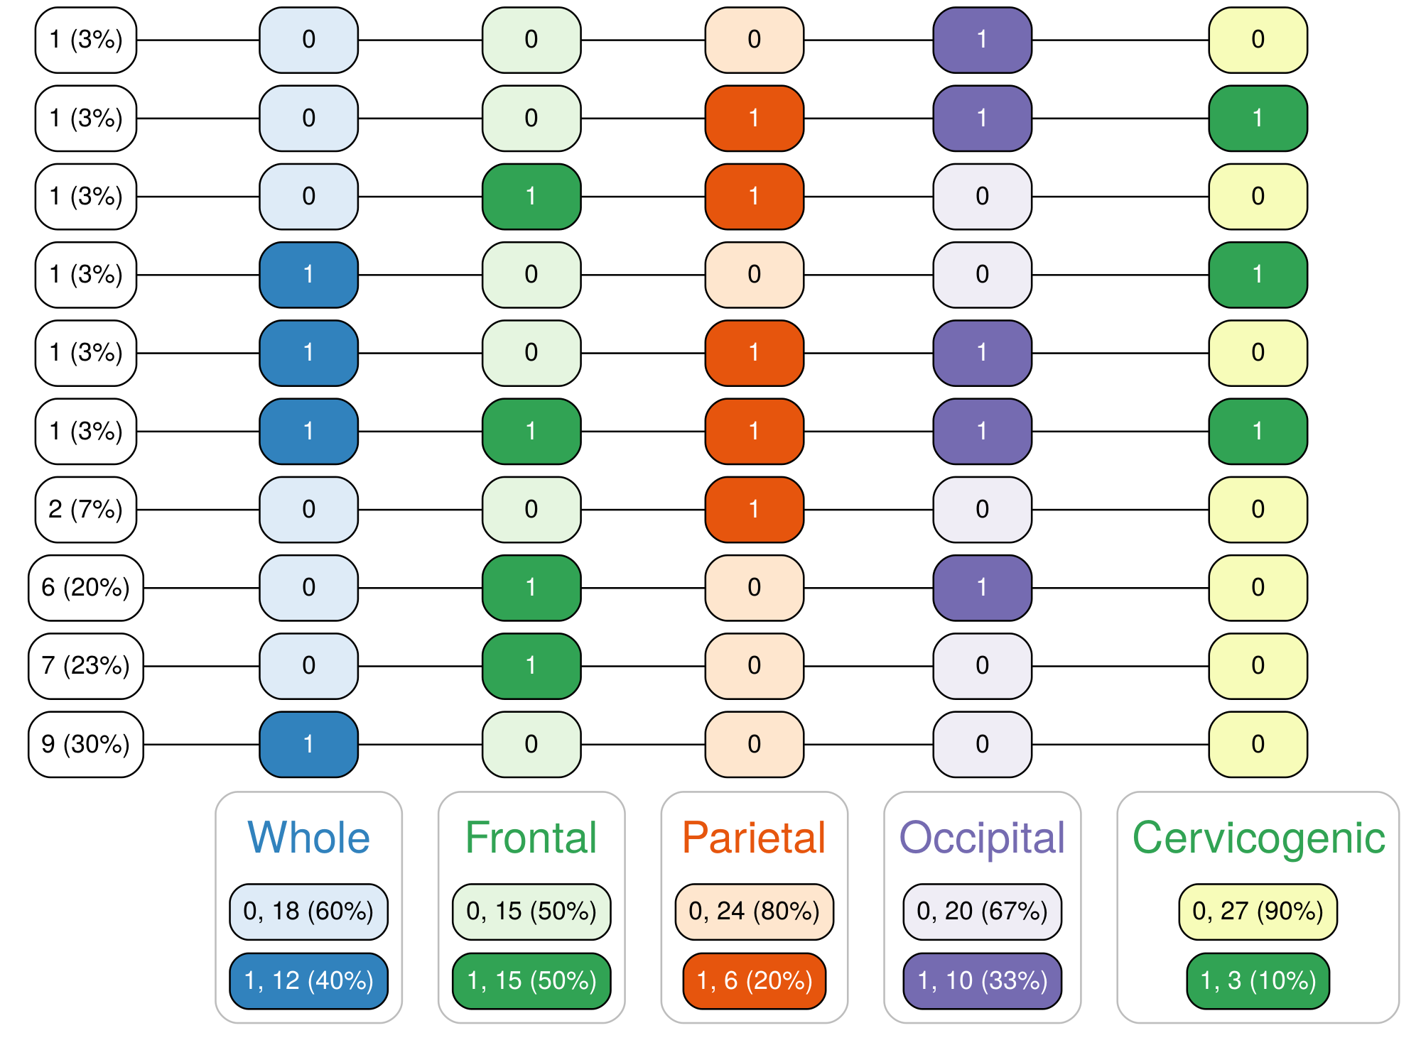
Notes:
20240005- RAPPIDLY- Relief and prevention of post-traumatic headache using intranasal delivery of lidocaine for youth

Slide 38
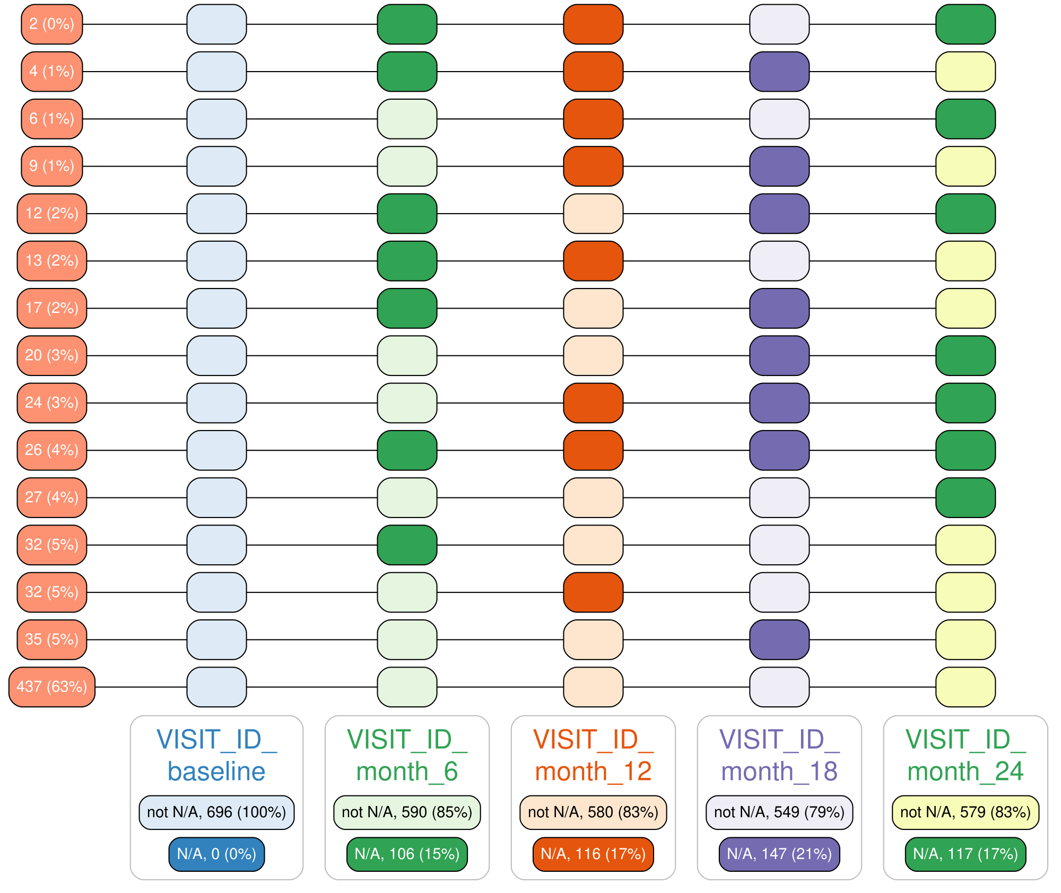
Notes:
20220057-LEAP -Longitudinal Analysis

Slide 39
Using the vtree function

Slide 40
Pruning
As you add variables to a tree, it can grow quickly!
So it's often useful to prune a variable tree, i.e. to remove a node and all of its descendants.
library(ggplot2)
library(dplyr)
library(tidyr)
library(vtree)
titanic <- crosstabToCases(Titanic) |>
mutate(Class = factor(Class))

Slide 41
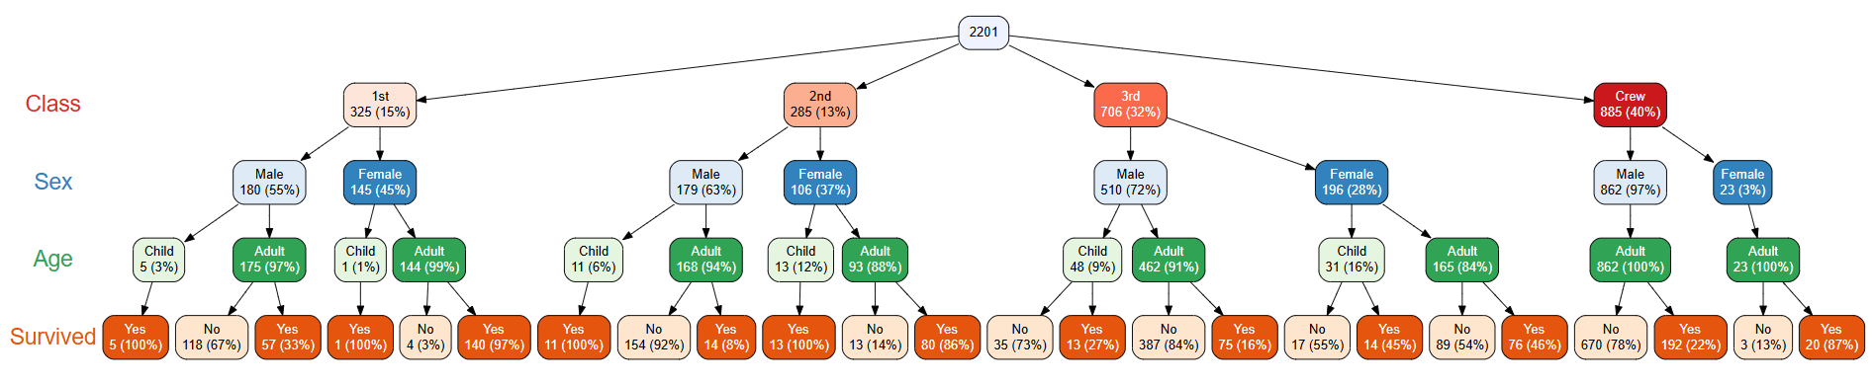
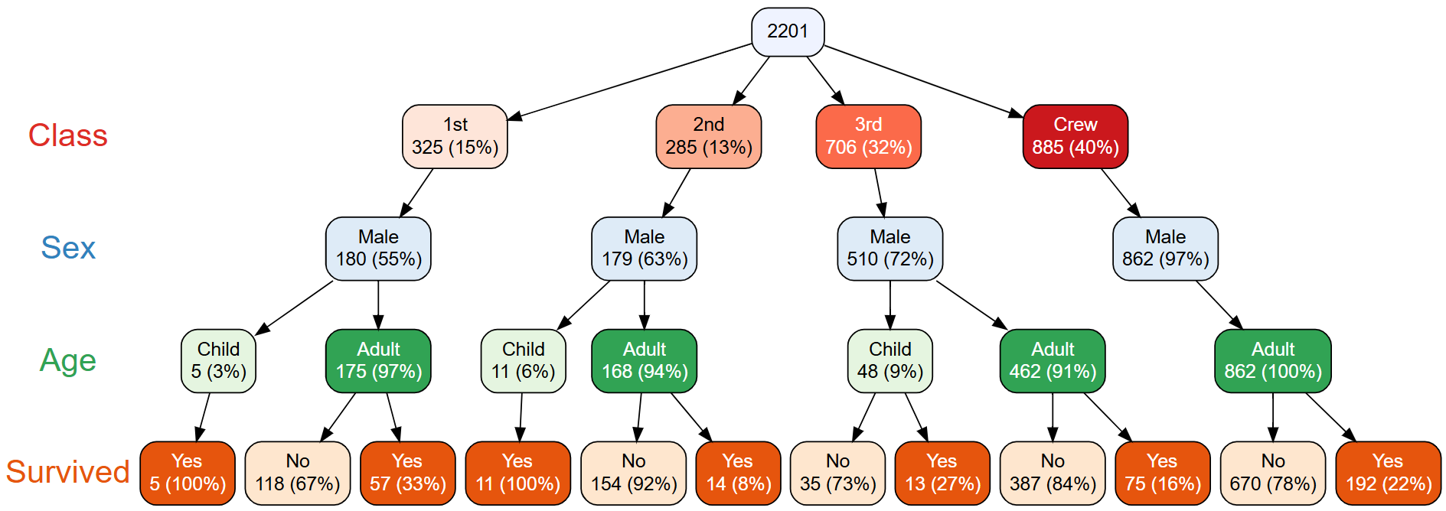
vtree(titanic, "Class Sex Age Survived", horiz = FALSE)
vtree(titanic, "Class Sex Age Survived", horiz = FALSE, prune = list(Sex = "Female"))

Slide 42
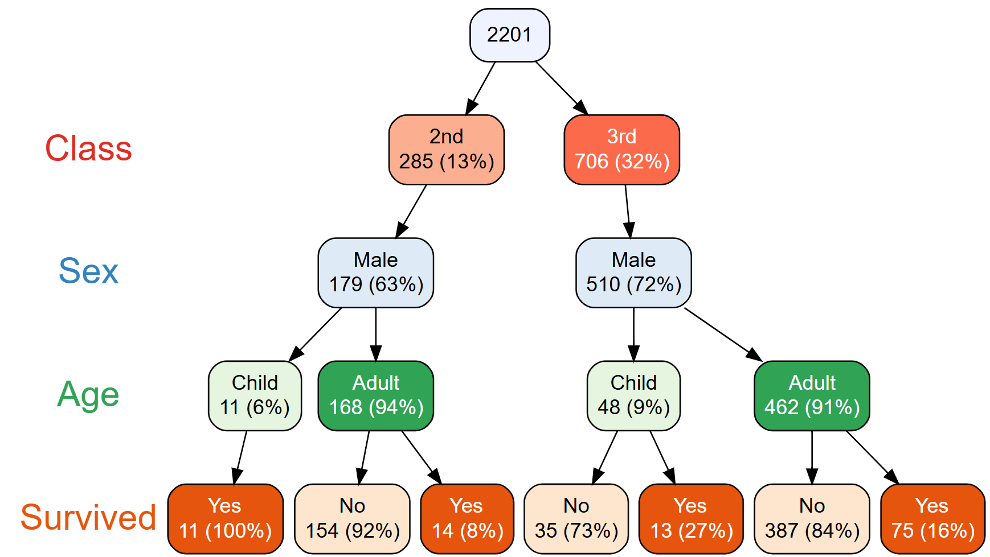
vtree(titanic, "Class Sex Age Survived", horiz = FALSE, prune = list(Sex = "Female", Class = c("1st", "Crew")))

Slide 43
Other ways to prune
keep | Prune all nodes except the specified nodes
prunebelow | Prune all nodes below the specified nodes
follow | Prune all nodes except those below the specified nodes
In my experience, follow is particularly convenient.
For example, in a study where some patients die, measurements after this time will of course be missing. So we might want to specify something like this:
follow = list(status = "Alive")

Slide 44
Summaries
The nodes in a vtree can also display summary information,
for example, information about a quantitative variable.
mt <- mtcars
mt$name <- rownames(mt)
rownames(mt) <- NULL

Slide 45
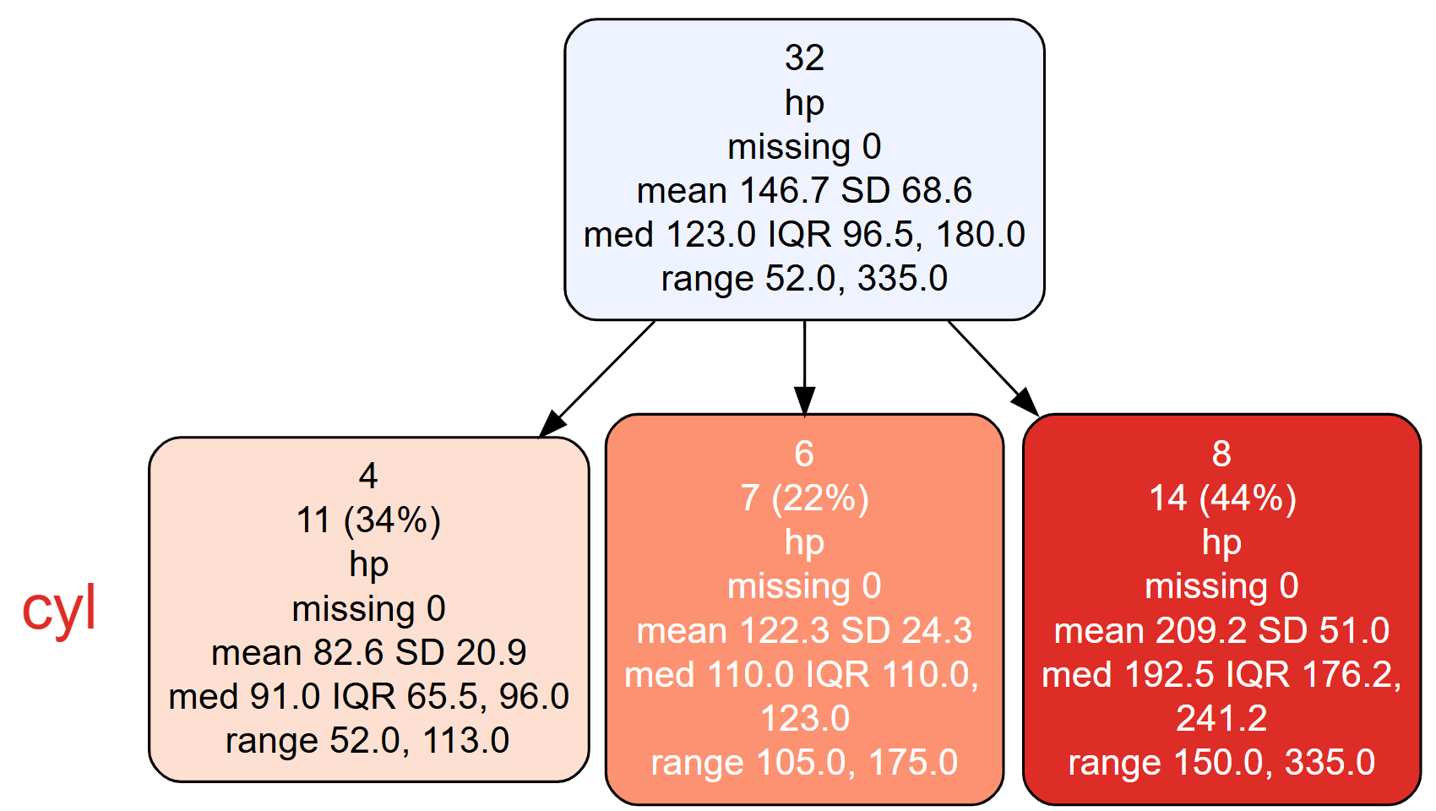
vtree(mt, "cyl", summary = "hp")

Slide 46
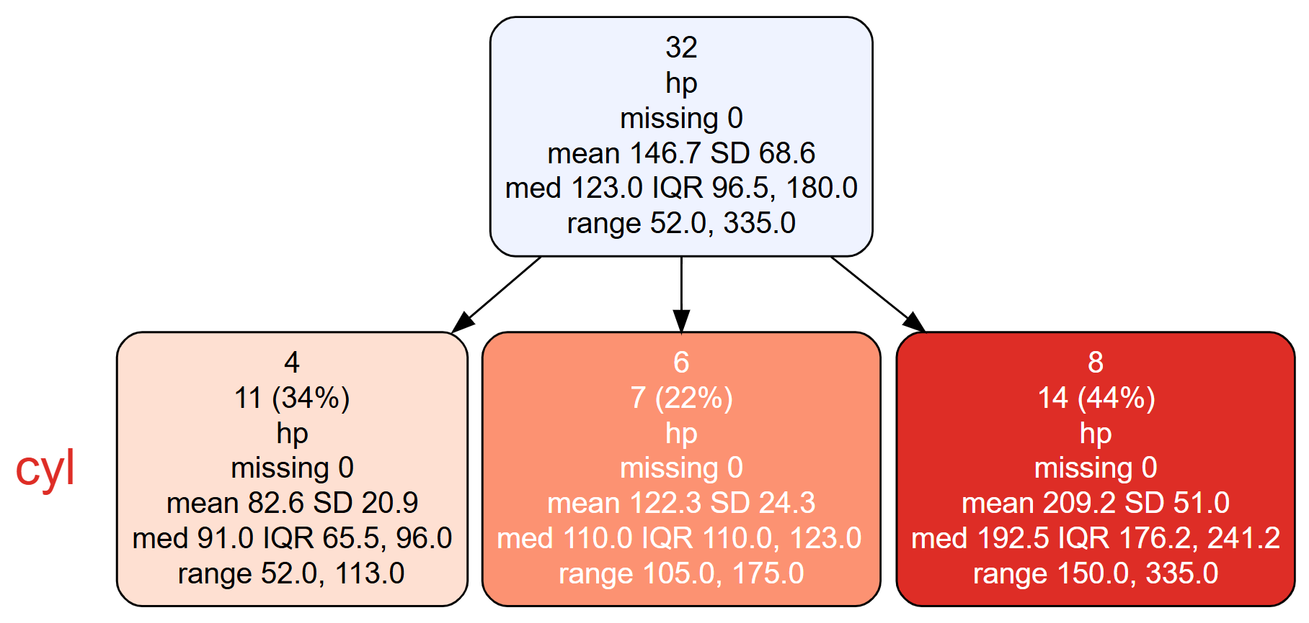
vtree(mt, "cyl", summary = "hp", horiz = FALSE, splitwidth = 40)

Slide 47
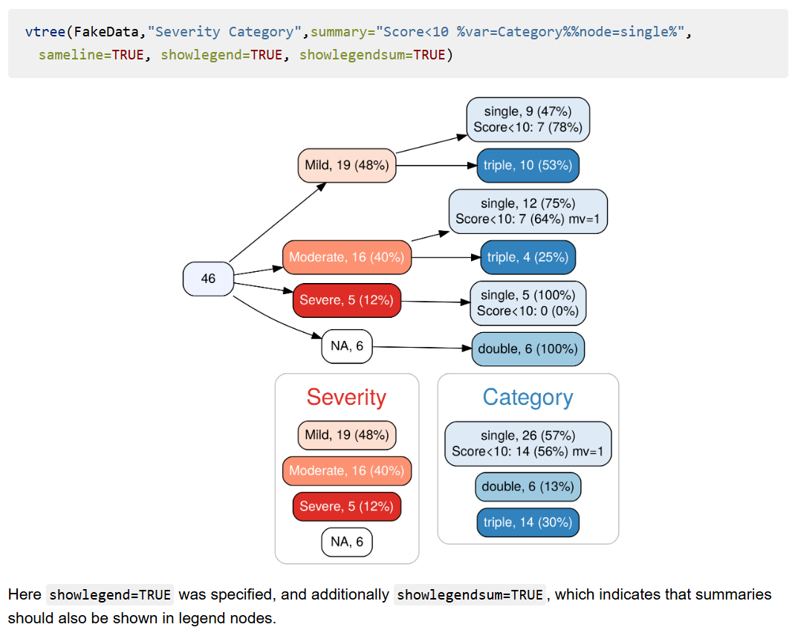
More complex summaries

Slide 48
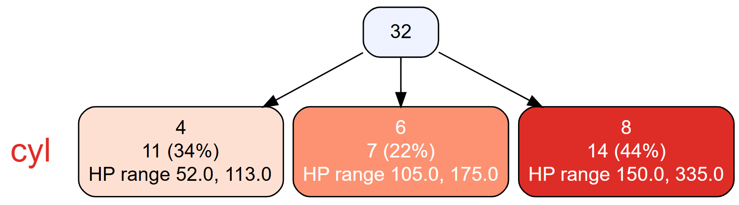
vtree(mt, "cyl", summary = "hp \nHP range %range%%leafonly%", horiz = FALSE)

Slide 49
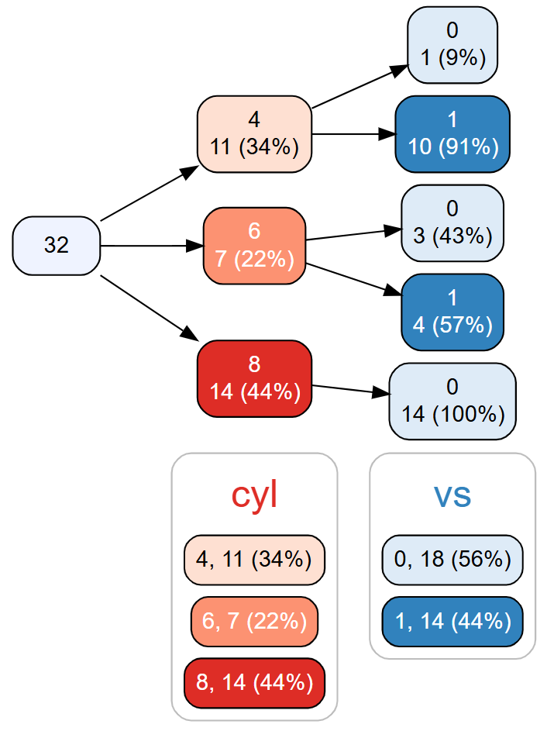
"legends"
Legends in vtree provide marginal counts for variables.
vtree(mt, "cyl vs", showlegend = TRUE)

Slide 50
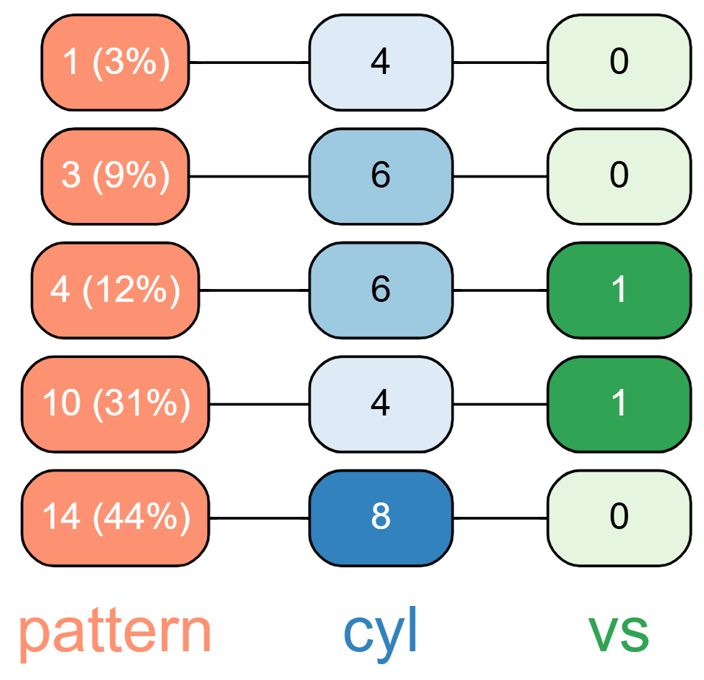
pattern trees
When combinations are of particular interest, you can show a "pattern tree".
vtree(mt, "cyl vs", pattern = TRUE)

Slide 51
Example: A survey

Slide 52
Example: A survey
A survey was given to a group made up of young people and older people.
When the results were presented, there was concern about how few people responded, particularly the younger people. A figure of 3% was quoted.
But there was some confusion about this. Did only 3% of young people respond, or were only 3% of the responders young?

Slide 53
d <- build.data.frame(
c("age_group","responded"),
c("young","Yes",1),
c("young","No",30),
c("old","Yes",90),
c("old","No",194))
> dim(d)
[1] 315 2
> head(d)
age_group responded
1 young Yes
2 young No
3 young No
4 young No
5 young No
6 young No

Slide 54
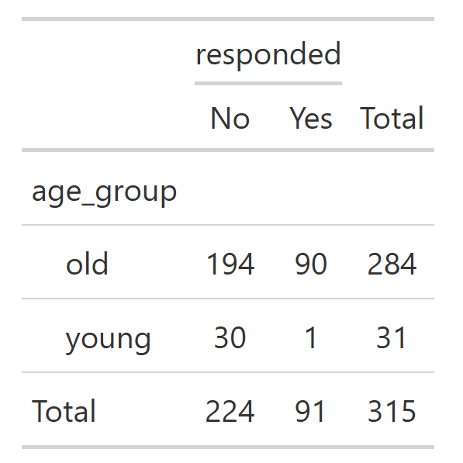
library(gtsummary)
d |> tbl_cross(age_group,responded)

Slide 55
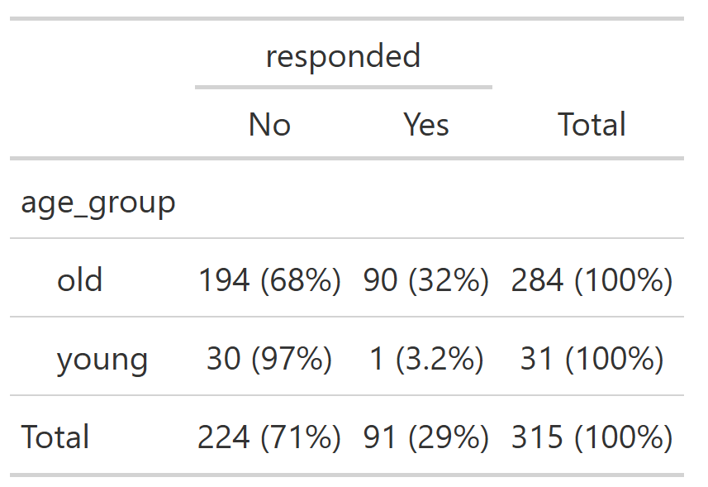
d |> tbl_cross(age_group, responded, percent = "row")

Slide 56
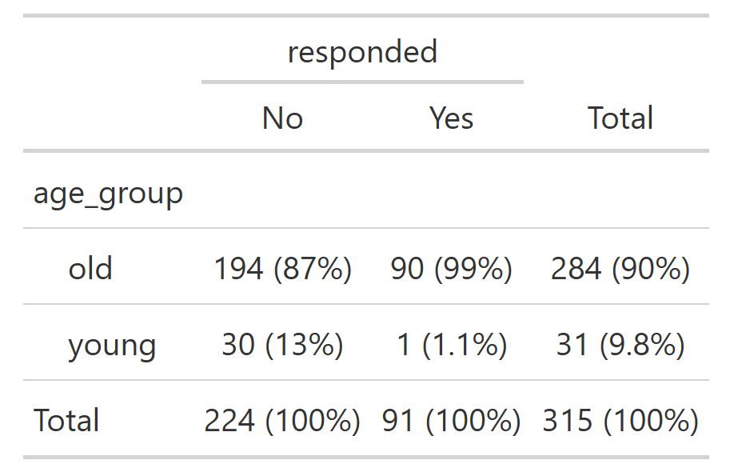
d |> tbl_cross(age_group, responded, percent = "column")

Slide 57
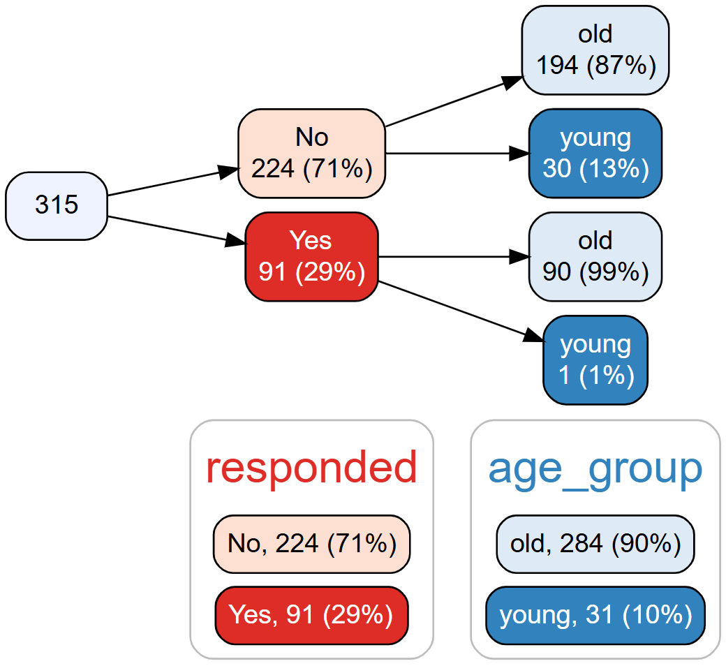
vtree(d, "responded age_group", showlegend = TRUE)

Slide 58
vtree(d, "responded age_group", showlegend = TRUE)

Slide 59
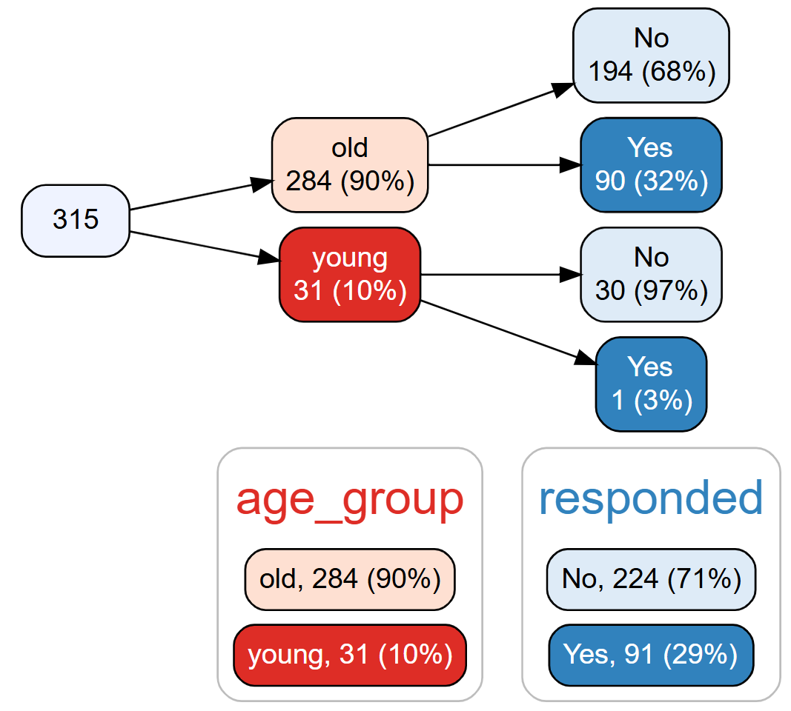
vtree(d, "age_group responded", showlegend = TRUE)

Slide 60
Example: Variable trees compared to bar graphs

Slide 61
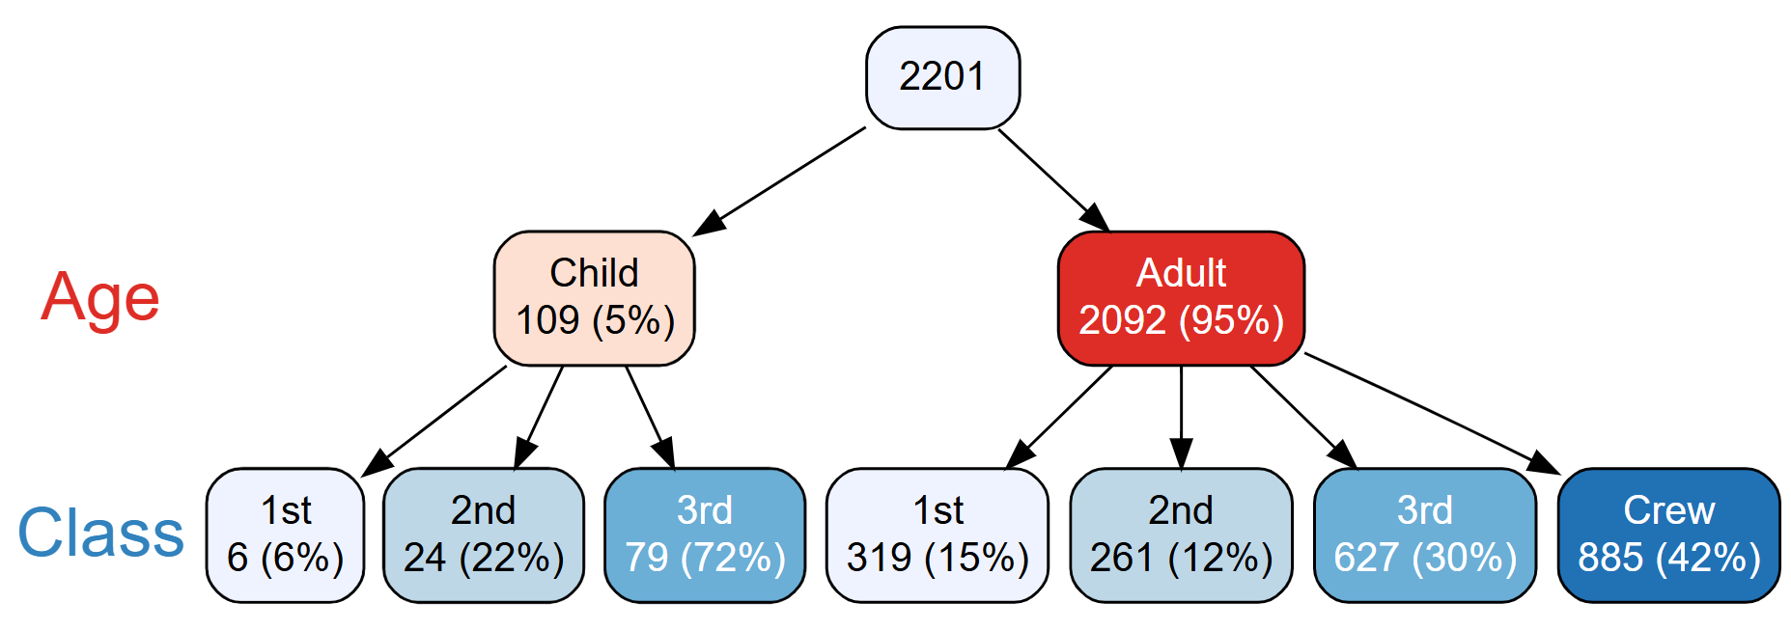
library(ggplot2)
library(dplyr)
library(tidyr)
library(vtree)
titanic <- crosstabToCases(Titanic) |>
mutate(Class = factor(Class))
vtree(titanic, "Age Class", horiz = FALSE)

Slide 62
q <- titanic |>
group_by(Age, Class) |>
summarize(count = n(), .groups = "drop_last") |>
mutate(
Percent = (count/ sum(count)) * 100,
label_text = paste0(count, " (", around(Percent,0), "%)")) |>
ungroup() |>
complete(Age, Class)
ggplot(q, aes(x = Age, y = Percent, fill = Class)) +
geom_col(position = position_dodge(preserve = "single"), width = 0.8) +
geom_text(aes(label = label_text),
position = position_dodge(width = 0.8),
vjust = -0.5, size = 4, fontface = "bold"
) +
theme_gray(base_size = 18)

Slide 64
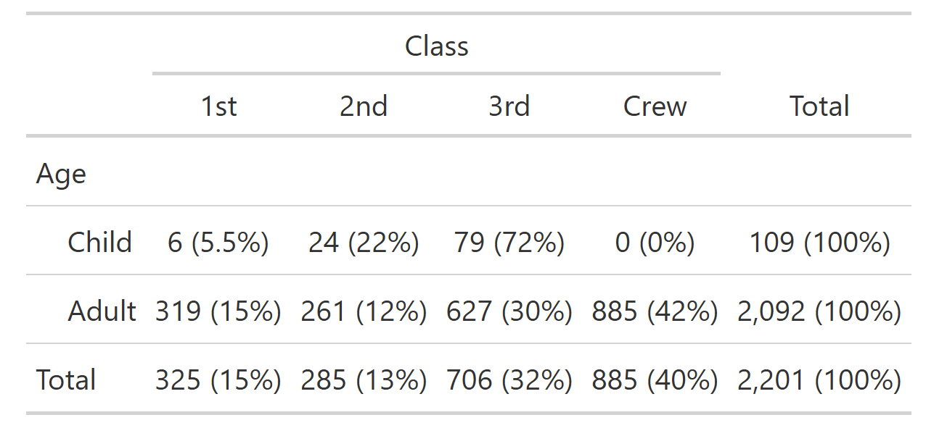
titanic |> tbl_cross(Age, Class, percent = "row")

Slide 66
Example: Diagnostic test properties

Slide 67
Let's compare a diagnostic test to a gold standard
The test result is either positive or negative.
The gold standard is either positive or negative.
How well do they agree?
d <- build.data.frame(
c("test","gold_standard"),
c("positive", "positive", 100),
c("negative", "positive", 2),
c("negative", "negative", 10000),
c("positive", "negative", 1000))

Slide 68
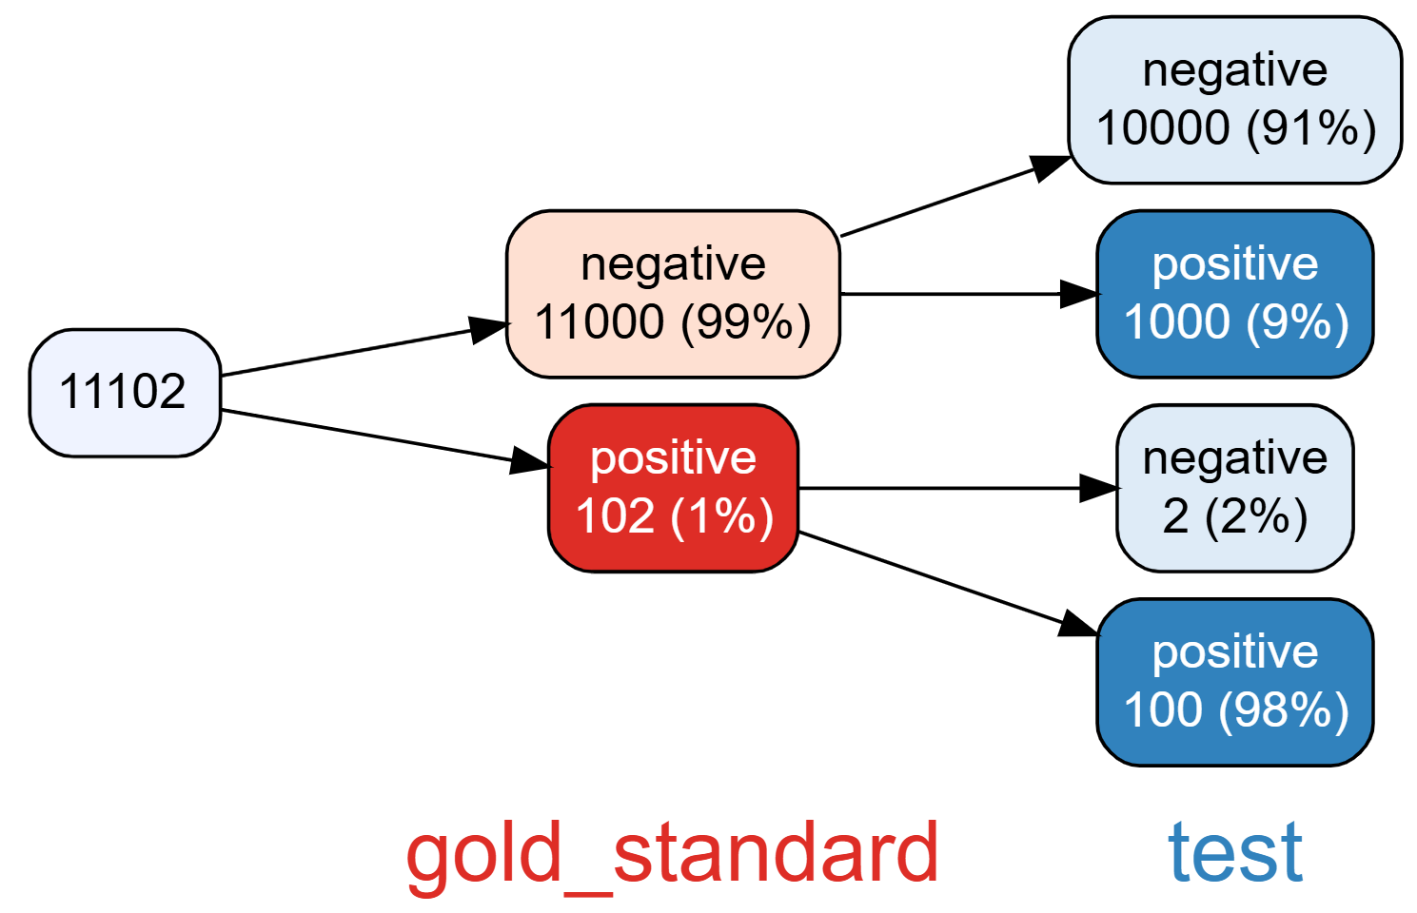
vtree(d, "gold_standard test")
Specificity
Sensitivity
The test has very good sensitivity and specificity.

Slide 69
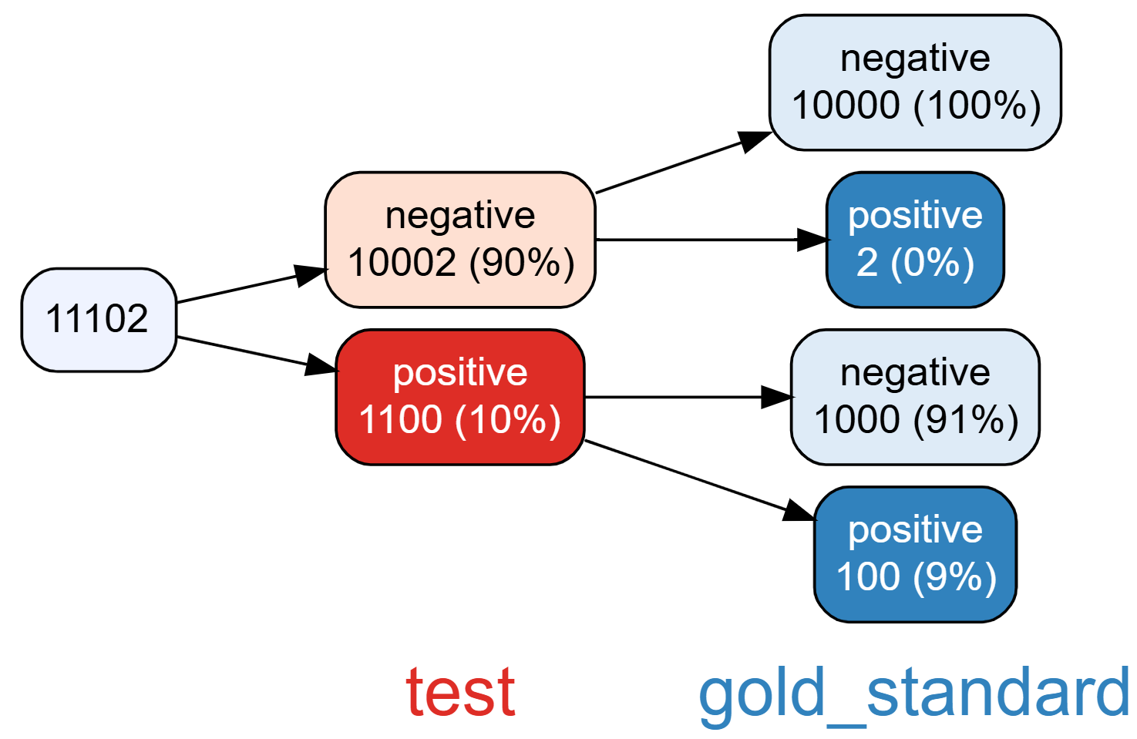
vtree(d, "test gold_standard")
Negative predictive value
Positive predictive value
The positive predictive value is terrible.
A positive test means you only have a 9% chance of truly being positive.

Slide 70
Example: Study flow diagrams

Slide 71
Study flow diagrams
To ensure that scientific studies are reproducible, there must be transparency about inclusion and exclusion.
For example, in a clinical trial, potential study participants are approached and then
assessed for eligibility
consented
randomized
followed up
It is very important to be able to determine the correct denominator at different points.

Slide 72
df <- build.data.frame(
c( "eligible", "consent", "rand","exc1","exc2", "group", "fu"),
list(F, NA, NA, NA, NA, NA, NA, 100),
list(T, F, NA, NA, NA, NA, NA, 75),
list(T, NA, NA, NA, NA, NA, NA, 1),
list(T, T, F, T, F, NA, NA, 13),
list(T, T, F, F, T, NA, NA, 8),
list(T, T, T, F, F, "A", T, 100),
list(T, T, T, F, F, "B", T, 100),
list(T, T, T, F, F, "A", T, 14),
list(T, T, T, F, F, "B", T, 27),
list(T, T, T, F, F, "A", T, 3),
list(T, T, T, F, F, "B", T, 8),
list(T, T, T, F, F, "A", T, 10),
list(T, T, T, F, F, "B", T, 20),
list(T, T, T, F, F, "A", F, 10),
list(T, T, T, F, F, "B", F, 20),
list(T, T, T, F, F, "A", F, 3),
list(T, T, T, F, F, "B", F, 2))

Slide 73
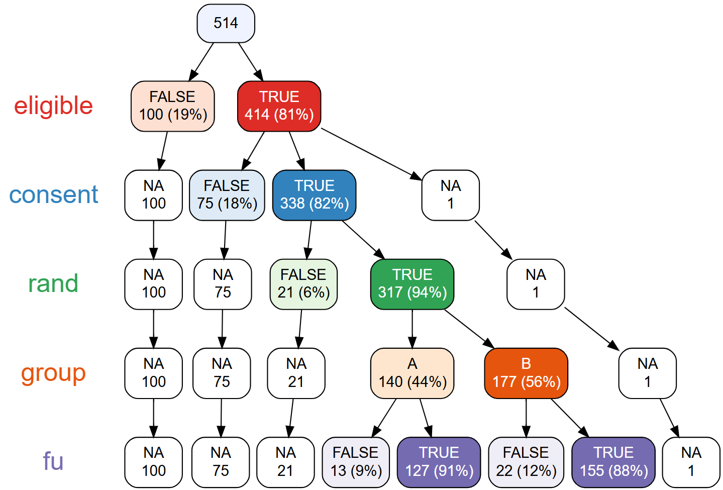
vtree(df, "eligible consent rand group fu", horiz = FALSE)

Slide 74
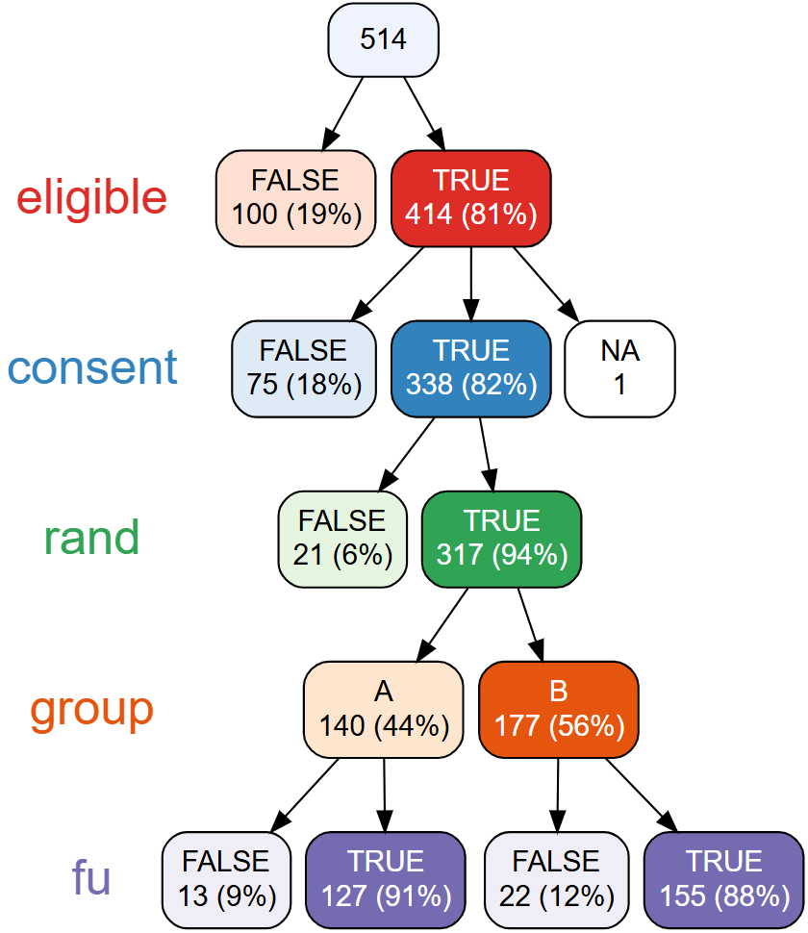
Prune irrelevant nodes
vtree(df, "eligible consent rand group fu", horiz = FALSE,
follow = list(eligible = TRUE, consent = TRUE, rand = TRUE))

Slide 75
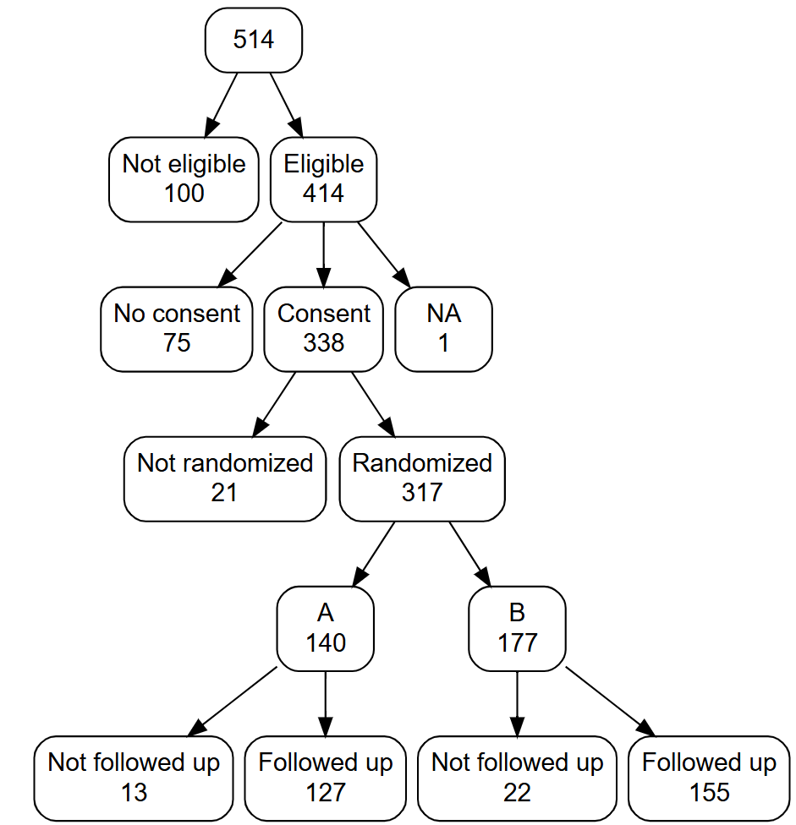
Change node labels, remove variable names, etc.
vtree(df, "eligible consent rand group fu", horiz = FALSE,
fillcolor = "white", rootfillcolor = "white",
follow = list(eligible = TRUE, consent = TRUE, rand = TRUE),
showvarnames = FALSE, showpct = FALSE,
labelnode = list(
eligible = c("Eligible" = TRUE, "Not eligible" = FALSE),
consent = c("Consent" = TRUE, "No consent" = FALSE),
rand = c("Randomized" = TRUE, "Not randomized" = FALSE),
fu = c("Followed up" = TRUE, "Not followed up" = FALSE)))

Slide 76
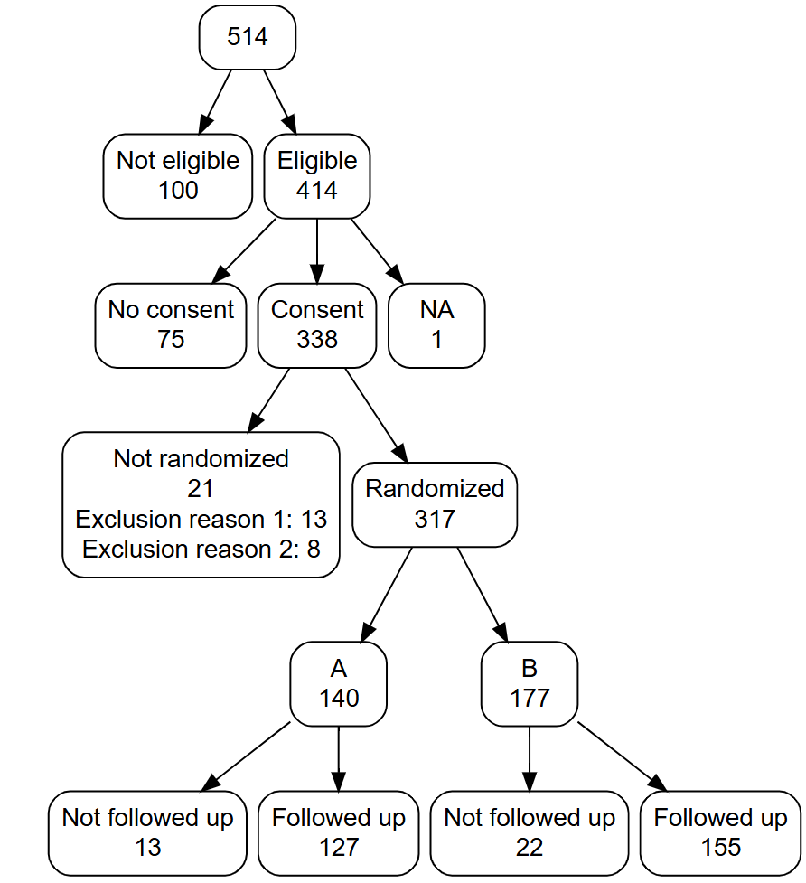
Show reasons why some participants were not randomized
vtree(df, "eligible consent rand group fu", horiz = FALSE,
fillcolor = "white", rootfillcolor = "white",
follow = list(eligible = TRUE, consent = TRUE, rand = TRUE),
showvarnames = FALSE, showpct = FALSE,
labelnode = list(
eligible = c("Eligible" = TRUE, "Not eligible" = FALSE),
consent = c("Consent" = TRUE, "No consent" = FALSE),
rand = c("Randomized" = TRUE, "Not randomized" = FALSE),
fu = c("Followed up" = TRUE, "Not followed up" = FALSE)),
summary = c(
"exc1 \nExclusion reason 1: %sum%%var=rand%%node=FALSE%",
"exc2 \nExclusion reason 2: %sum%%var=rand%%node=FALSE%"))

Slide 77
CONSORT diagrams for randomized trials
For randomized trials, CONSORT study flow diagrams are recommended.
Several other R packages can draw CONSORT diagrams.
However vtree is not just a drawing tool, but a tool for deriving the counts.
Study flow diagrams for other kinds of studies
Study flow diagrams are useful for all kinds of different studies.
vtree has the flexibility to generate these diagrams.
Study flow diagrams with vtree can be used to reproducibly track study progress.

Slide 78
Part II

Slide 79
Data set: Traffic stops

Slide 80
Traffic stops data set
In 2005, the Ontario Human Rights Commission received a complaint about racial profiling and racial discrimination by the Ottawa Police Service.
The Ottawa Police Service subsequently agreed to collect race data when they stop drivers, known as the Traffic Stop Race Data Collection Project (TSRDCP).
The TSRDCP required police officers to record their perception of the driver’s race, for traffic stops from 2013 to 2023. A data set representing these traffic stops was made public (licensed under the Open Government Licence – Ottawa Police Service*).
https://data.ottawapolice.ca/datasets/76a54b7f7ef44ab1b78dd96f3061c7cb_0
* https://data.ottawapolice.ca/pages/open-data-licence

Slide 81
Reading the Traffic stops data set
https://events.digital-research.academy/event/109/contributions/370/
traffic_stops.csv
traffic_stops_prepare.Rmd
library(vtree)
library(dplyr)
data <- read.csv("traffic_stops.csv")
traffic_stops <- data |>
rename(race = Driver.Race, age = Driver.Age, gender = Driver.Gender,
how_cleared = How.Cleared, year = Occurred.Year) |>
filter(!is.na(race) & age != "" & gender != "") |>
filter(gender != "D", age != "-15")

Slide 82
Traffic stops data (after data preparation)
Unit of analysis: Each row of the data frame represents a traffic stop.
Variables:
how_cleared =
year | Divison | how_cleared | day | hour | age
gender | race | city | province | Time.of.Day
Charged | Police officers laid charges (such as speeding or distracted driving) to the drivers after the traffic stops.
Warning (T-Stop) | Police officers gave verbal or written warnings to the drivers after the traffic stops.
Final | Police officers did not give warnings or lay charges to the drivers after the traffic stops. No further action was taken by officers.
Data Quality | Some extra records in the database.

Slide 83
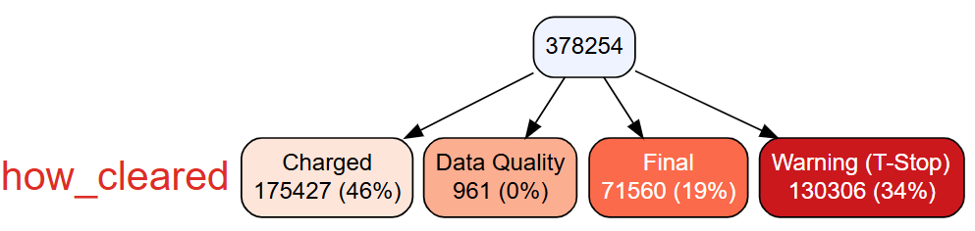
> head(traffic_stops)
year Division how_cleared day hour age gender race city province Time.of.Day
1 2018 Central Final Mon 2300 16-24 M Middle Eastern OTTAWA ON Evening
2 2020 East Warning (T-Stop) Thu 1700 16-24 M Middle Eastern GLOUCESTER ON Afternoon
3 2019 Central Charged Tue 1700 16-24 M White OTTAWA ON Afternoon
4 2015 West Charged Tue 2000 16-24 M White DUNROBIN ON Evening
5 2019 Central Warning (T-Stop) Fri 2300 25-54 M White OTTAWA ON Evening
6 2022 Central Final Tue 300 25-54 M White ORLEANS ON Night
vtree(traffic_stops, "how_cleared", horiz = FALSE)
Notes:
vtree(traffic_stops, "race=White age gender", splitwidth = Inf, sameline = TRUE, summary = "how_cleared=Final \nNo action %pct%", title = "Total stops", showlegend = TRUE, showlegendsum = TRUE)

Slide 84
Data set: FIFA World Cup matches 1930 – 2022

Slide 85
FIFA World Cup matches 1930 – 2022
Unit of analysis: Each row of the data frame represents a football match.
Source: https://www.kaggle.com/datasets/piterfm/fifa-football-world-cup/data
License: https://creativecommons.org/licenses/by-nc-sa/4.0/

Slide 86
Reading the FIFA World Cup matches data set
https://events.digital-research.academy/event/109/contributions/370/
matches_1930_2022.csv
fifa_prepare.Rmd
library(vtree)
library(dplyr)
fifa <- read.csv("matches_1930_2022.csv")
fifa <- fifa |>
mutate(
HOME_OWN_GOAL = home_own_goal != "",
AWAY_OWN_GOAL = away_own_goal != "",
total_own_goals = HOME_OWN_GOAL + AWAY_OWN_GOAL,
game = paste(home_team,"v",away_team,Year)
)

Slide 87
Data set: WHO indicators

Slide 88
4 indicators from the WHO Noncommunicable Diseases Country Capacity Survey
Source: WHO Global Health Observatory https://www.who.int/data/gho
Unit of analysis: Each row of the data frame represents a country
Variables:
CountryCode | 3-letter code
Tob | Existence of operational policy/strategy/action plan to decrease tobacco use
PA | Existence of national guidelines for physical activity
Alc | Existence of a national target on alcohol
Diab | Existence of a diabetes registry
Country | Name of country

Slide 89
Reading the WHO indicators data set
https://events.digital-research.academy/event/109/contributions/370/
WHO_indicators.csv
WHO_indicators_prepare.Rmd
library(vtree)
library(dplyr)
d <- read.csv("WHO_indicators.csv")

Slide 90
Extra Stuff

Slide 91
Extra vtree features
sameline
title
splitwidth, vsplitwidth
targeted summaries
showvarnames
showpct
labelnode
labelvar
etc.

Slide 92
Other things to talk about
features vtree is missing?
suggestions for improvements

Slide 93
Exploring and visualizing data subsets using the vtree package 3h 30m
Suppose you want to know how many companies there are with over 100 employees in each region of several countries. We could write this as country >> region >> company >> employees. With just two variables, you can make a two-way table of counts with row or column percentages. But this does not easily generalize to larger numbers of variables, and attempts to display this kind of information can be hard to interpret. The vtree package provides a general and easily-interpreted way of displaying “variable trees” giving the size of nested subsets of an R data frame, along with tools for pruning, displaying additional summary information, customizing, and more. I first released the package in 2018 and since then my experience using vtree, along with that of many others, has shown where vtree fits in the toolbox of methods for exploratory data analysis and data visualization.
This interactive tutorial will cover the basics of using vtree, including a wide variety of examples. More advanced and special-purpose features will also be explained. Participants in the tutorial will have the opportunity to work through construction of variable trees and how to choose the order of variables, whether and how to prune, and what kinds of summary information to display. An extended example will demonstrate how to generate CONSORT-style study flow diagrams reproducibly. Additionally, other tools (e.g. UpSetR) will be compared to vtree. The tutorial will be informal and audience participation will be welcome.

