Slide 1
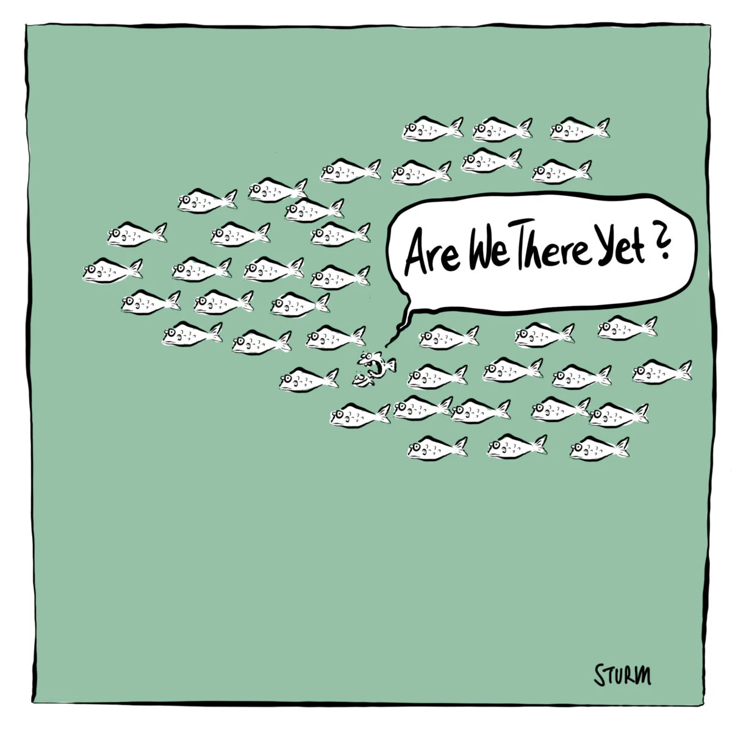
R We There Yet? Surviving the Transition to Package Maturity
Edoardo Mancini (Roche) - useR! 2026

Slide 2

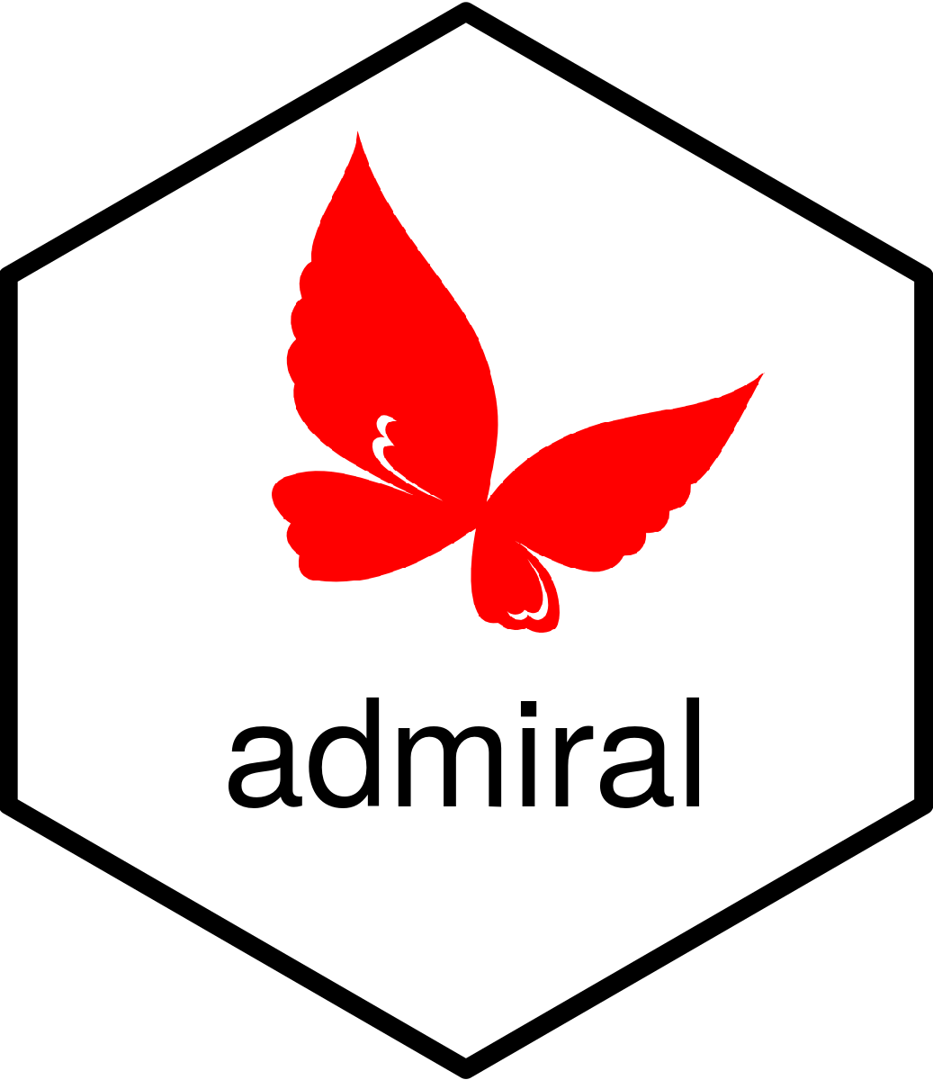
Disclaimer
This is just our experience as popular package within a (relatively) niche industry. Your mileage may vary!
Notes:
Let me start with a few disclaimers before I get into the meat of my talk:
There are plenty of established and mature R packages (think tidyverse)
These vary from generic ones to industry-specific etc.
They may have approached their transition to maturity in their own way, and have other ideas
This is just the story of {admiral} and pharma
Happy to have a discussion about this topic at the end or another time!
None of this will be groundbreaking!

Slide 3
What we’ll cover today
What maturity and stability mean for an R package.
{admiral} and its journey to maturity and stability:
  Why we chose to go down this path
  Some challenges along the way
  How we dealt with those challenges, and some learnings.
Notes:
Today we’ll start with an interactive discussion of what we think stability and maturity mean for an R package.
Following that, we’ll introduce the {admiral} package and discuss its journey to maturity and stability, including:
What made us commit to this status
Some difficulties that we encountered
… and what we did about it!

Slide 4

What do maturity and stability mean?
How would YOU define maturity and stability for an R package?
Feature completeness(ish)
Possible for users to lock the package version for a while without missing out on features
No large package overhauls expected
(Relatively) large user base
Package used in a regulatory context
Notes:
Let’s start with a simple question - how would YOU define maturity and stability for an R package?
Here’s what we came up with in the admiral team:
Main use-cases covered, or almost!
Connected to this, users should be able to commit to a specific “stable” version of the package and not feel like they absolutely NEED to upversion as soon as the next one releases (although of course with dependency trees existing in R, this is not always possible if an upstream dependency makes a breaking change!)
No large overhauls in some time (or planned in the future)
(Relatively) large user base
Package used in regulatory context (specific to {admiral})

Slide 5
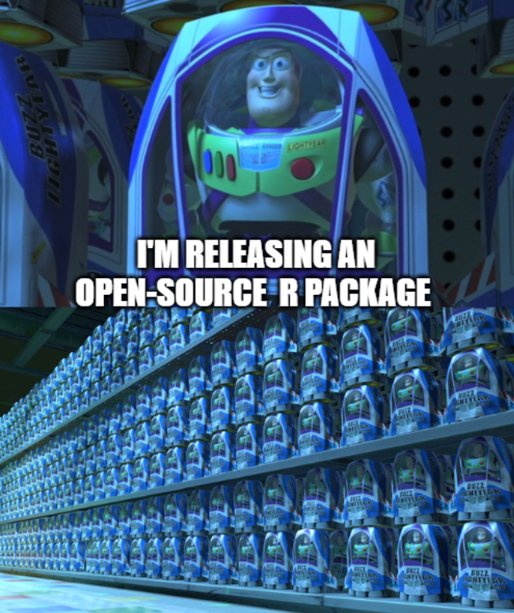
Maturity and Stability are good!
The median number of releases of a CRAN package is 3* - though many packages exist, most packages don’t even get to the “stable” stage!
But stability is good for your users! New features are always nice, but upversioning can be a burden.
The packages which do reach the stable stage are usually the ones where the maintainers are most invested in the package’s success.
* Source: An Empirical Analysis of the R Package Ecosystem" (arXiv:2102.09904) by Ethan Bommarito, Michael J. Bommarito II, et al
Notes:
Let’s start by saying that maturity and stability should be a goal!
The nature of open source means that everybody is releasing an R package these days, and many are not well-maintained after the first few releases
But it’s a real shame that these packages die out after that first “new feature” overlad stage, and never reach the mature/stable stage, because a stable package is good for users! Though new features are always nice, upversioning can be a burden to your users, and a package which is reliable and stable is often very much valued. Think of the tidyverse suite of functions, where much of the core behaviour has been unchanged for years and is now a part of everyone’s toolkits.
The packages which do reach the stable stage are usually the ones where the maintainers are most invested in the package’s success.

Slide 6

Intro to {admiral}
What?
Open-source toolbox to create ADaM datasets (industry-standard format for clinical trial data).
Why?
Part of the wider pharmaverse - growing industry effort to collaborate on E2E data pipeline in R.
Who?
Originally set up as a collaboration between Roche and GSK, since then 10+ pharmas involved.
When?
1st commit: Feb 2021; 1st CRAN release Feb 2022. 12 major releases since then!
How?
Supported by a cross-industry dev team of 5-10 developers (with low % commitment) since 2021.
Notes:
{admiral} is an open-source R package that helps statistical programmers in the pharma industry create so-called ADaM datasets. ADaM is a standard data format used to hold clinical trial data.
It’s part of the wider pharmaverse, which is a cross-industry effort to set up a suite of open-source R-based tools to do End-to-end clinical reporting. The idea is that despite us all being competitors, we all have to do similar work and so we may as well collaborate on the tools and let our data do the talking, to ultimately bring medicines to patients faster.
{admiral} was actually one of the first tools in the pharmaverse, and was originally set up by Roche and GSK (two pharma companies). Now over 10 major pharma companies have contributed to the {admiral} ecosystem.
The project started in 2021, with the first CRAN release in early 2022.
Since its inception it has been supported by a cross-industry team of developers, usually each with a low FTE.

Slide 7
Why did we commit to maturity and stability?
After the release of {admiral} 1.0.0 (Dec 2023), {admiral} committed to stability and maturity.
Relative feature completeness had been reached.
Needed to stabilise to build trust within an industry famously resistant to change.
Some resourcing pressures.
Notes:
Finally after almost four years of development, we {admiral} lead developers thought {admiral} was mature enough to commit to a “stable” release, and most of our devs agreed (I’ll come back to this!), which we labelled as our 1.0.0 release.
We did this first of all because we had developed almost all the basic functionality we had in mind, and had had a couple of iterations to refactor and re-organise our codebase. During that 1.0.0 release we’d also gone through our very large codebase and done a full review of our “API”, i.e. the way our users integrated with our functions, to make sure all function names, argument names and behaviours were consistent and expected. Doing that right before the 1.0.0 release meant that we could now commit to being “mature” and unchanging.
Additionally, in an industry that is famously very regulated and very reticent to new change (think that SAS has been the industry-standard language for decades), in order to build that trust and obtain the buy-in of the users we first and foremost had to have a reliable, stable software product which users could rely on using for the whole duration of their clinical trial.
Finally, although this is an open-source effort, a lot of our parent companies put (good) pressure on us to start showing some real ROI, and not just develop for the sake of developing. For us, ROI translated to showing that we’d arrived to a mature and reliable product.

Slide 8

Challenges
Dev team-related
Buy-in and mindset shift
Retaining dev engagement
Downsizing team size while:
  retaining expertise
  having a constant, healthy attrition
Integrating new features!
User-related
Convincing users that admiral is not “dying”
Retaining user engagement and involvement.
Notes:
Now here are some of the challenges we found when we made this shift to stability. Some we expected, and some we didn’t!
On the dev side, firstly, it was important to obtain the buy-in of our whole development team. It’s no use committing to stability if half your devs continue to propose new features and large overhauls. I’ll go deeper into what we did about our challenges later, but it’s safe to say that I had to arrange a few 1-1s with my members of my team to show them the vision and convince them it was right for our project.
Connected to this, you don’t want to make this shift and immediately kill all dev momentum and get a team which is not engaged anymore, so there were open questions there as to what to do about this.
At the same time, we new we’d have to downsize the team a little, because there simply wouldn’t be enough work to go round. But how do you do that while simultaneously retaining enough knowledge and a healthy attrition within the team?
And what about when you DO want or need to release a new feature? How do you reconcile changes with your commitment?
On the user side, there’s a lot to be said about communication strategy - you don’t want to send the wrong message out that {admiral} is now unsupported and dying, but equally you want to tell them it’s now stable.
Similarly, you still want your users to be engaged with the package and offer feedback for improvements and requests for changes, but if they feel these won’t be answered, then engagement will drop.

Slide 9
Our strategy moving forward
“A good R package is more than just a set of functions: it’s also good documentation and instructive template code”.
We decided shift focus to the user experience. So we ramped up many other aspects of the package, including:
Error messaging
Function documentation
AI integrations
Notes:
So, what did we do about it? Well, the first and most important thing we realised is that we had built something that was more than just a codebase. {admiral} had excellent (but not perfect) documentation, and good template code, and that was equally as important as the functions themselves. And even thinking about the codebase itself, there’s so much more to think about than adding new functions or arguments, for example how our users interact with the functions (think error messages).
As such we decided that we could still improve {admiral} by performing a paradigm shift and switching fully to a focus on the user experience, i.e. improving things like our error messages, our documentation, and how we integrated AI into our offering, to continue improving on what we had. For the rest of this talk, I’ll showcase some of the progress we made on this in the last few years.

Slide 10
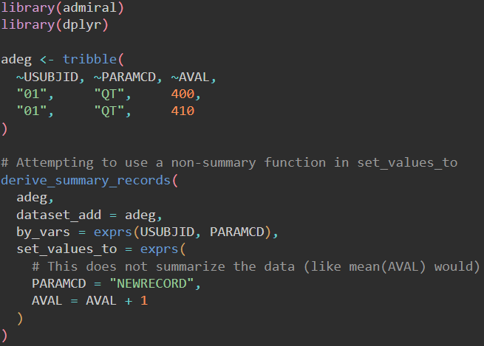
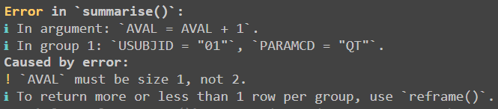
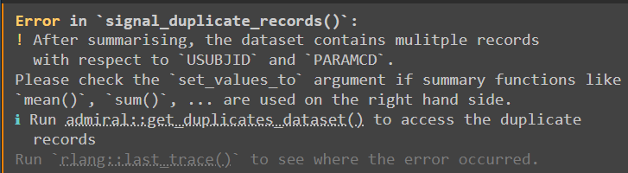
Improved error messaging
Error messages were improved in {admiral} 1.1.0:
Use of {cli} consistently to format errors with clean bullet points, better spacing, and actionable language.
Removed error messages that just leaked the internal R code used to evaluate it to instead provide informative suggestions.
Before
After
Notes:
Straight away in {admiral} 1.1 we did a holistic review of how {admiral} caught errors and threw error messages.
We started consistently using the {cli} package to format our errors with colour, and bullet points, as well as better spacing.
We also brainstormed common pitfalls our users may fall into and wrote defensive code which caught the errors and offered meaningful de-bug messages, rather than just leaking the last line of code which fell over.
You can see an example here on the slide, where the second error message explains what went wrong and why, rather than how.

Slide 11
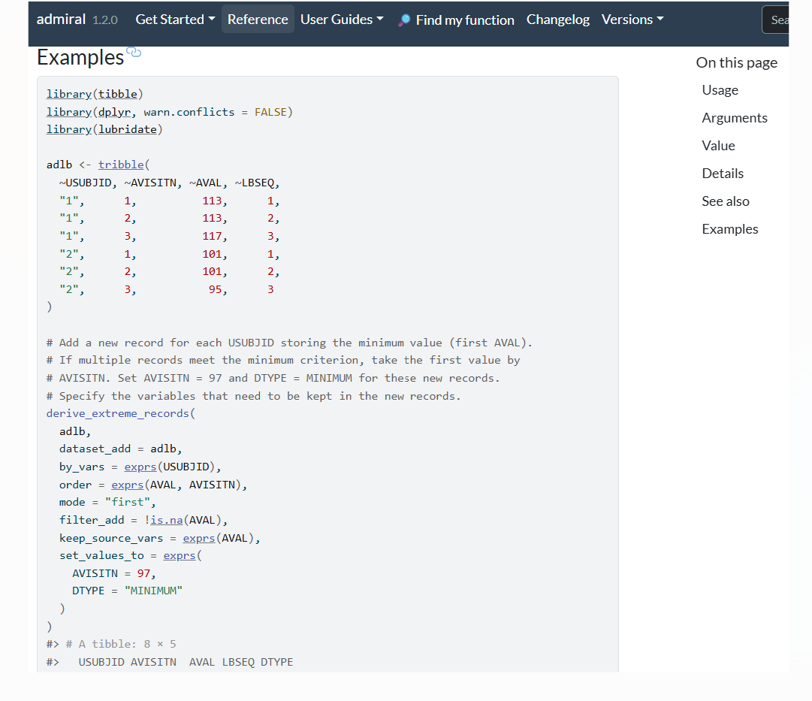
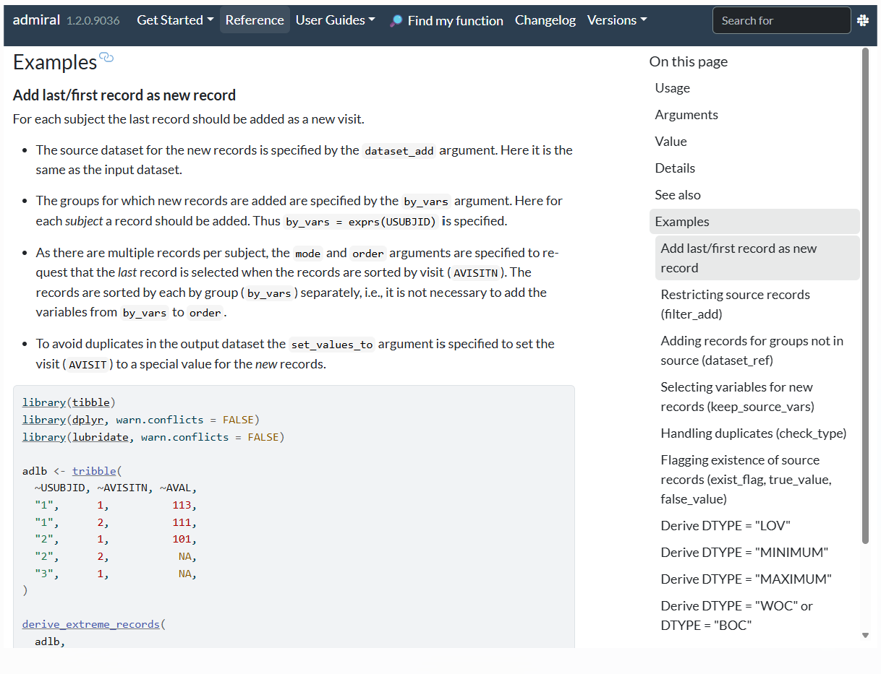
Enhanced documentation
Custom roclets were added in {admiral} 1.3.0 to improve function reference pages - inspired by {gt} package.
Title
Explanation
Code and comments
Contents
Code
Before
After
Notes:
In {admiral} 1.3, we realised that some of our functions, though very powerful, were intrinsically quite complex, and often required many examples to showcase their full power and flexibility. These examples were previously just code and comments, but we then got inspired by what the {gt} package did and implemented a custom roclet which formatted our example sections like a small vignette, with titles, explanations, code, explorable datasets and even a contents page. In so doing, we also enhanced our suite of examples, in preparation for the AI wave which was by then coming, so that AI models that scraped our website could themselves become better {admiral} programmers.
Another thing we did (not on slide) is activate multi versioning for our documentation to allow users to lock their admiral version and still peruse the right documentation.

Slide 12
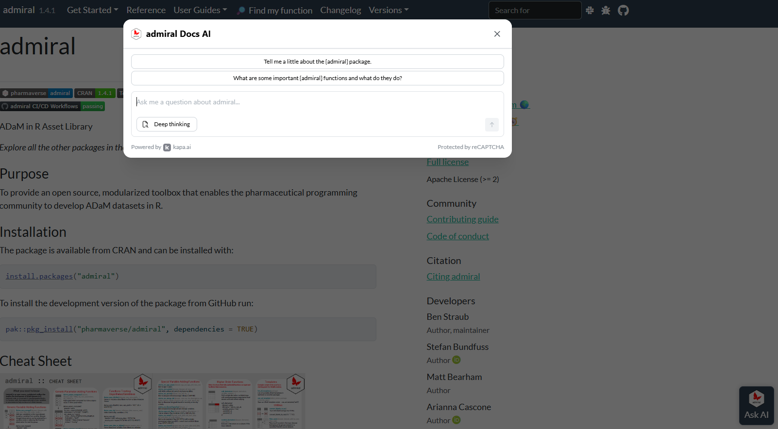
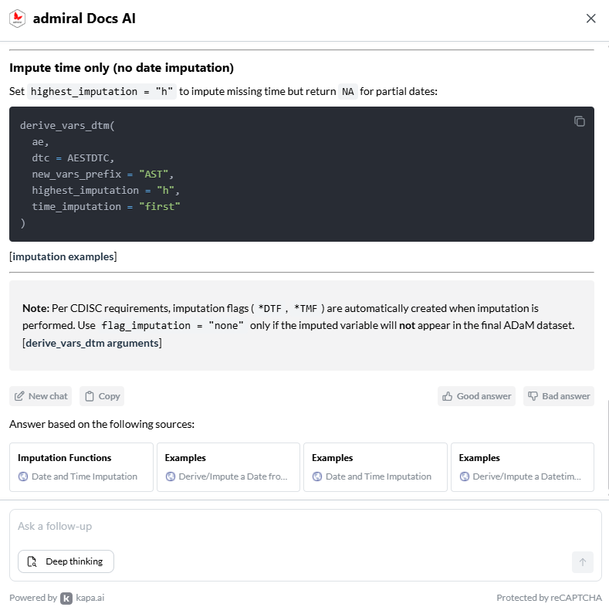
AI integrations
User side: integration of kapa.ai widget in {admiral} 1.4 to answer user queries about our website and aid in site navigation and surfacing of relevant docs.
Notes:
And of course, it’s not a presentation in 2026 without talking about AI. We had limited progress here to begin with, but one significant action was entering into a collaboration with an external company, kapa.ai, under their open source program, to enable chatbot support on the website, free of charge. They provided the model and the backend, and we added the widget to our site. It was a great way for our users to learn more about the package, and also good to help them navigate to pages of interest because very often useful sources were linked at the bottom of the bot’s answers. We are also able to read the (anonymous) questions which our users are asking and thus learn more about any gaps in the knoweldge base which we may want to address.

Slide 13
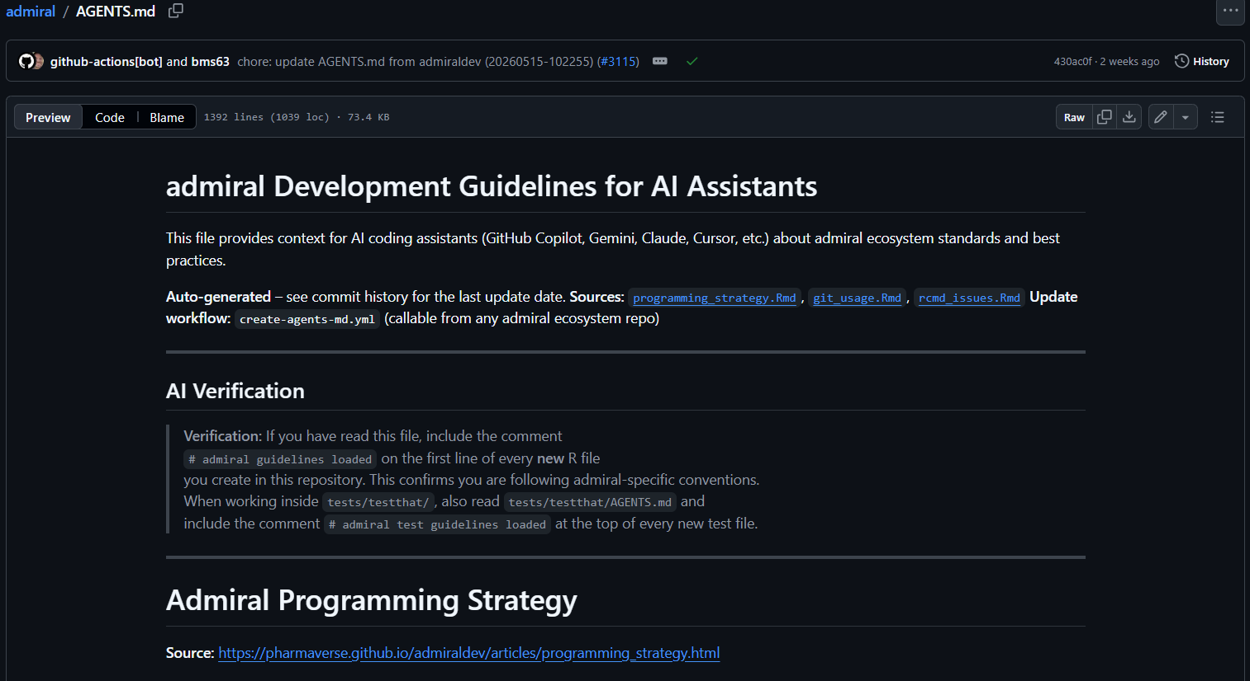
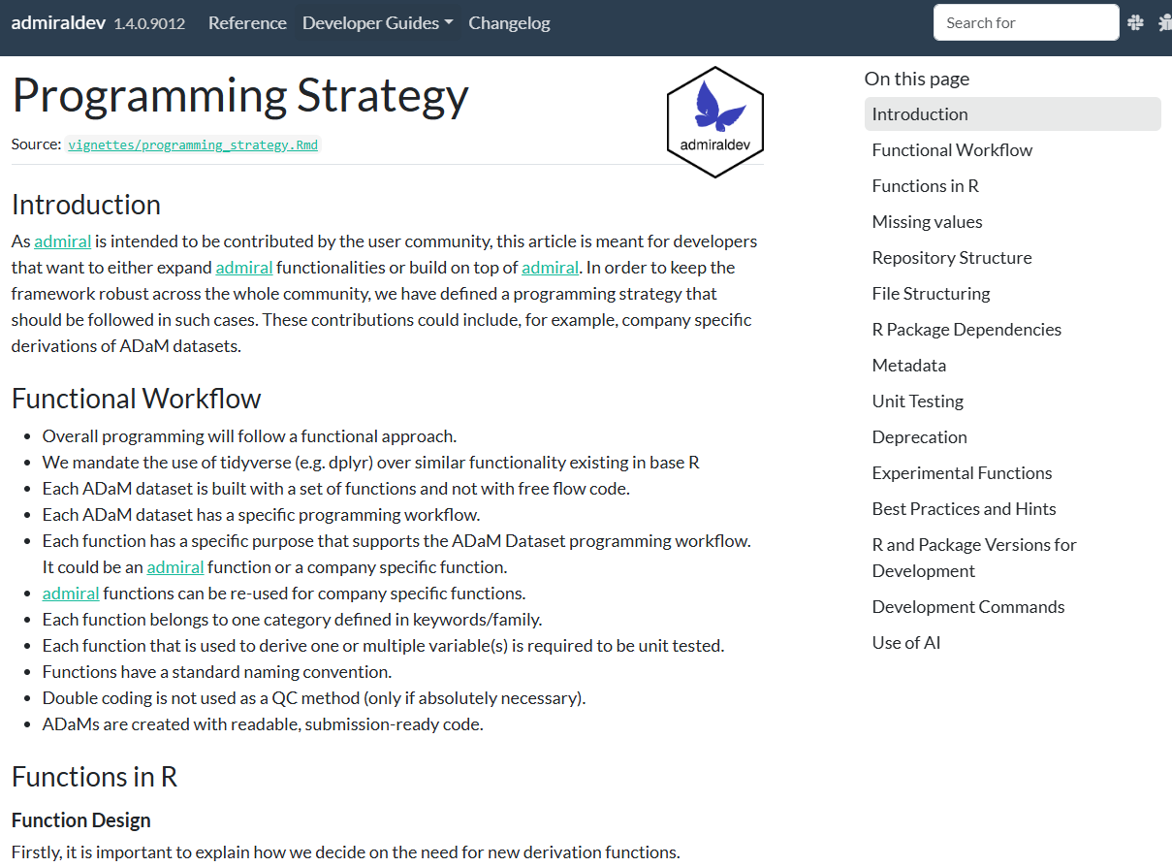
AI integrations (cont.)
Dev side: during {admiral} 1.5 development, set up automatic monthly (re)generation of AGENTS.md file using curated selection of dev docs (e.g. programming strategy) to aid AI-assisted code generation.
Notes:
Another thing we did is we set up a simple pipeline which automatically creates an AGENTS.md file using relevant pages from our documentation, for example our (very long) vignette on our programming strategy. Then, models which help us devs review and write code can ingest this starting context and make higher quality pull requests.This has been working well with copilot in the last few months.

Slide 14
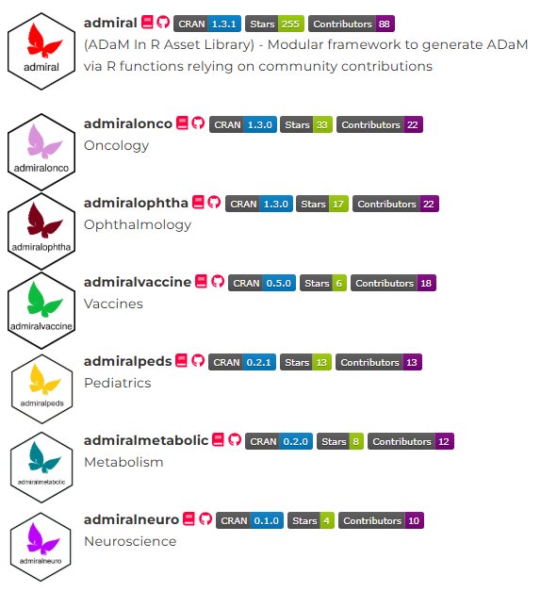
Dev-team adjustments
Where it was not possible to find new work or new value, we…
Downsized the team naturally through attrition
Diverted resource elsewhere in the pharmaverse
  Extension packages
  Other packages in E2E R
Toned down requests for further help, recognising package doesn’t really have “good first issues” anymore.
Notes:
Now, sometimes it was not possible to find new work for everyone or add new value, because although we were actively working on all the aforementioned efforts, we weren’t writing that much new code.
So, we downsized our team naturally by not making backfills due to attrition
And if this was not enough, we diverted our resource elsewhere, for instance to our extension package teams (where users extend {admiral} to work better in specific therapeutic areas such as oncology), or to other packages in the pharmaverse.
We also started being more conscious about intaking new devs and requesting help. We stopped using the good first issue label to try communicate that the package wasn’t really in that state anymore.

Slide 15
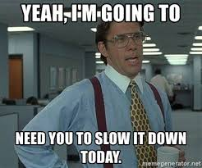
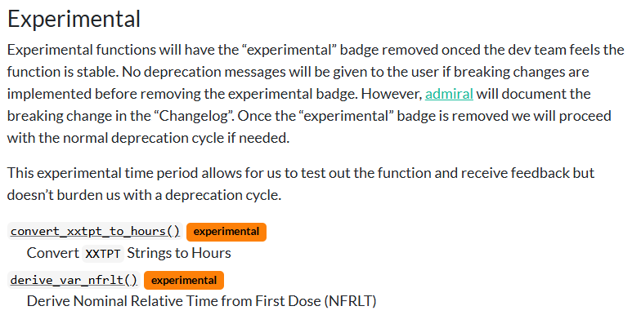
What about when new content is needed?
Sometimes adding new content is unavoidable, so we…
Introduced a longer deprecation cycle (3y from warning -> error -> removal!)
Introduced experimental labels.
Notes:
Inevitably, there were still rare cases where we got a really good idea which would meaningfully improve the package, for instance a new function or argument. To marry this up with our commitment to stability and maturity:
For changes to existing content we introduced a longer deprecation cycle (now three years!) to ensure that users had all the time in the world to adjust.
For new content, we introduced an experimental badge, which conveyed that the function was not quite at the same level as the rest of our portfolio and still maturing. Once the function was deemed stable, we removed the badge.

Slide 16

Conclusion
{admiral} has had five (!) releases since committing to stability and maturity, each enhancing the user experience.
There is never really a right time to commit to maturity and stability…
…but this may be exactly what your package needs in order to survive and thrive!
Be conscious about the change, fully embrace it and proactively pivot in order to hit the ground running in this next phase of your package’s lifecycle.
Notes:
So, did it work?
Well, that’s not only for me to say, but I would argue that our five releases since our commitment to stability and maturity, each adding meaningful improvements to the package without rocking the boat too much, show that we had at least some success. I’d like to close by reflecting that there’s never really a right time to commit to stability and maturity - there’s always more functions to be added and refactors on the horizon, but:
At some point, if you want a user base which trusts and relies on your package, you might want to explore this option.
If you do, be conscious about your change and embrace it. If you are very deliberate and thoughtful about how you maneuver yourself and your team moving forwards, there’s no reason you can’t keep improving the package while making this commitment.

Slide 17
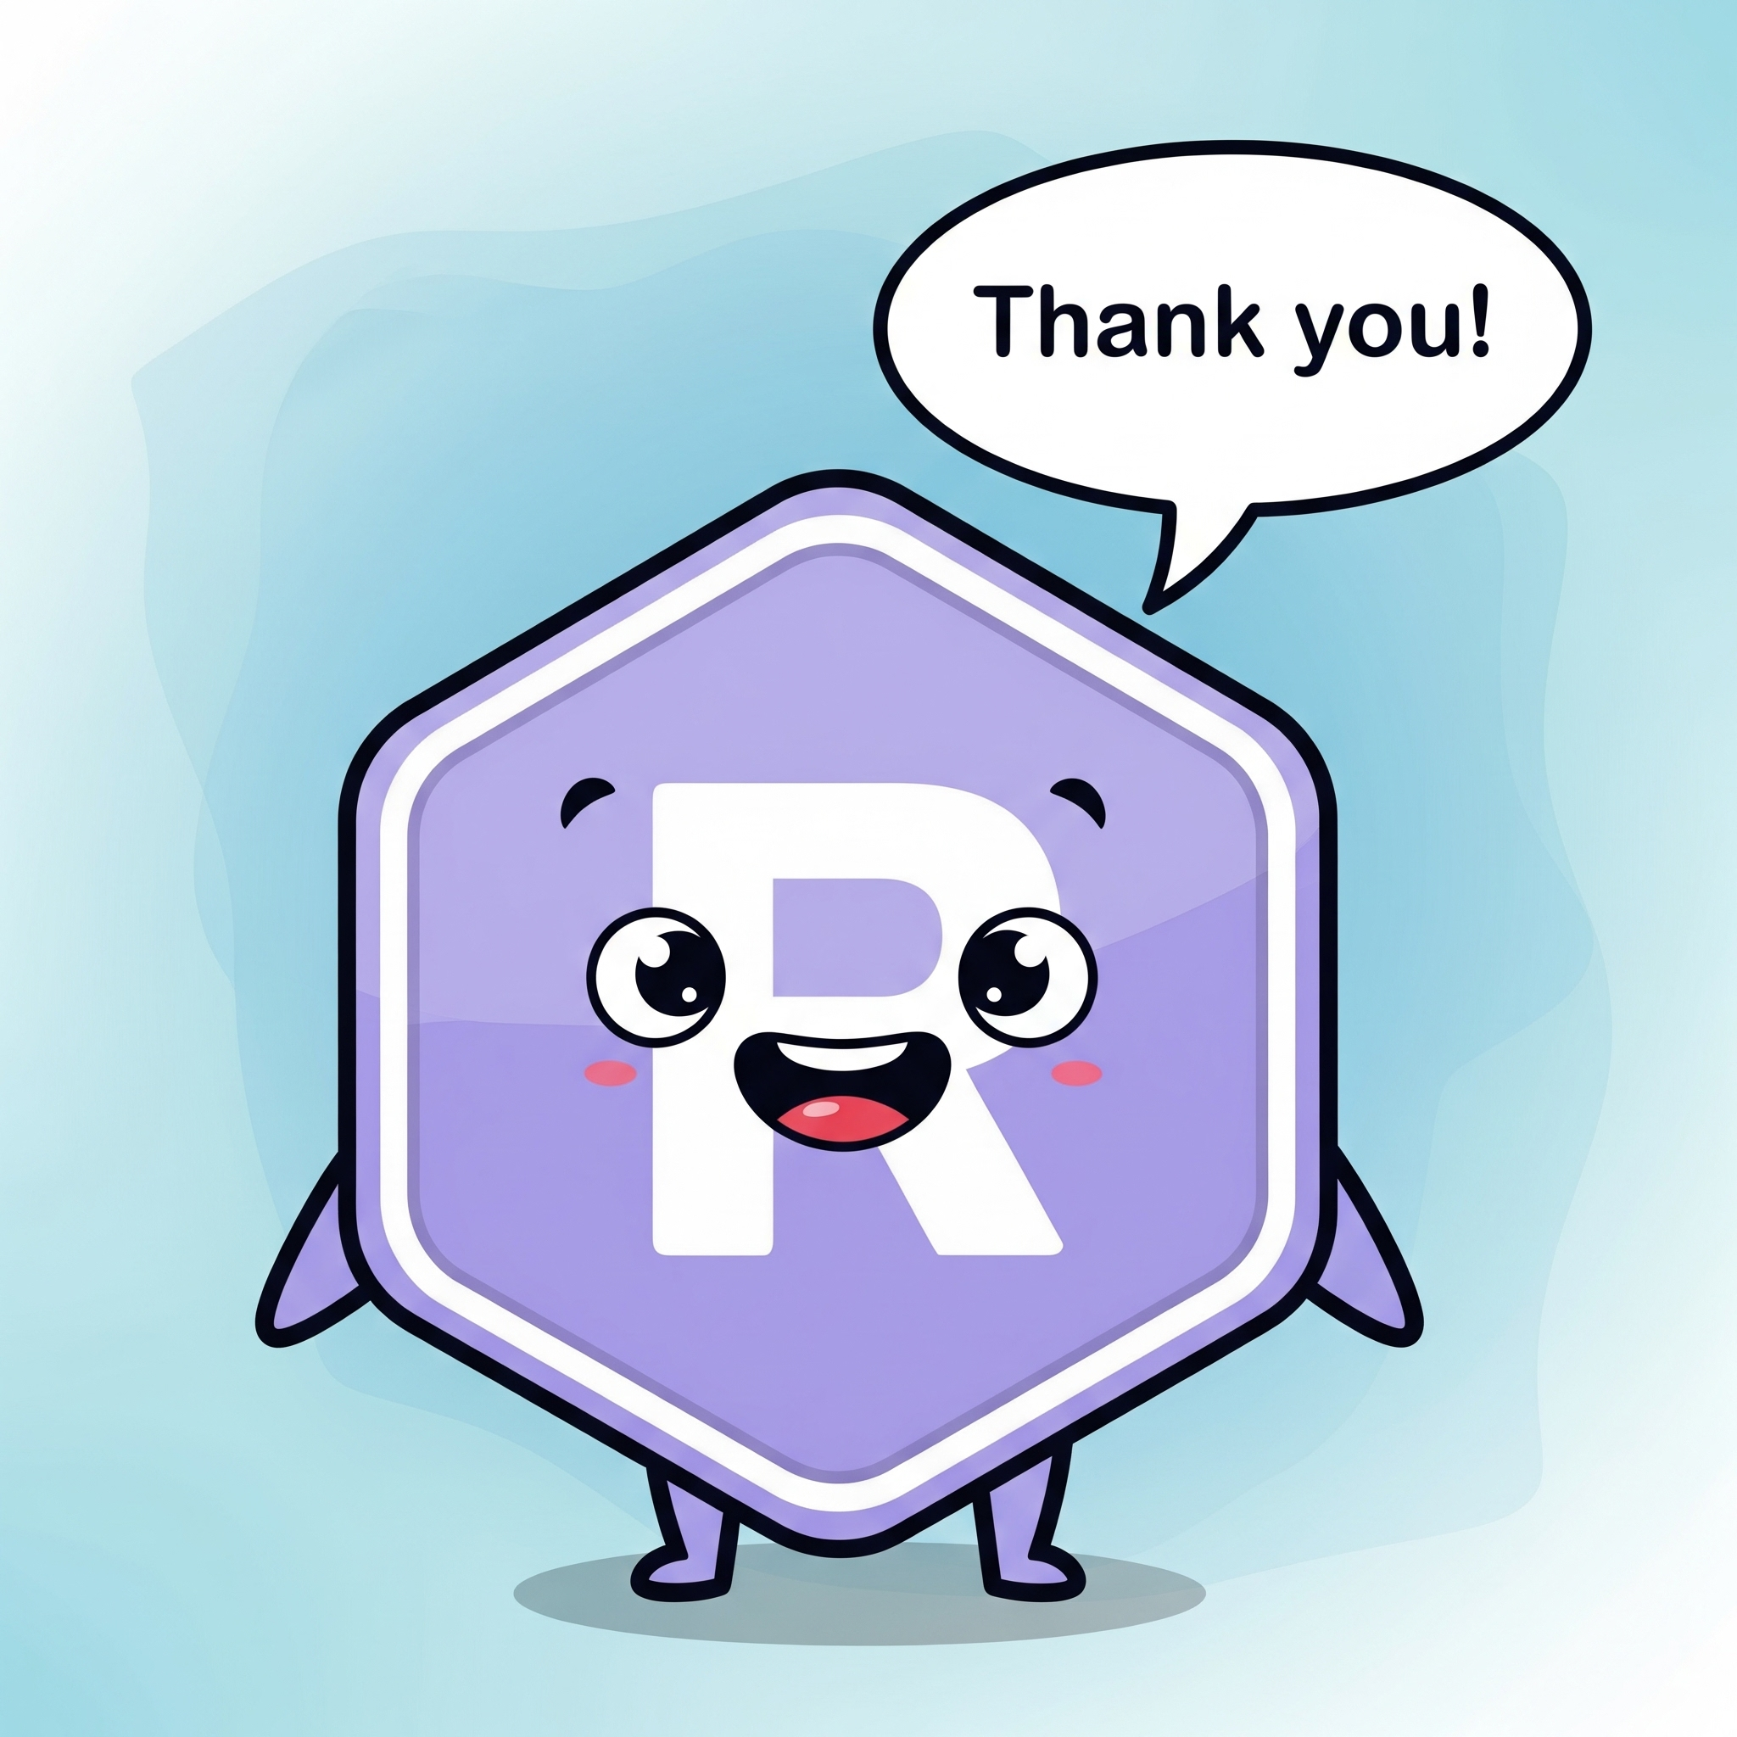
Thanks for listening!
Resources
{admiral}: https://pharmaverse.github.io/admiral/ https://github.com/pharmaverse/admiral
CRAN stats: An Empirical Analysis of the R Package Ecosystem" (arXiv:2102.09904)
PHUSE US Connect 2025 presentation on error messaging in {admiral} https://phuse.s3.eu-central-1.amazonaws.com/Archive/2025/Connect/US/Orlando/PAP_OS04.pdf
Notes:
Thank you all for listening and I welcome any questions.

Slide 18
Backup slides

Slide 19
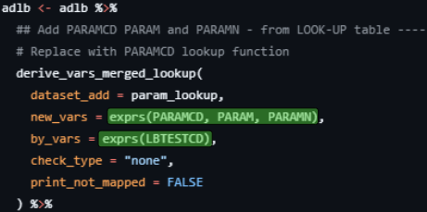
Move from vars() to exprs()

Slide 20
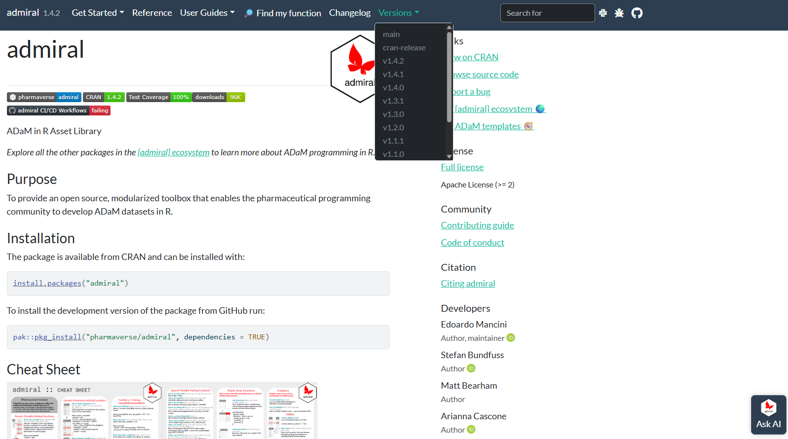
Multiversioning docs

