Slide 1
Why Pay for Survey Platforms?
Just Use R!
useR! 2026

Slide 2
Motivation
1. Taking part in a (psychological) study shouldn't be boring.
  E.g., through immediate feedback
2. Sensible participant data should be under researchers control.
  E.g., „Unipark“
How?
  (Payed) Service → R environment
Today: A workflow to do the assessment and the data handling – all within R

Slide 3
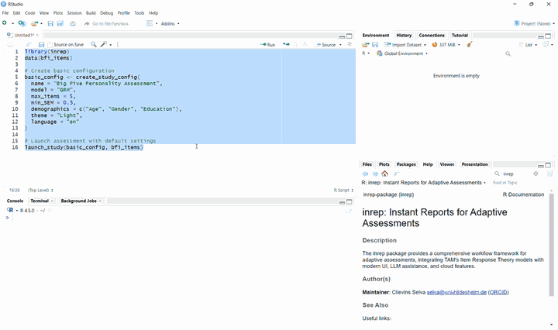
Assessment
  inrep package (`instant reports`)
  – helps with survey design, data collection, and analysis
Pages (type=)
"instruction"
"demografics"
"items"
"custom_page"
"results"

Slide 4
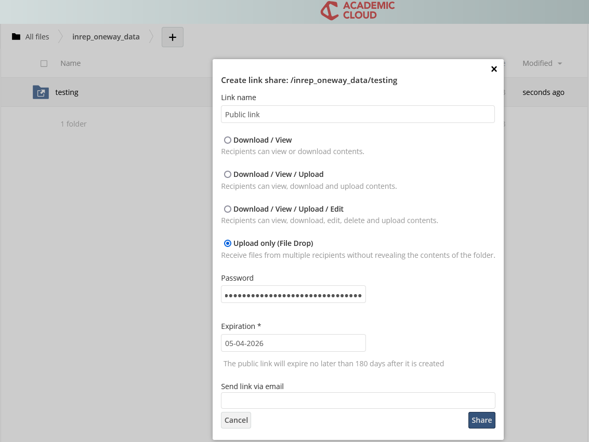
Data handling
Store where it is secure
  e.g., institutional server
  No third-party providers
  R runs for each participation
  Hosting: e.g., offline, shiny.io,…

Slide 5
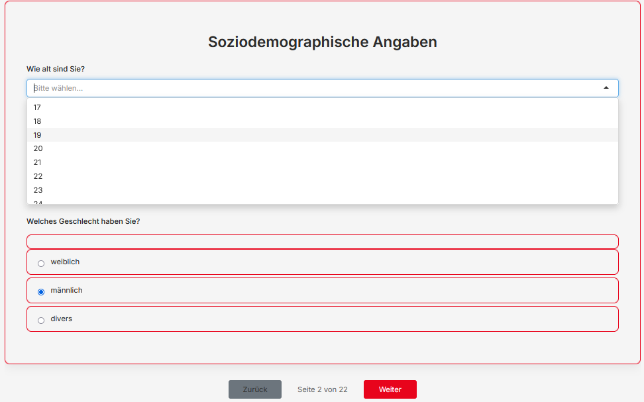
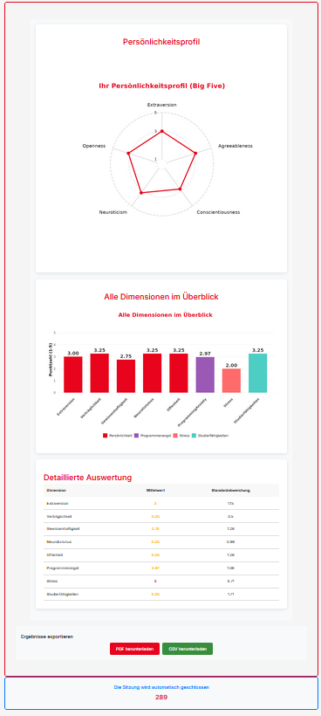

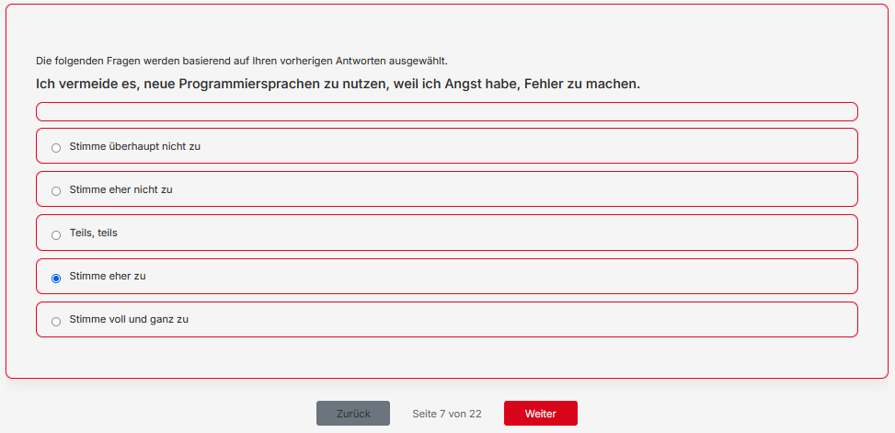
A case study
Notes:
renew

Slide 6
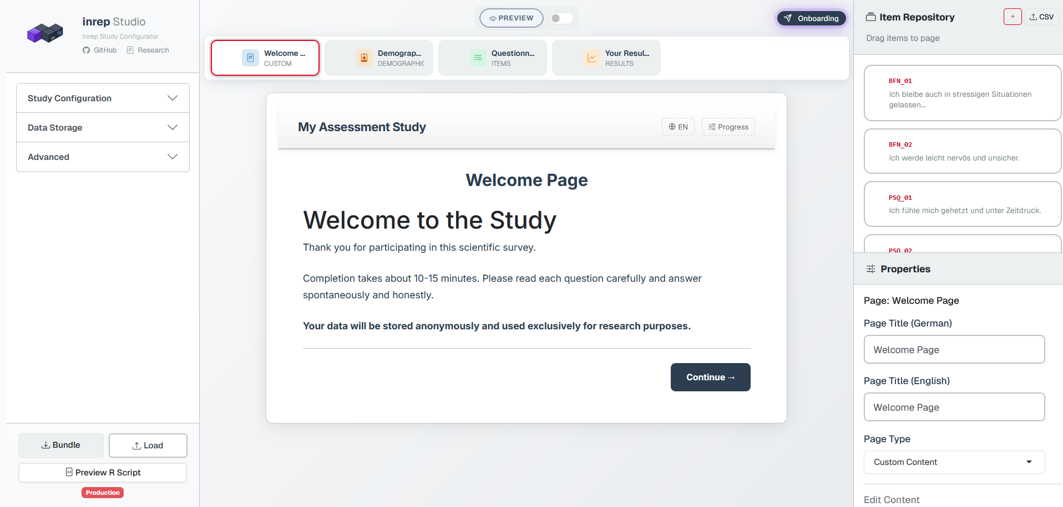

Minimizing technical barriers
Check out LIVE
(mostly vibe coded with Claude Code ☺)

Slide 7
Message
Let's do assessments in the very program we love to do our analysis in
Clievins Selva, Universität Hildesheim
Email: clievins.selva@uni-hildesheim.de
Projekt: github.com/selvastics/inrep

