Slide 1
{teal}: A production-ready framework for data analysis on clinical trials
Lluís Revilla Sancho, Roche
useR!2026, 8th July 2026 | Public

Slide 2

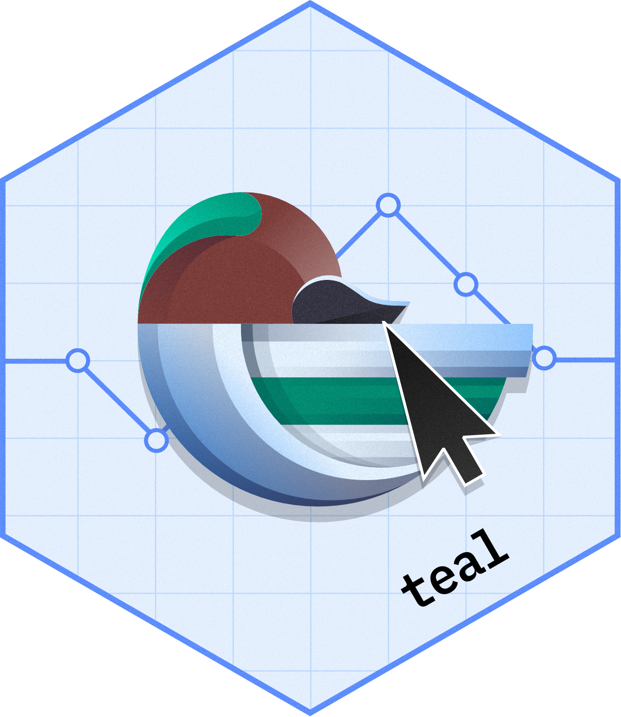
What is {teal}?
Open-source R Shiny-based framework
Reporting engine
Code reproducibility
Analysis tool
Notes:
Teal is R Shiny-based interactive data exploration framework and has been open sourced since summer of 2022.
It provides modularized and standardized building blocks that can help streamline the creation of web apps that offers
Dynamic filtering - data slicing and dicing, subgroup analyse
Code reproducibility - reproducible code generation so that recreate the outputs outside shiny in plain R
Reporting engine - generating reports from analyses: code and output
Bookmarking features
Also out of the box we provide a collection of module packages that provide many readily available data summarization and visualizations for different analysis needs

Slide 3

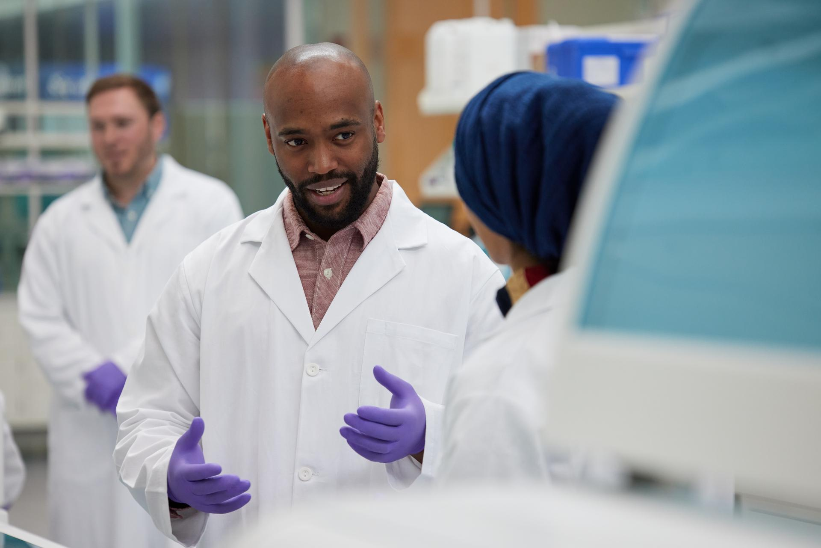



How {teal} helps in production
Study A
App developer
modules
study app
Study module developer
user
Study B
Module developer
Study C
Study D
Notes:
Clinical studies are a team effort. How do we organize and support to find medicines that are life-changing?
Clinical studies about cancer have different needs than IBD (inflammatory bowel disease) or diabetes or Alzheimer
Some parts, read modules are shared across areas. This allows to have experts write the appropriate module.
Other modules are specific to studies: they are not shared across the organization.
Last the modules are joined in one app for the users: clinical scientists.
Who then check adverse events, compare arms of studies with confidence.

Slide 4

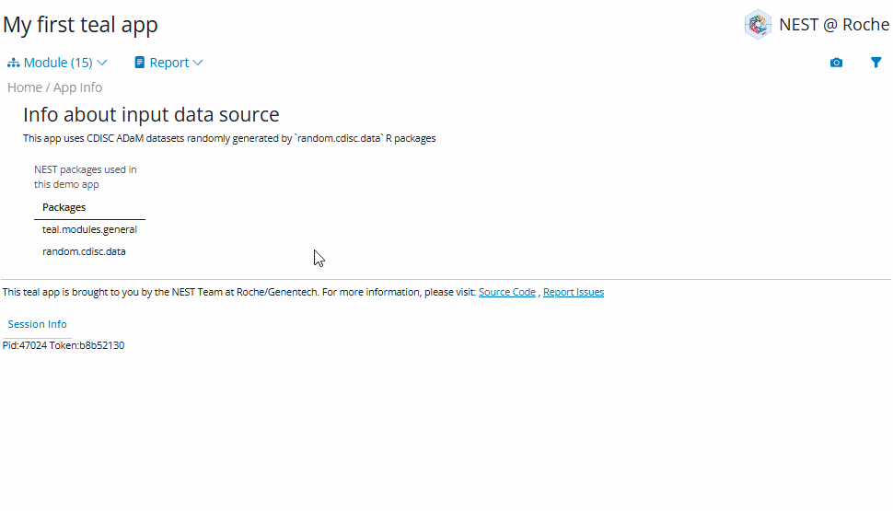
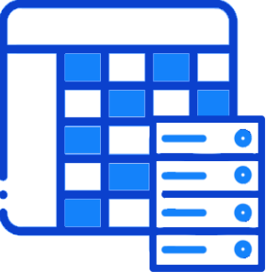
Workflow with {teal}
Building modularized web-apps is quick and easy
(clinical) data
teal framework
teal.modules.clinical
teal.modules.general
teal.osprey
teal.goshawk
teal modules
Deploy R-shiny web-apps
Notes:
In practice what does it mean:
We get the data for a study, we use teal and the appropriate modules and users get a shiny app to analyze the data.

Slide 5
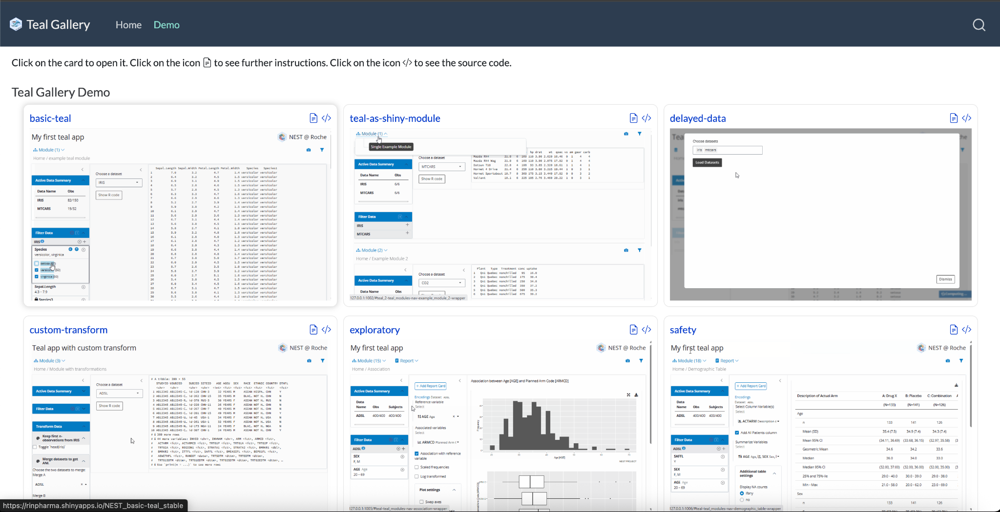
teal.gallery
https://insightsengineering.github.io/teal.gallery/demo.html
Notes:
Examples of applications that can be used for
Source code of this apps are available

Slide 6
{teal} demo
https://github.com/llrs-roche/useR2026/blob/main/app.R
Notes:
Link to the app of the demo

Slide 7
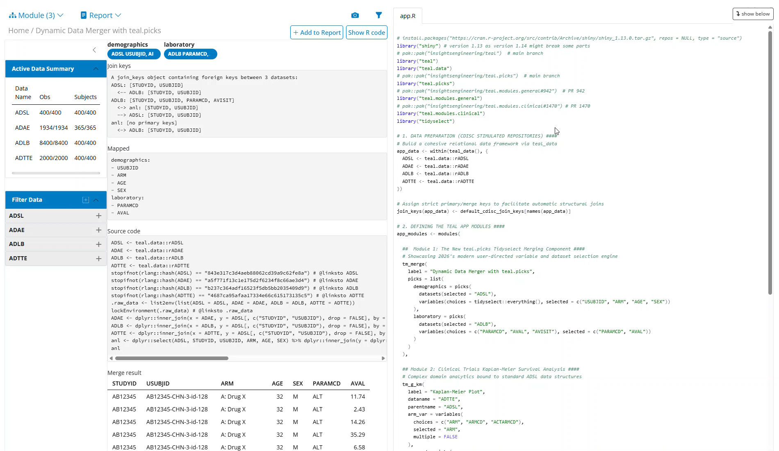
{teal} demo
Notes:
Show how teal.picks works
Show how reporter works
Show how code blocks work

Slide 8
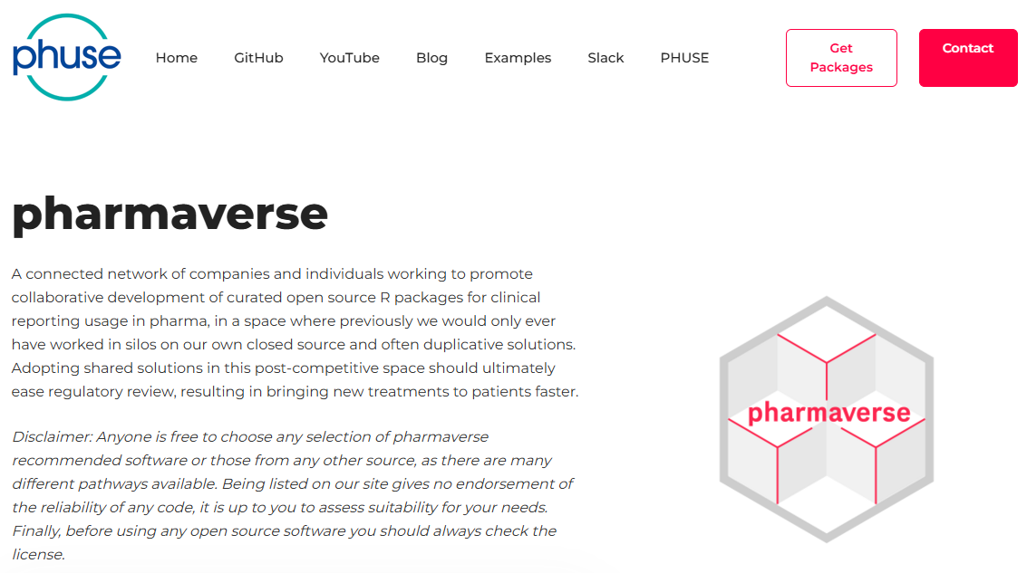
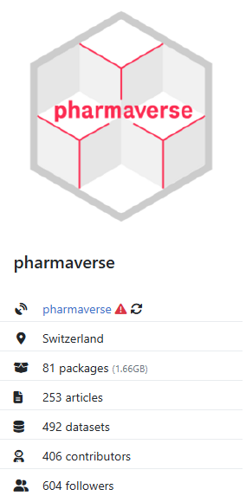
Pharma context
https://pharmaverse.r-universe.dev/builds
Teal Enhancements for Cross-Industry Adoption
Join next meeting: Wednesday, August 5
Notes:
It is developed publicly within pharmaverse and PHUSE.
There are monthly meetings about developments and ideas for teal.
Teal is part of the r-universe pharmaverse too: you can install from there the latest development

Slide 9



Success stories
reporter, teal decorator & others
teal.builder
teal.modules.bsafe
plus adoption from GSK, BMS, Pfizer, etc.
Notes:
I want to share some success stories from our collaborations with other pharmaceutical companies since we open-sourced teal.
We worked with JnJ to develop teal.decorator, a feature that allows users to modify output aesthetics.
Sanofi created teal.builder, an extension that simplifies the creation and deployment of teal apps.
Boehringer Ingelheim developed teal.modules.bsafe, a module package designed for statistical analysis of adverse event data.
Beyond these contributions, users from different companies have been actively submitting issues, sharing ideas, and reporting bugs—continuously helping to improve the quality of teal.

Slide 10
{teal} modularity
https://github.com/insightsengineering.com/teal
teal.modules.clinical
teal.osprey
teal.goshawk
teal.builder
teal.modules.general
uteals
teal
teal.widgets
teal.reporter
teal.slice
teal.data
teal.code
teal.picks
teal.transform
Notes:
A graph representing teal as a tree:
The roots are low level packages responsable for some features
The trunk is teal and teal.modules.general
The leaves are other packages creating new teal modules

Slide 11
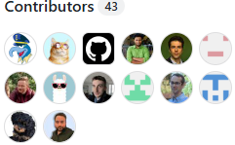
Top recent {teal} features
Extensively tested ({shinytest2}, shiny::testServer)
Reporter functionality
Transformators and decorators
Open to community feedback
Notes:
More tan 85% code coverage, Try to get 90%
Teal.reporter was enhanced with feedback from JnJ
Transformators and decorators modify input and output objects to give flexibility to users but keep modules minimal

Slide 12

Lessons learned
Training & documentation
Balance flexibility & usability
CRAN checks & Validation
Notes:
Fix the issue with validation

Slide 14

Other talks & posters
Two posters today at 16:30 about {teal}
From Static to Smart: Exception-Driven Medical Data Review with Teal and AI
Ms Daphne Grasselly (Roche), Magdalena Krochmal (Roche)
Interactive and Instant GenAI-Driven Creation of Clinical Trial Applications
Marcin Dubel (Appsilon)
R/Pharma genAI day2026
Using LLMs to generate Teal applications: from proof of concept to production
Nikolas Burkoff (Johnson & Johnson)
https://youtu.be/Q8pwUUELlkc
Notes:
Encourage people to come to us and look for other material (also about AI)

