Slide 1
Create your own dashboard with EurostatRTool
Antonio Grosso
Eurostat Unit C.1- National Accounts Methodology

Slide 2
Outline
Introduction
Flexibility
Implementing the dashboard
Interface Customisation
Overview Section
Generating the dashboard
Visualisation options
Conclusions

Slide 3
Introduction
The EurostatRTool is a package developed under the European Statistical System Innovation Agenda, designed to facilitate data dissemination
Key features :
It requires only basic knowledge of R
Supports several interactive visualisation types
Includes a storyboard layout which facilitates a storytelling approach
Easy to maintain and update

Slide 4
Flexibility
Adapting the R tool to a specific use case
The EurostatRTool was initially built for European short-term economic indicators at monthly and quarterly frequency
The tool’s flexibility has been proved by:
can be tailored to manage national and regional data
can be tailored to handle both quarterly and monthly data
the package could be easily extended with minor source-code modifications

Slide 5
Implementing the dashboard
The development of the EurostatRTool began with the preparation of input files, each structured according to a template provided in the GitHub repository
The three main input files are:
data.csv: containing the data which will be displayed. This data structure is the one that the user must accurately replicate to build its own data files. It can contain different data and indicators following the structure of the file.
dashboard-structure.xlsx: layout configurator to define the dashboard’s structure, the graph types selected, the display position within the dashboard and the accompanying text
dim-labels.csv: link between the indicators code and labels.

Slide 6
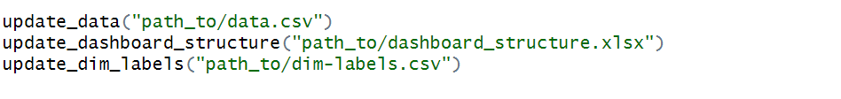
Implementing the dashboard
Once the input files are ready, the eurostatRTool package can be installed and initialized using the reset_to_default() function.
To tailor the dashboard structure to the needs of Eurostat, the update_scenario() function has to be parametrized by selecting “eurostat" as entity. This will generate a layout fitted Eurostat requirements. The function also offers the "nsi“ option, which knits a dashboard tailored to the needs of National Statistical Institutes.
Once the layout scenario has been defined, we proceed by uploading the main input files

Slide 7
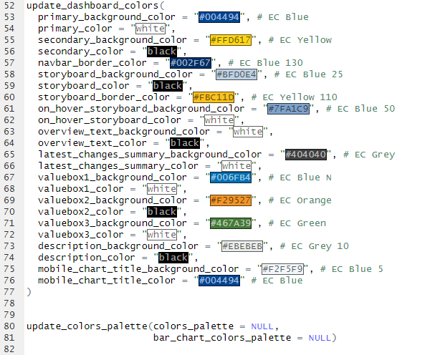
Interface Customisation
Customisation is based on two functions:
update_dashboard_colors() updates the palette to reflect the visual identity.
This customizes UI elements such as the navigation bar, tabs, footer, value boxes, text areas
update_colors_palette() defines the colour scales selected for data visualisations
This specifies the colours selected for bar charts and line plots, ensuring a consistent visual identity across the entire dashboard and its plots.

Slide 8
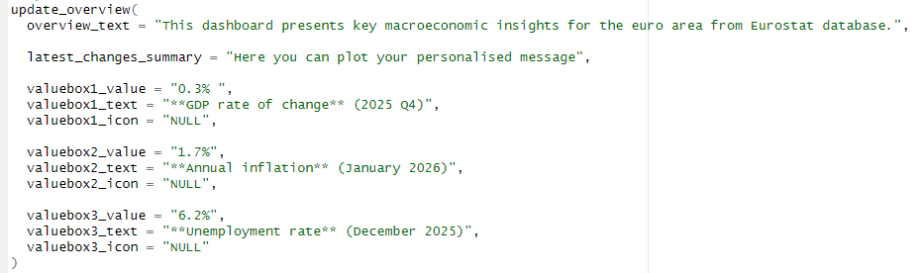
Overview
The update_overview() sets up the first section, providing users with concise insights into the most significant developments.
It consists of three key parts:
a main heading introducing the purpose of the dashboard,
a subheading summarising most recent developments,
three prominent value boxes used to highlight the headline indicators

Slide 9

Generating the dashboard
The update_title() and update_edition() functions set the main title shown in the dashboard’s header, specifying also version or edition
To enhance personalization of the dashboard, the update_logo() function adds a logo image, which links to the relevant institutional webpage.
After completing all configurations, you can run the generate_dashboard() function to compile the designed elements into an HTML file, ready for online publication or local distribution.

Slide 10
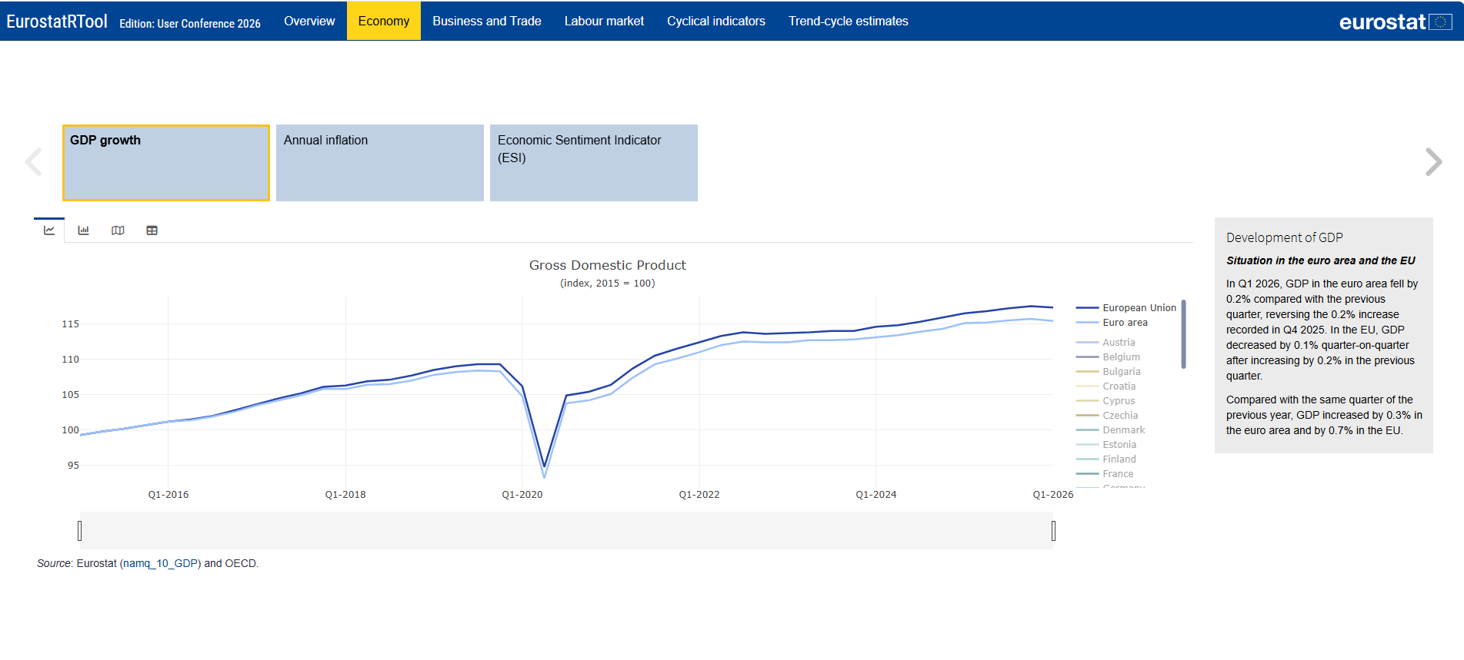
EurostatRTool visualisations
The EurostatRTool presents different visualizations types:
Timeline plot, which provides a dynamic line graph showing the evolution of the HDI and its sub-indicators over time.

Slide 11
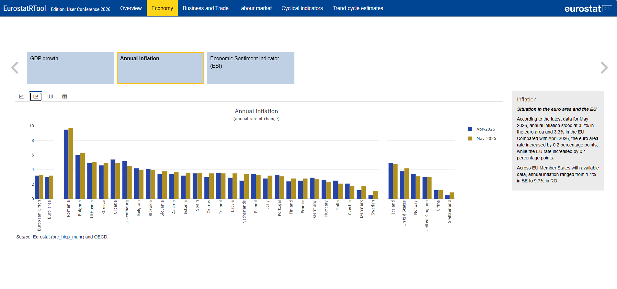
EurostatRTool visualisations
The EurostatRTool presents different visualizations types:
Comparative bar chart which compare the two most recent data for each indicator, disaggregated by region.

Slide 12
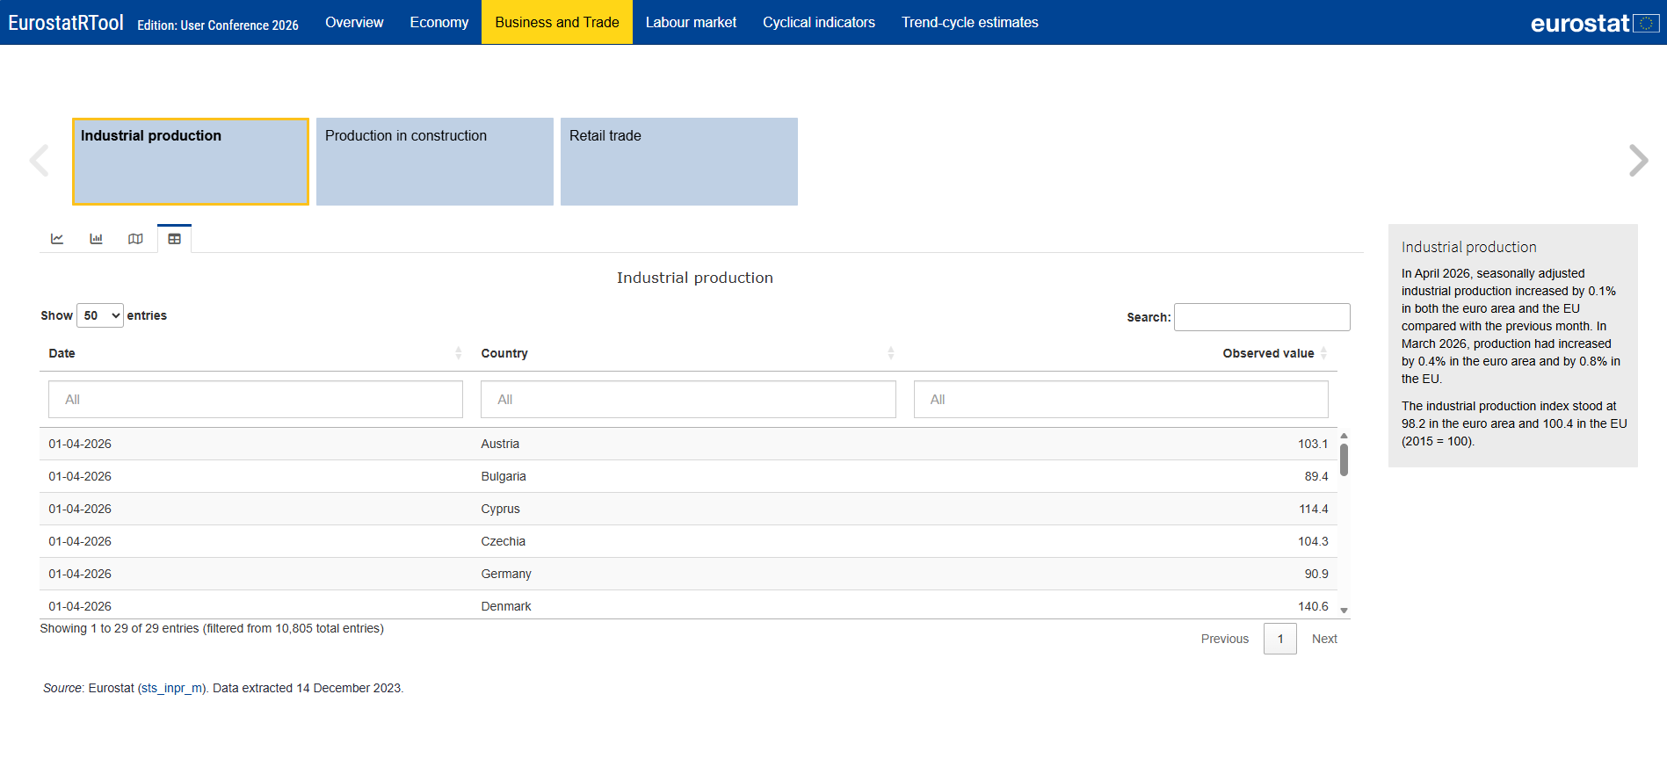
EurostatRTool visualisations
The EurostatRTool presents different visualizations types:
Table format, which provides a structured overview of all indicator values, enabling users to view values and their components in a clear, side-by-side layout.

Slide 13
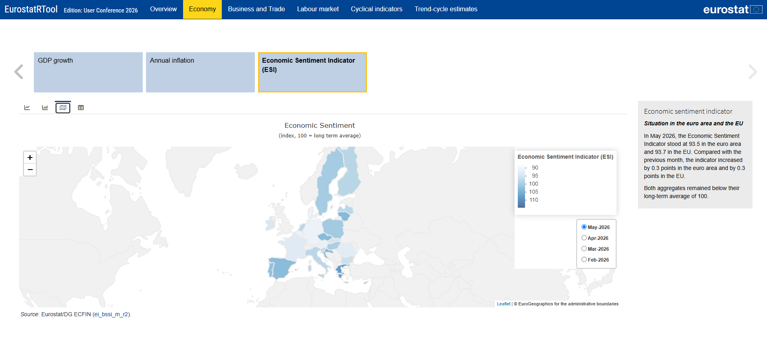
EurostatRTool visualisations
The EurostatRTool presents different visualizations types:
You can also allow the visualisation of your data in Map fomat.

Slide 14
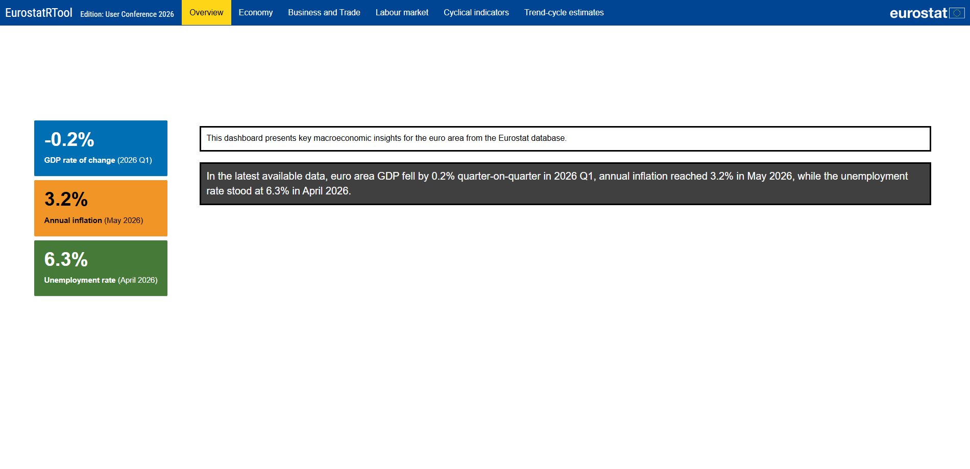
Conclusions
Demonstrating the flexibility of the EurostatRTool is a major outcome of the project.
The tool effectively handles quarterly and monthly data, streamlining the creation of an efficient dissemination product.
Moreover, users have acquired the capability to independently maintain and update the dashboard for future releases, showcasing the tool’s potential for sustainable use.
This highlights the scalability of the EurostatRTool and its potential as a model for other National Statistical Institutes (NSIs) or international organisations.
It demonstrates how NSIs can improve access to official statistics through open-source, interactive solutions while requiring only limited resource investment.

Slide 15
THANK YOU FOR YOUR ATTENTION
Antonio Grosso, Eurostat
Ph.D Rosa Ruggeri Cannata, Eurostat

