Slide 1



Plumbing Your Way to React:
Using Plumber APIs to Evolve Shiny Systems
Deepansh Khurana · Dimwit Labs · useR!2026 · 8th July 2026

Slide 2

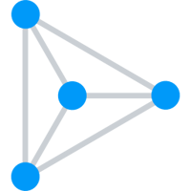



Hi, I’m Deepansh!
I tinker at Dimwit Labs: a one-person software lab.
I also currently
work at Appsilon as an Innovation Engineer.
I will soon start with a
Previously, I was building
a Masterclass & Workshop at Athlyticz.
cool stuff at Viti Science (there was a talk about that at useR! too).
I am a proponent of open-source, a maker of PRs on random projects,
and the creator and maintainer of supabaseR.

Slide 3
SECTION 01
Exposition & Managing Expectations

Slide 4
We are not going to hate on Shiny
I have stretched Shiny to achieve incredible apps, including a SaaS, for the better part of the last decade.
🫶

Slide 5
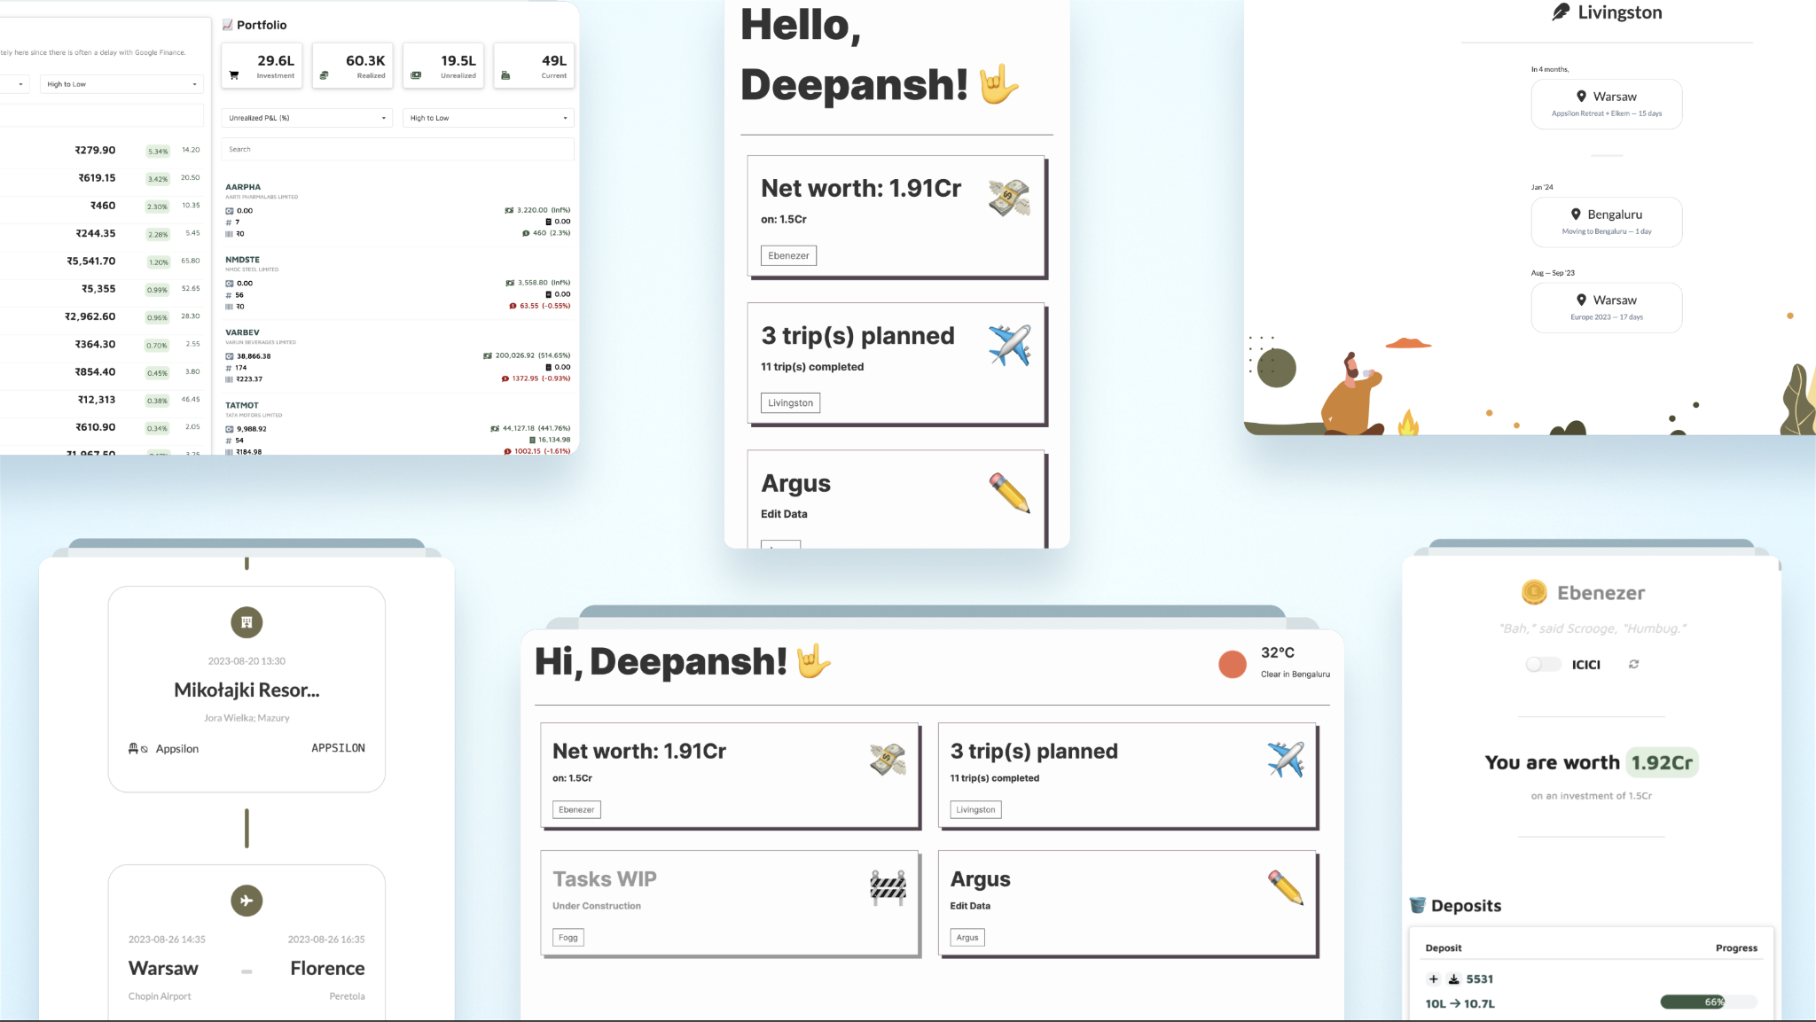
At useR! 2024, I shared the Hrafnagud project…

Slide 6
But needs tend to evolve
And while Shiny itself is wonderful, the challenges start propping up the more you cross into a systems-level territory

Slide 7
For instance…

Slide 8
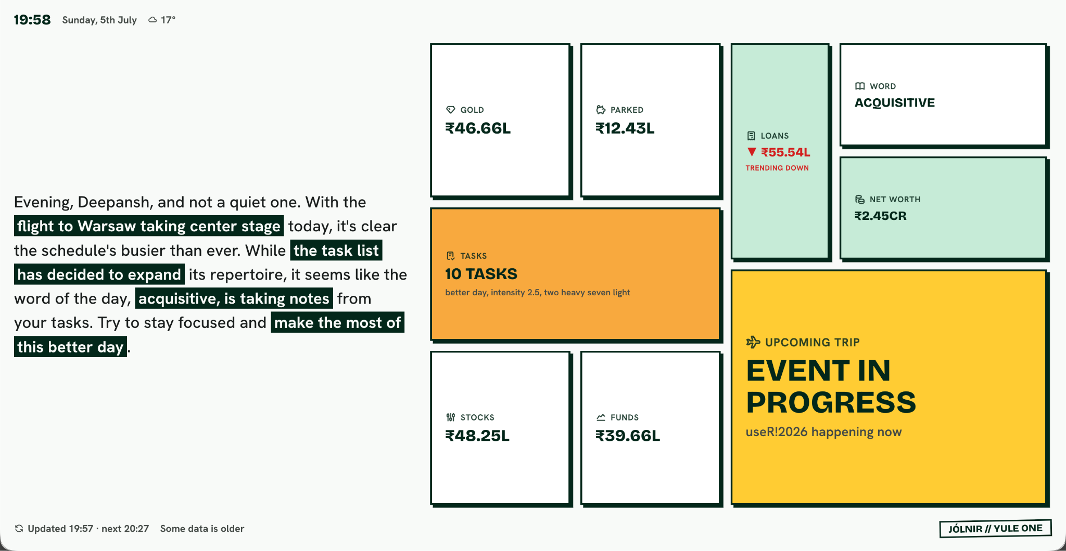
When you want a dynamic, AI-powered layout…

Slide 9

…or things that don’t look like a dashboard
And yes, that is the same app just working differently on mobile

Slide 10
The closer you get to a real web app…
…the harder it becomes to justify using Shiny

Slide 11
But, let’s contextualise that to real work…
After all, that is why we are all here
😉

Slide 12
SECTION 02
Why Even Build An API?

Slide 13
It’s Quite Simple, Really
I have a script
I make a Shiny app

Slide 14
Chris in the other team sees the app and wants a feature that lets him do the thing only he wants to do
Until it Isn’t…
Now, Kim in the other other team thinks the app is doing too much, is too slow, waits too much
Joanna now needs LLMs and chat support because that is the rage and who even uses dropdowns anymore.
I have a script
I make a Shiny app
🤯
Also you need to
now make it pretty and less box-y. useR! is coming up and “we cannot show this”
Now you have a bloated mess of an app and most of your time goes in the Shiny gymnastics of it all

Slide 15

How It Should Be
I have a script
I make an API

Slide 16
SECTION 03
What APIs Unlock…
Notes:
You already know this obviously. But now, let’s talk about what APIs unlock

Slide 17
But first, why do you like R?
Most likely answer:
tidyverse
…or a specific, highly-domain centric, incredible package that is available only in R
and is being maintained thanklessly by one person and institute for decades
Reminder: donate to open-source regularly

Slide 18
APIs unlock the world of web apps
Your analysis now stays in R, its native space, but is no longer bound to Shiny
🌐

Slide 19



There Is No One Tool For Web Apps…
and many more…

Slide 20



But We’ll Go With React For Now…

Slide 21
A Lot Of What You Know Is Translatable
Reactive Graph (observe, observeEvent, reactive) all translate really well to React’s model of state + hooks.
Independent modules are the bread and butter of React. Encapsulated UI, logic and often styling is precisely how React works.
Both have a unidirectional data flow, inputs are sent down the modules, outputs are raised up.

Slide 22
A Lot Of What You Know Is Translatable
All your packages that you already know (plotly, echarts, reactable) are JS packages and have React siblings with often more features.
Shiny already preps you well with understanding some JS, CSS and HTML. You’re not starting from scratch.
Local, Shared, Global states are translatable as well. React supports cross-module shared states.

Slide 23



And For What You Don’t Know…
…you can always ask your friends.

Slide 24
SECTION 04
Why Life Gets Easier
Notes:
You already know this obviously. But now, let’s talk about what APIs unlock

Slide 25
You stop fighting the tooling!
The modern web develops and works around these frameworks, you get better deployments, better packages, more diverse ways to express your data, and all of it mostly just works.

Slide 26
Performance is just… performant
Virtual DOM diffing and fine-grained re-renders instead of manually reasoning about which reactive expressions are re-firing and why your app got slow.

Slide 27
The npm ecosystem is enormous!
Need a date picker, a drag-and-drop list, a rich text editor? It already exists and has more alternatives than you can count.

Slide 28
And your data and analysis still stays in R!
While you still get to use dplyr, lubridate, janitor, and everything else you love about R.

Slide 29
SECTION 04
I Did It So You Don’t Have To

Slide 30
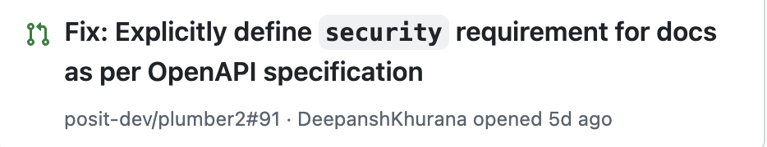
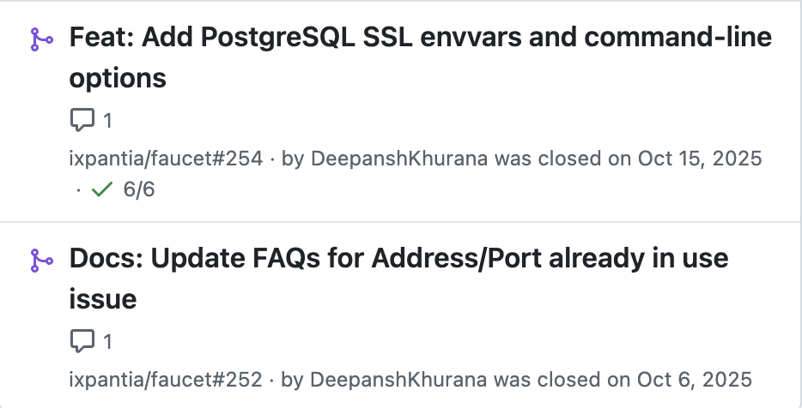
Two Thoughts On Scaling…
{plumber} is better than {plumber2}
old faithful
for now
ixpantia’s faucet scales {plumber}
built in rust
uses multi-core

Slide 31

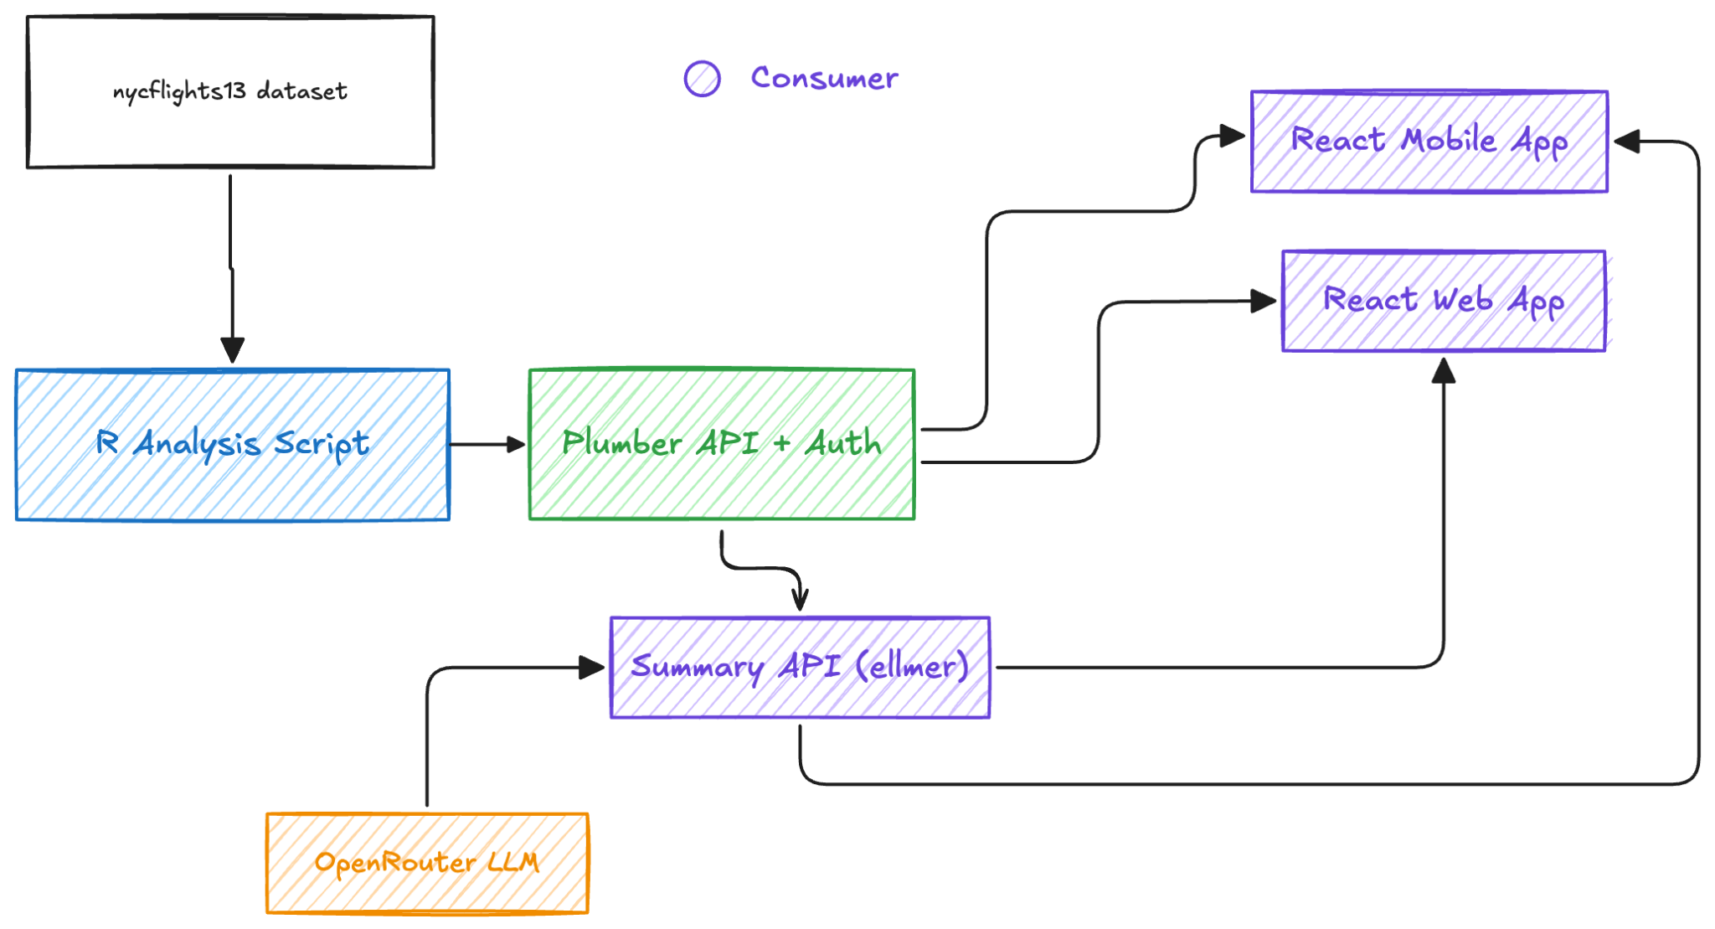

DeepanshKhurana/PlumberReactCookbook

Slide 32

A Note of Thanks
For the Diversity Scholarship and making it easier for me to be able to attend and speak today.

Slide 33
Questions?
Thank you for giving me twenty minutes of your life.
Deepansh Khurana
me [at] deepanshkhurana [dot] com | chief [at] dimwit [dot] me
LinkedIn →

