Slide 1

Computing ROC AUC Efficiently with R
Błażej Kochański
Gdańsk University of Technology
blazejkochanski.pl

Slide 2
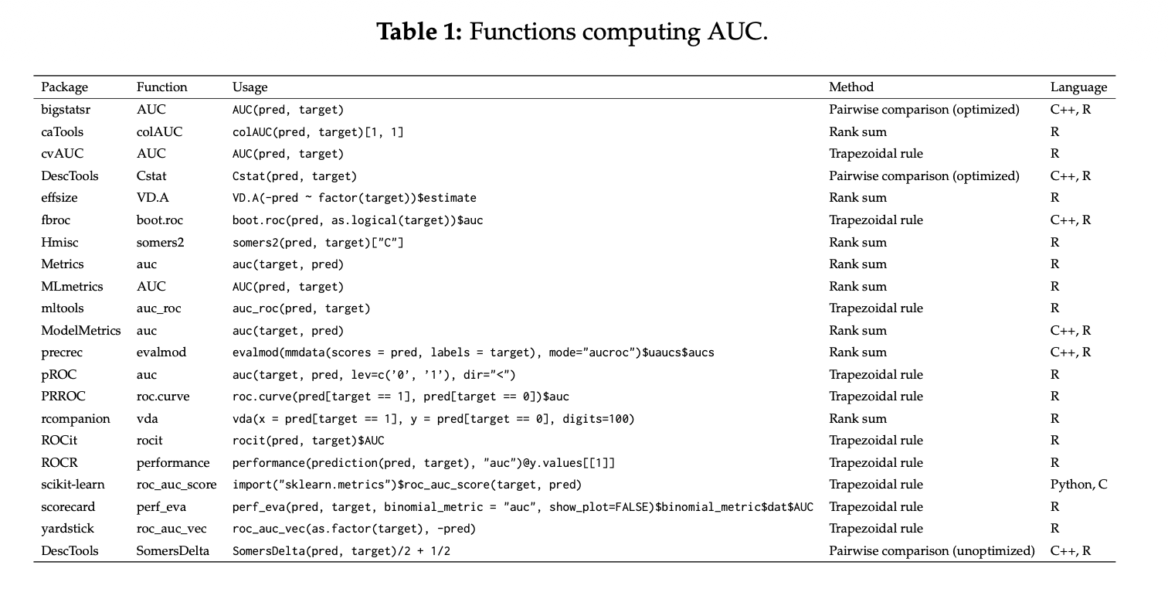
Many AUC implementations in R

Slide 3
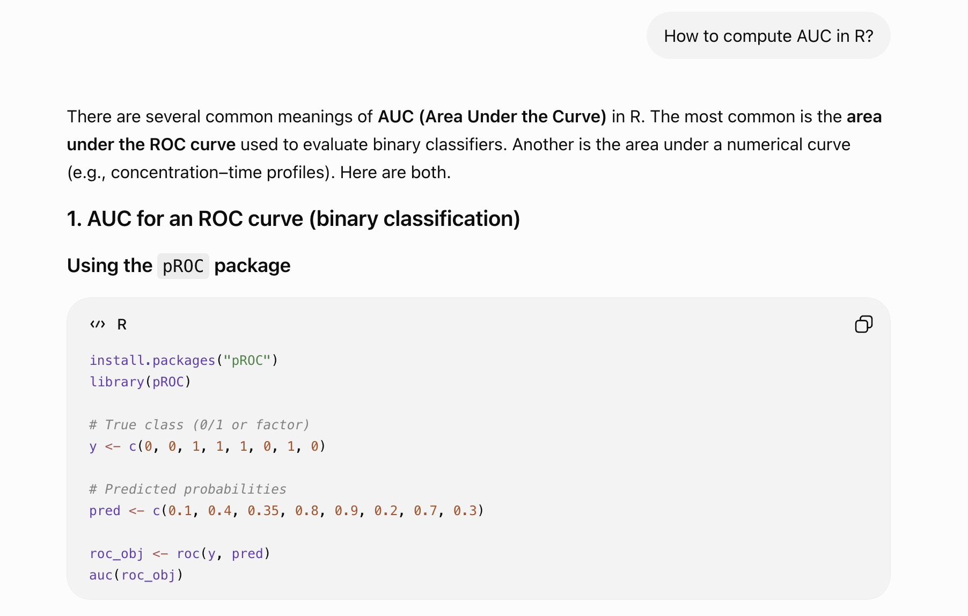

Slide 4
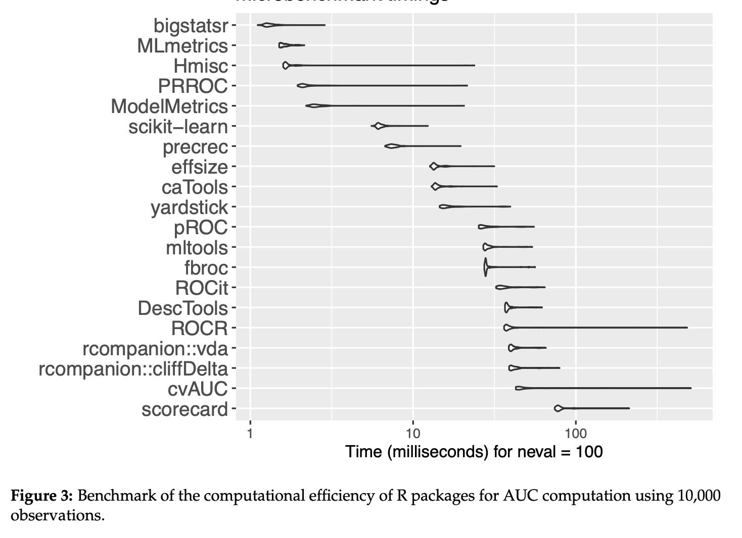
AUC implementations differ dramatically in speed

Slide 5
If you need to compute AUC repeatedly,
choose efficient algorithms or packages that implement them.

Slide 6
[ROC] AUC is a performance measure of a binary classifier

Slide 7
[ROC] AUC is a performance measure of a binary classifier
Binary target
(yes/no; good/bad; spam/ham; infected/healthy)

Slide 8
[ROC] AUC is a performance measure of a binary classifier
Binary target
(yes/no; good/bad; spam/ham; infected/healthy)
Ordinal or numeric „score”
(logit from regression model; credit scoring/rating; biomarker…)

Slide 9
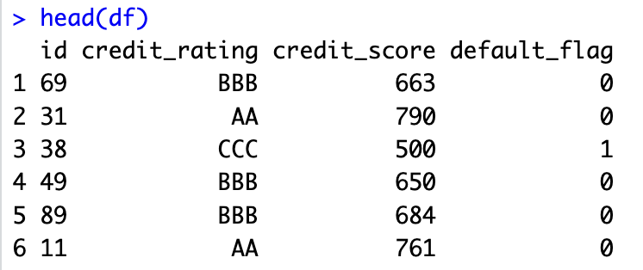
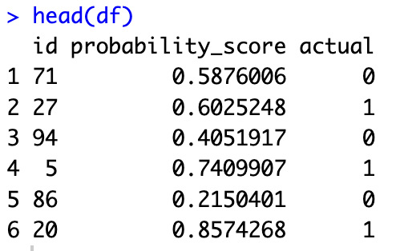
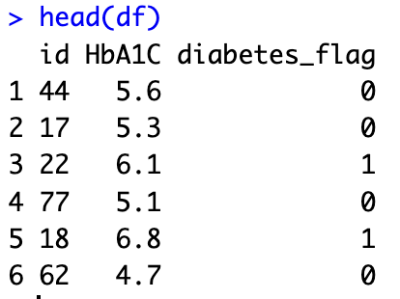

Slide 10
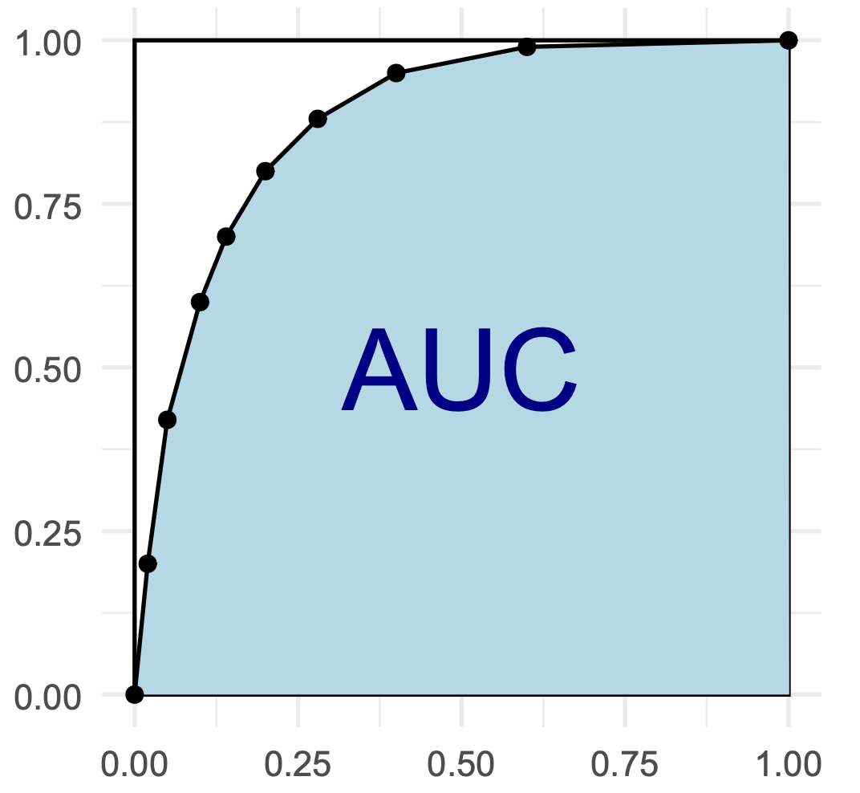
AUC = Area under the Curve

Slide 11
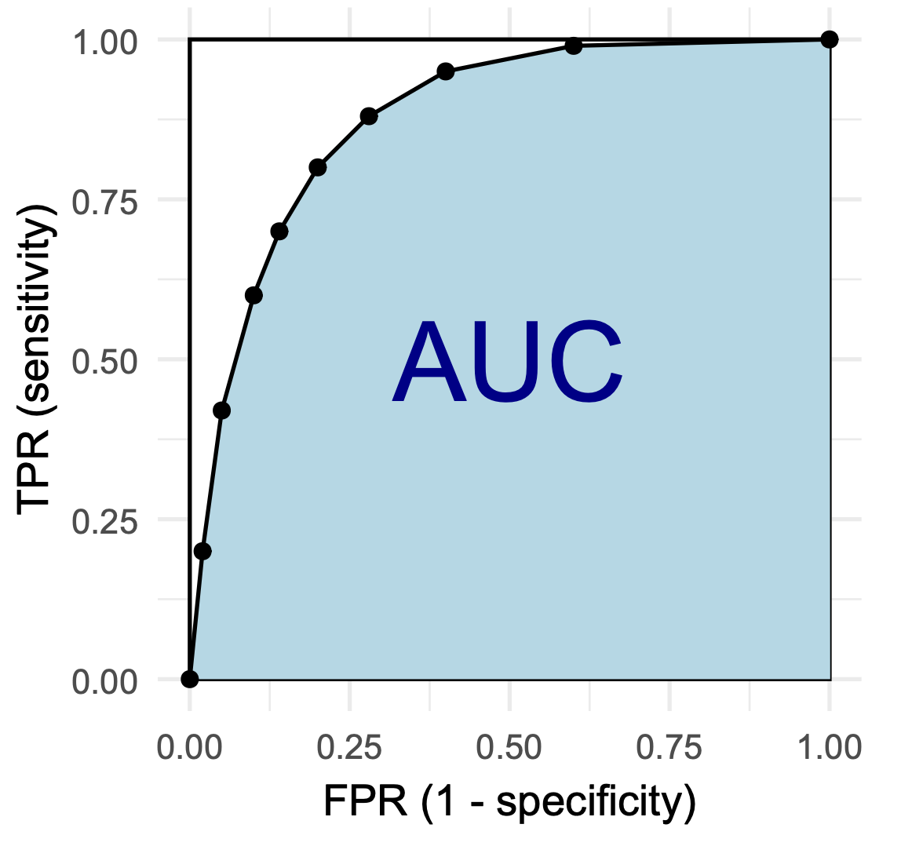
AUC = Area under the ROC Curve

Slide 12
AUC = Area under the ROC Curve
ROC = receiver operating characteristic Curve
plots True Positive Rate (TPR) against False Positive Rate (FPR)
for many (or all) score cut-off levels

Slide 13
AUC = Area under the ROC Curve
ROC = receiver operating characteristic Curve
plots sensitivity (or: recall)
against 1 minus specificity
for many (or all) score cut-off levels

Slide 14
AUC = Area under the ROC Curve
ROC = receiver operating characteristic Curve
plots probability of detection
against probability of false alarm
for many (or all) score cut-off levels

Slide 15
AUC = Area under the ROC Curve
ROC = receiver operating characteristic Curve
plots hit rate
against fall out
for many (or all) score cut-off levels

Slide 16
AUC is also known by several other names

Slide 17
AUC is also known by several other names
AUROC
ROC score
concordance statistic (C-statistic)
Vargha-Delaney A statistic
Brunner-Munzel test statistic
relative treatment effect
probability of superiority
measure of stochastic superiority (α)
[a version of] Common Language Effect Size

Slide 18
AUC is also known by several other names
probability of superiority
AUC = ℙ(score₁ > score₀) + ½ ℙ(score₁ = score₀)

Slide 19
AUC is also known by several other names
probability of superiority
AUC = ℙ(score₁ > score₀) + ½ ℙ(score₁ = score₀)
…if we randomly sample a pair of “0” and “1”.

Slide 20
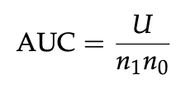
AUC is related to Mann-Whitney U statistic:

Slide 21
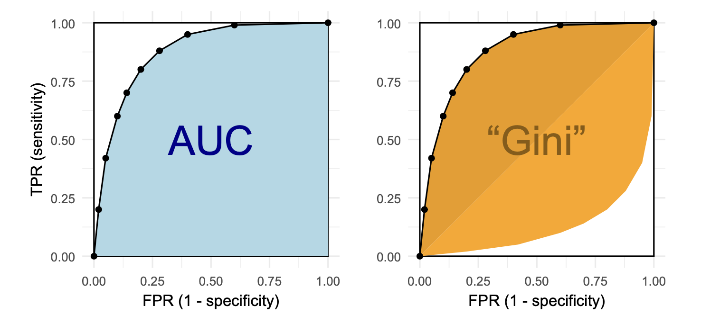


Slide 22
Perfect model AUC =1.00 Gini = 1.00
Not a bad model AUC = 0.80 Gini = 0.60
Useless model AUC = 0.50 Gini = 0.00
Flipped perfect model 0.00 -1.00
❓
✓

Slide 23
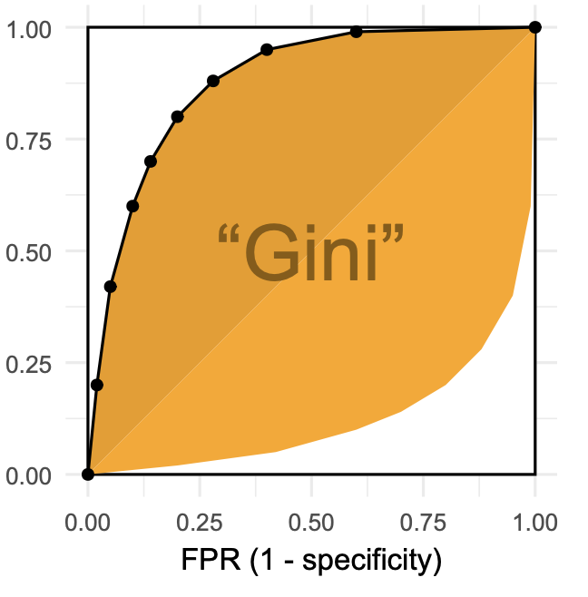

„Gini” is also known by several other names

Slide 24
„Gini” is also known by several other names
“pseudo-Gini”
ROC skill score (ROCSS)
Cliff’s delta
Accuracy Ratio (AR) based on Cumulative Accuracy Profile (CAP) curve
Glass rank-biserial correlation coefficient
[A special case of] Somers’ D statistic (where Y is binary)
Δ measure of stochastic superiority

Slide 25
Computing
AUC, AUROC, ROC score, concordance statistic, C-statistic, Vargha-Delaney A statistic, Brunner-Munzel test statistic, relative treatment effect, probability of superiority, measure of stochastic superiority (α), Common Language Effect Size, “pseudo-Gini”, ROC skill score (ROCSS), Cliff’s delta, Accuracy Ratio (AR) based on Cumulative Accuracy Profile (CAP) curve, Glass rank-biserial correlation coefficient, Somers’ D statistic and Δ measure of stochastic superiority
efficiently with R

Slide 26
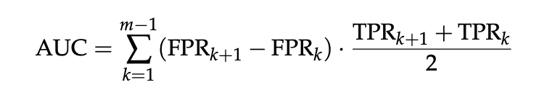
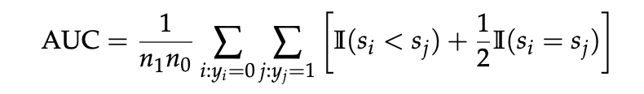
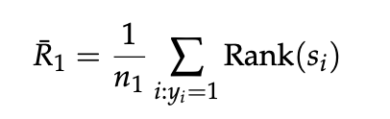

AUC calculation – three main approaches:
Trapezoidal integration
Pairwise comparison
Rank-based

Slide 29
Why do AUC implementations differ in efficiency?
extra computations
(other metrics,
confidence intervals, plots)
algorithm used
algorithm optimization
R vs C++

Slide 30
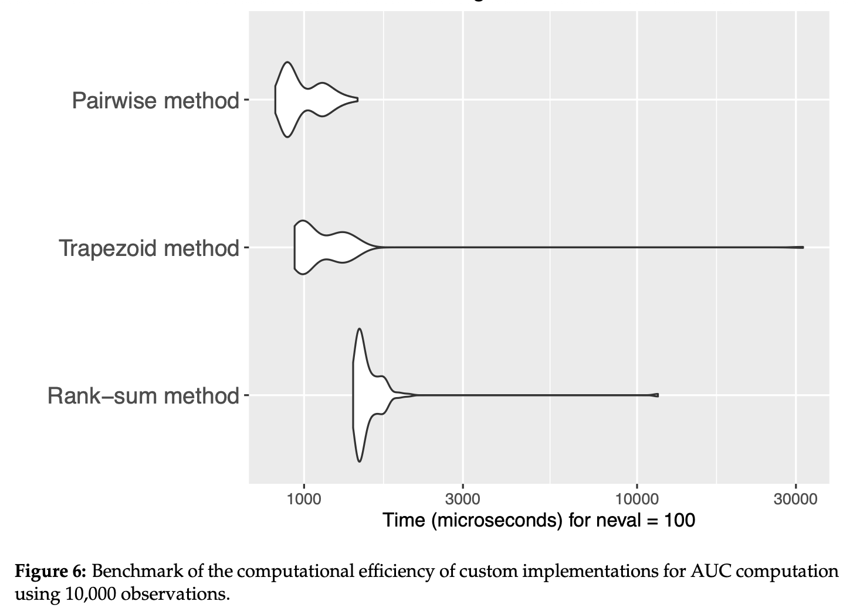
AUC algorithms – empirical speed assessment

Slide 31
Why does AUC computation speed matter?
Important where AUC is computed many times:
Bootstrap confidence intervals and permutation tests
Direct AUC optimization in machine learning
AUC-based feature selection and feature importance
Large-scale banking market simulations

Slide 32
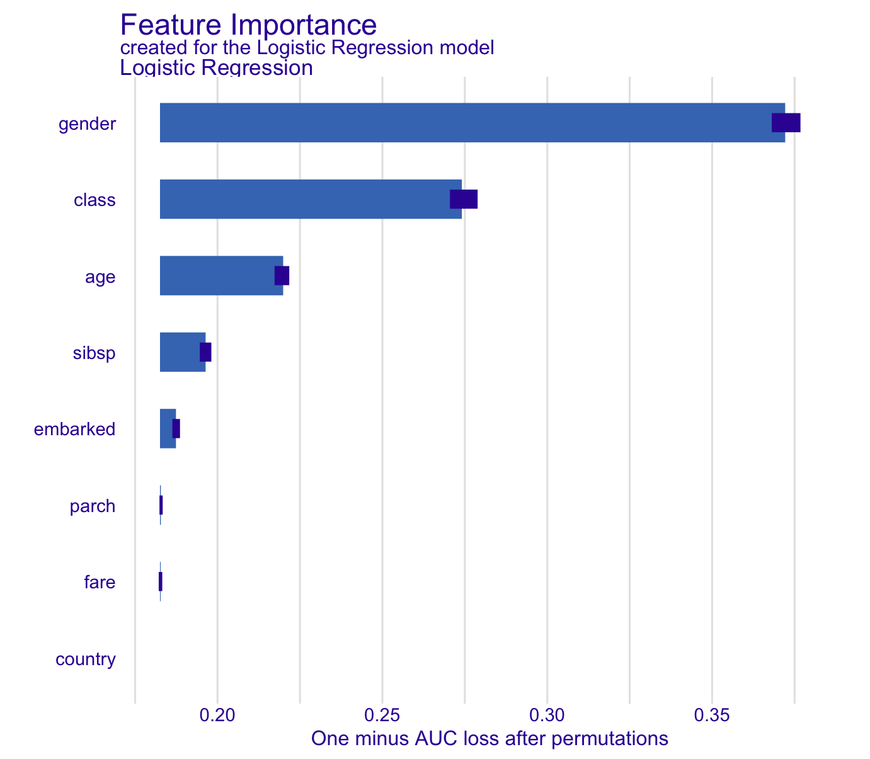
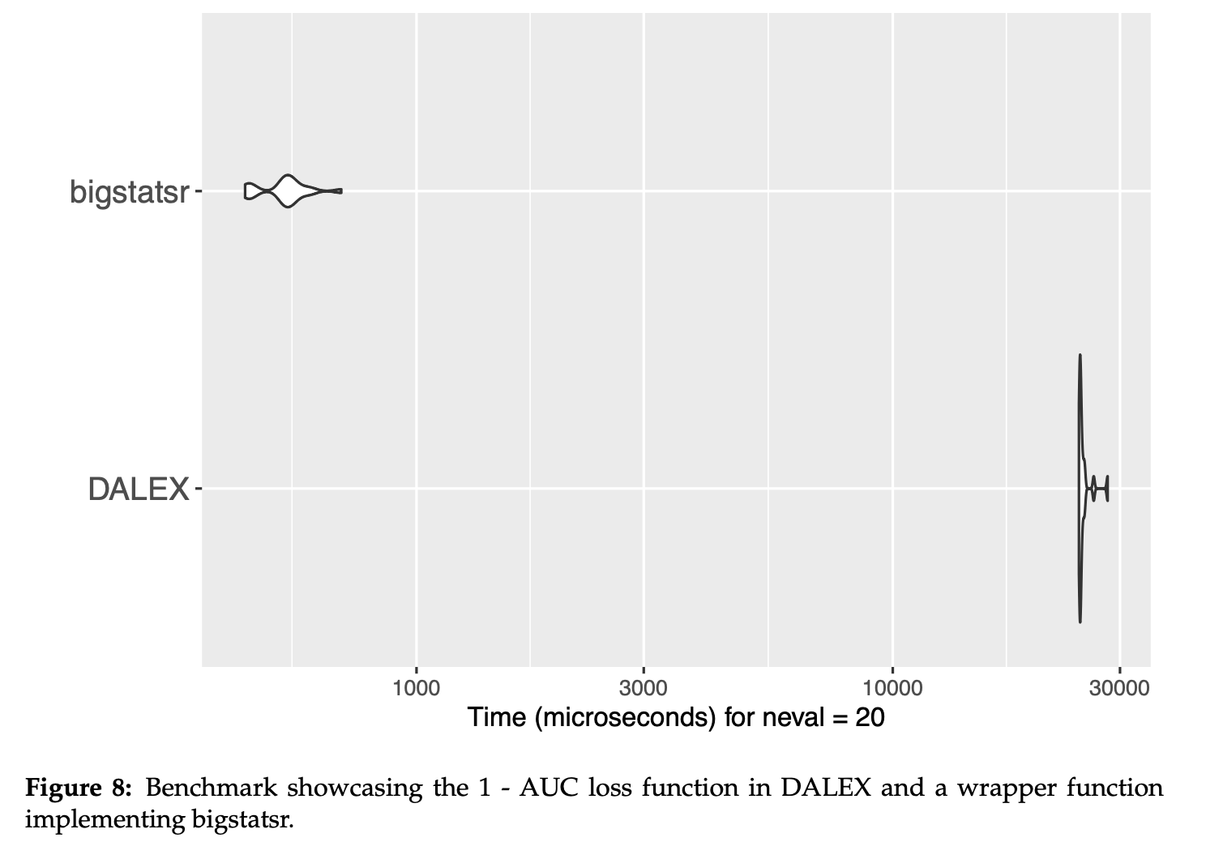
Case study
Optimized AUC computation in the DALEX explainability framework.
Setup: Logistic regression on the Titanic dataset (7 predictors); Permutation Variable Importance with 50 permutations per variable (350 AUC calculations).
Optimization: Replaced the default 1 − AUC loss function with a bigstatsr-based implementation.
Performance: ~0.026 s faster per AUC calculation, saving about 9–11 s per importance plot.
Result: 75% reduction in median computation time, demonstrating the value of fast AUC implementations in repetitive evaluation tasks.

Slide 33
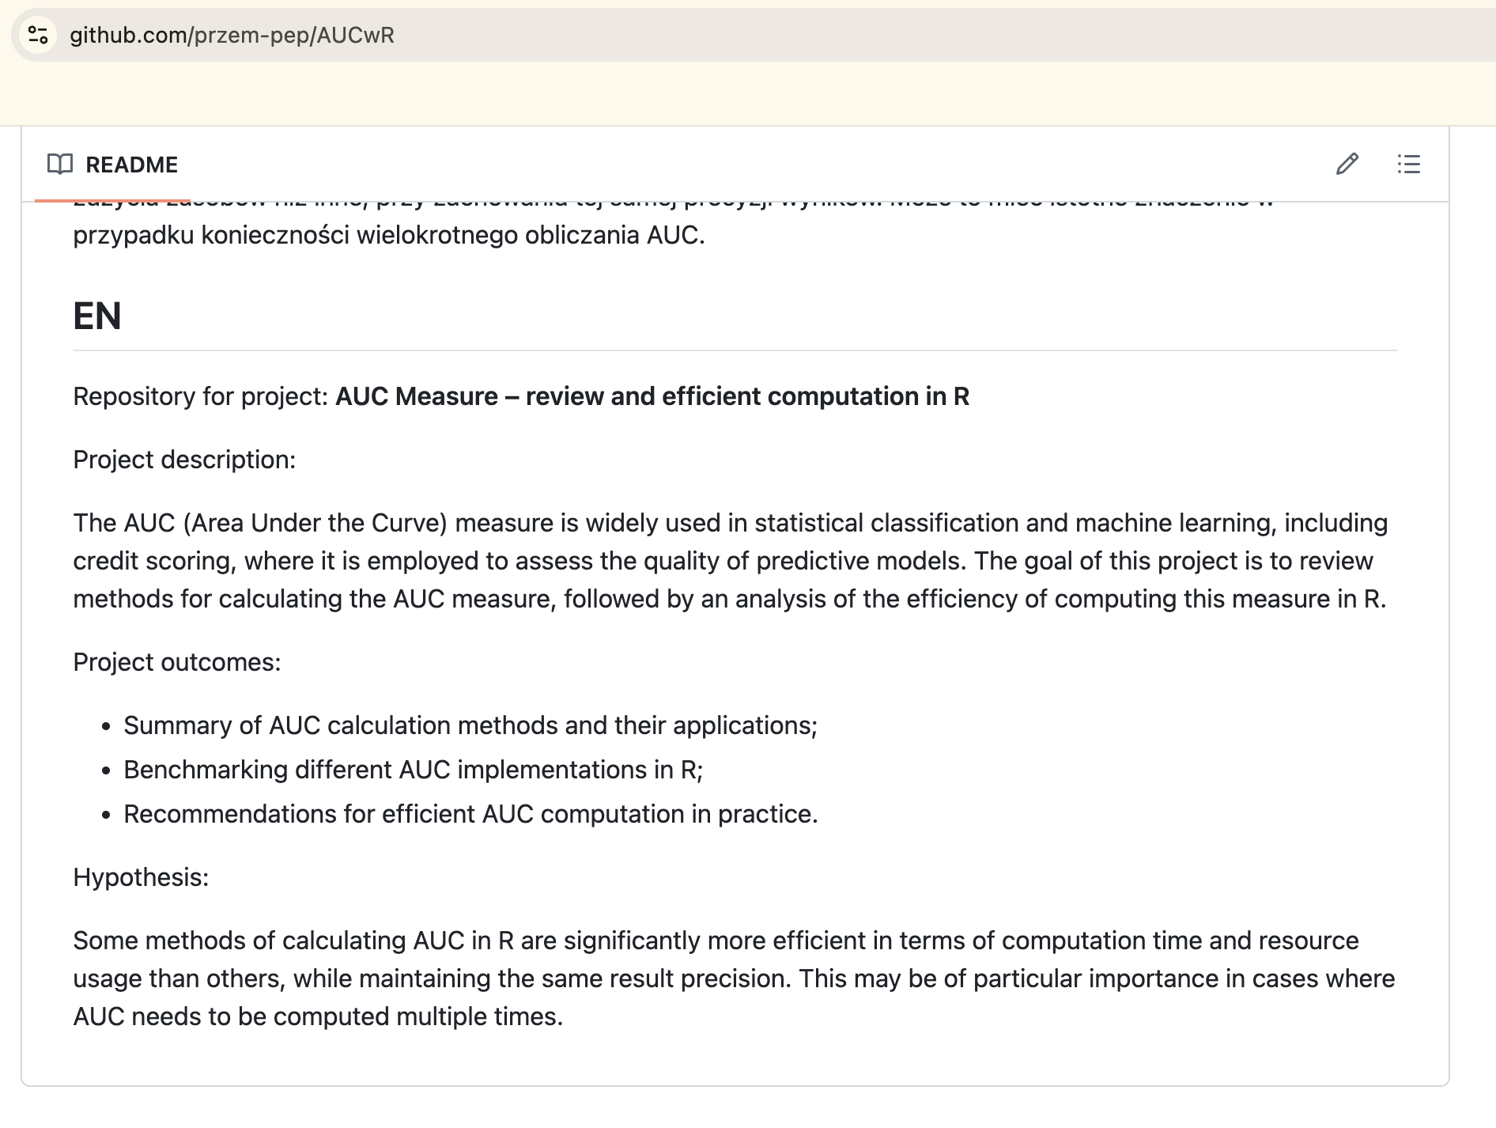

https://github.com/przem-pep/AUCwR

Slide 34
Computing
AUC, AUROC, ROC score, concordance statistic, C-statistic, Vargha-Delaney A statistic, Brunner-Munzel test statistic, relative treatment effect, probability of superiority, measure of stochastic superiority (α), Common Language Effect Size, “pseudo-Gini”, ROC skill score (ROCSS), Cliff’s delta, Accuracy Ratio (AR) based on Cumulative Accuracy Profile (CAP) curve, Glass rank-biserial correlation coefficient, Somers’ D statistic and Δ measure of stochastic superiority
efficiently with R

