Slide 1
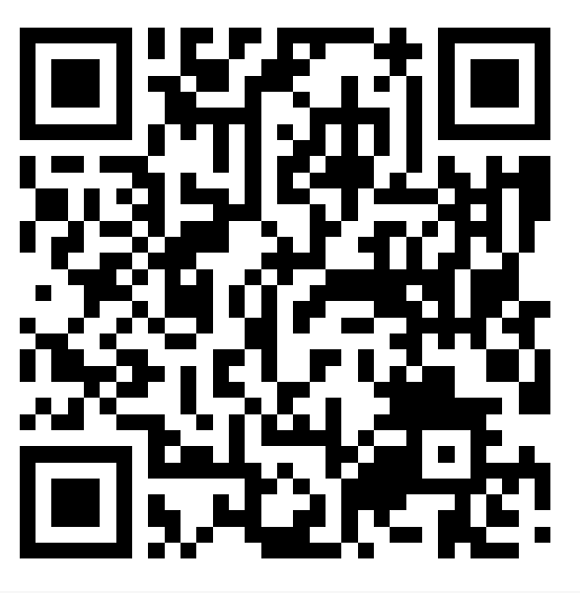
useR! Conference · Lightning Talk
SweEpiAI
Natural language exploration of Swedish epidemiological data.
R Shiny app with integrated LLMs.
Máté Szilcz, PhD
Viti Science
mate.szilcz@vitiscience.se

Slide 2
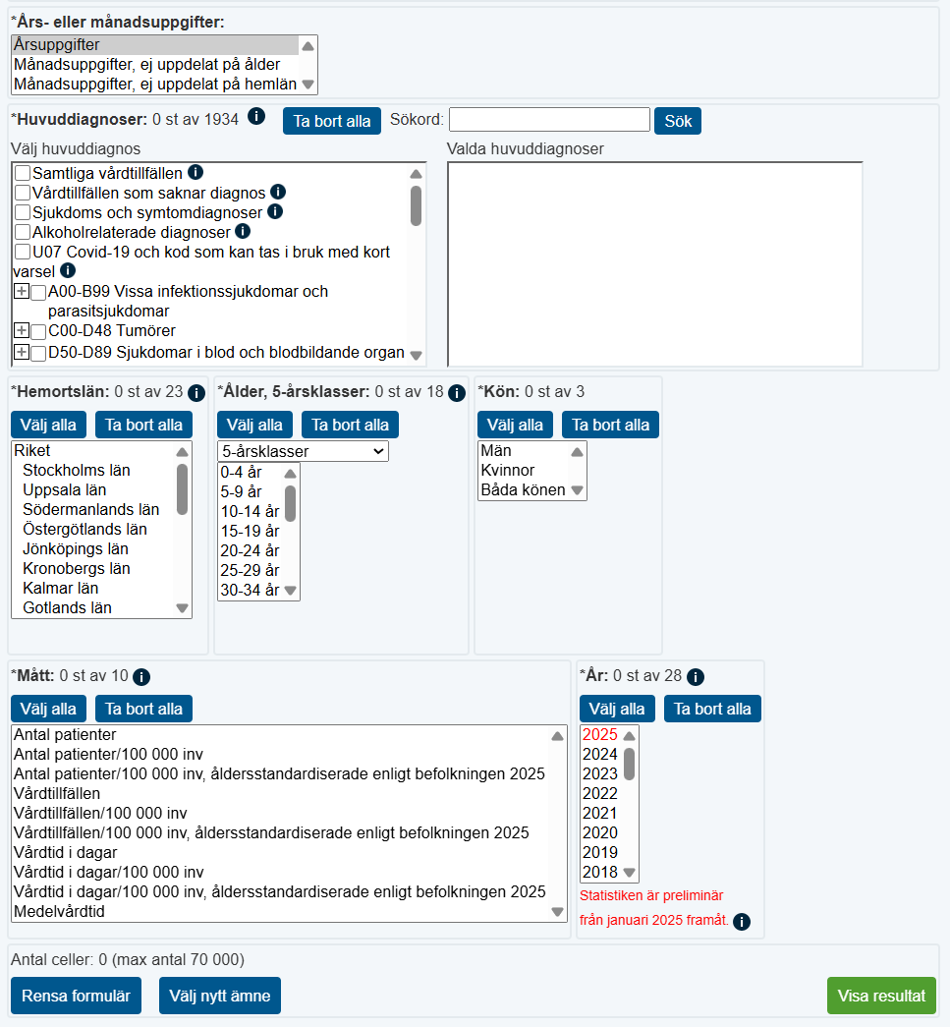
THE PROBLEM
Sweden has Rich open data but with Clunky access
Hidden behind ugly user interface
Querying it programmatically demands technical skill
You must know the variable codes
Non-technical users are shut out
What if you could simply ask:
“How many patients with lung cancer were recorded in the last five years?”

Slide 3
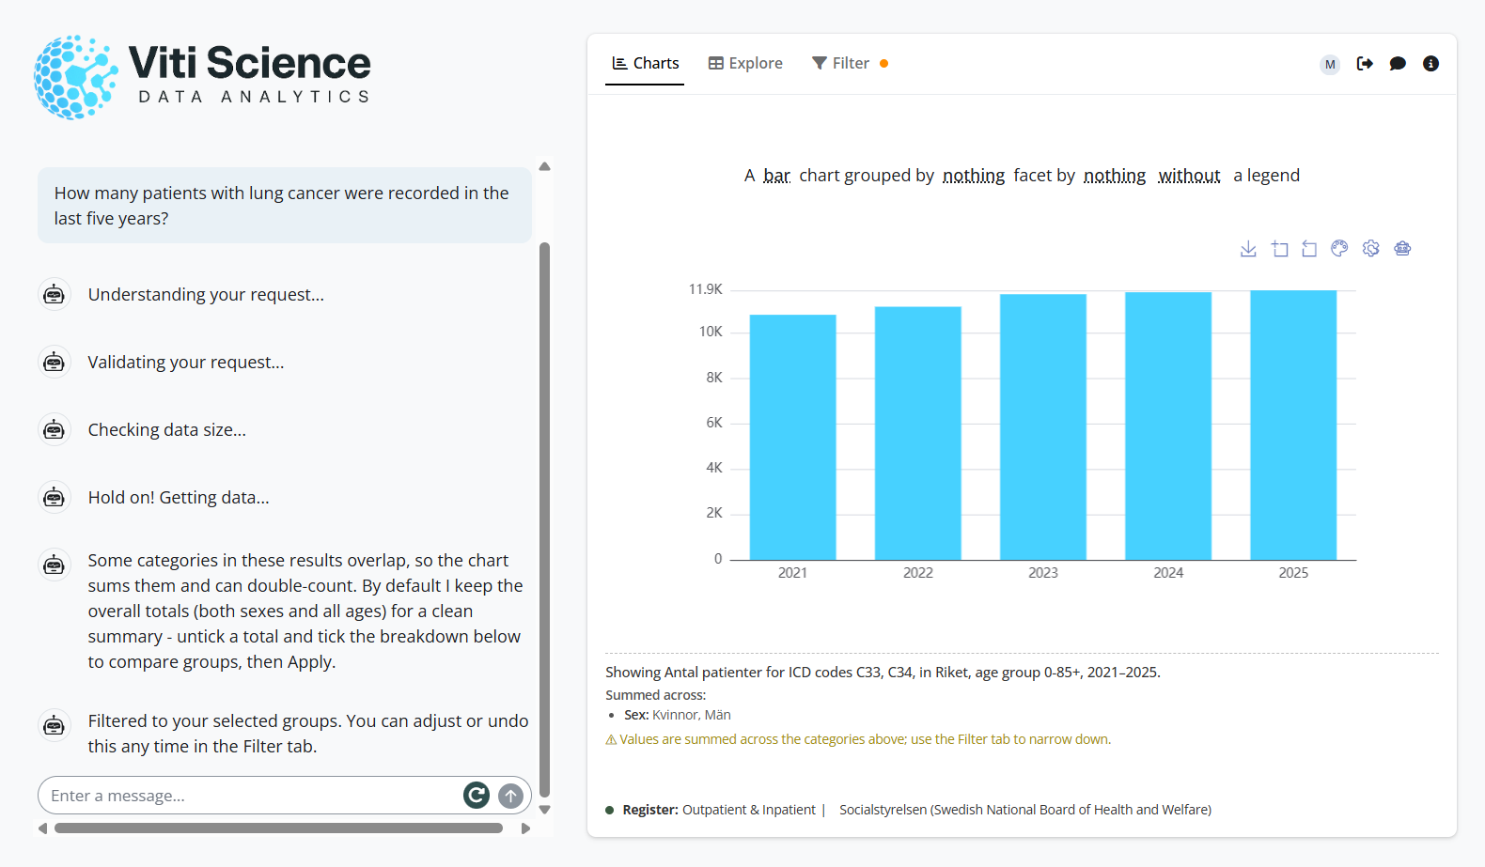

Slide 5
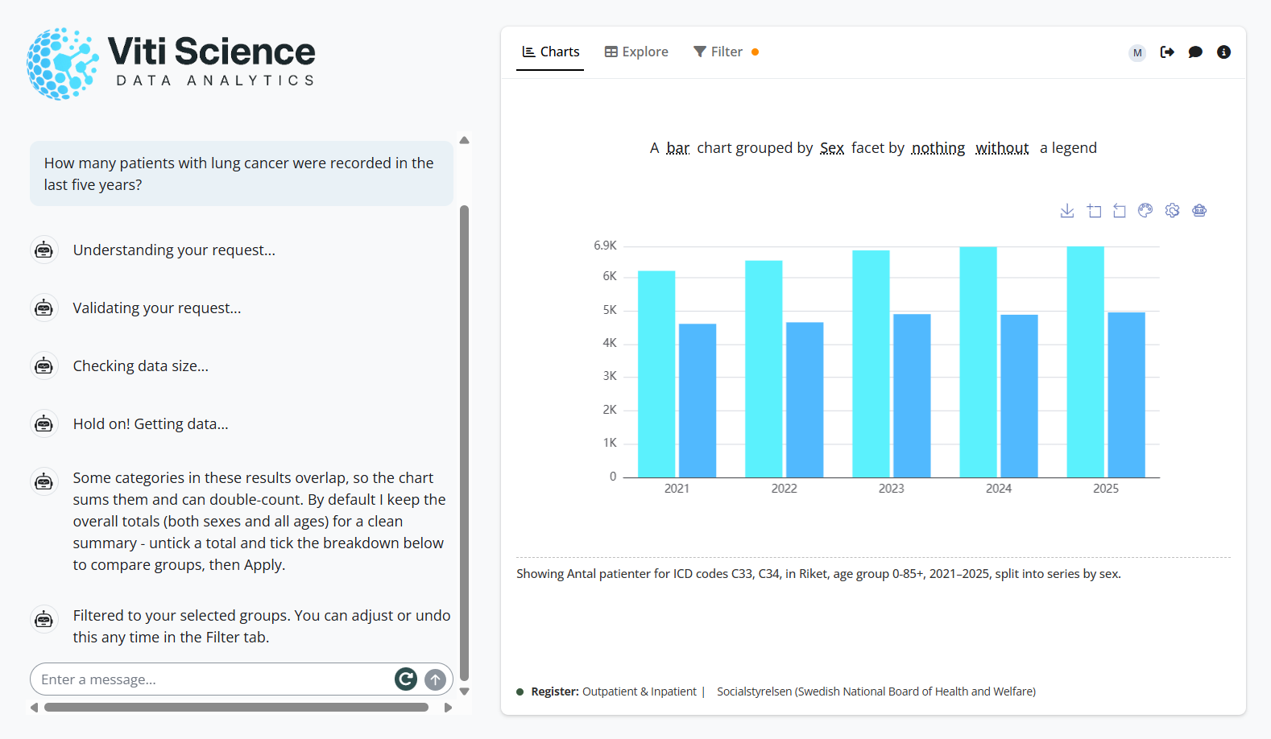

Slide 6
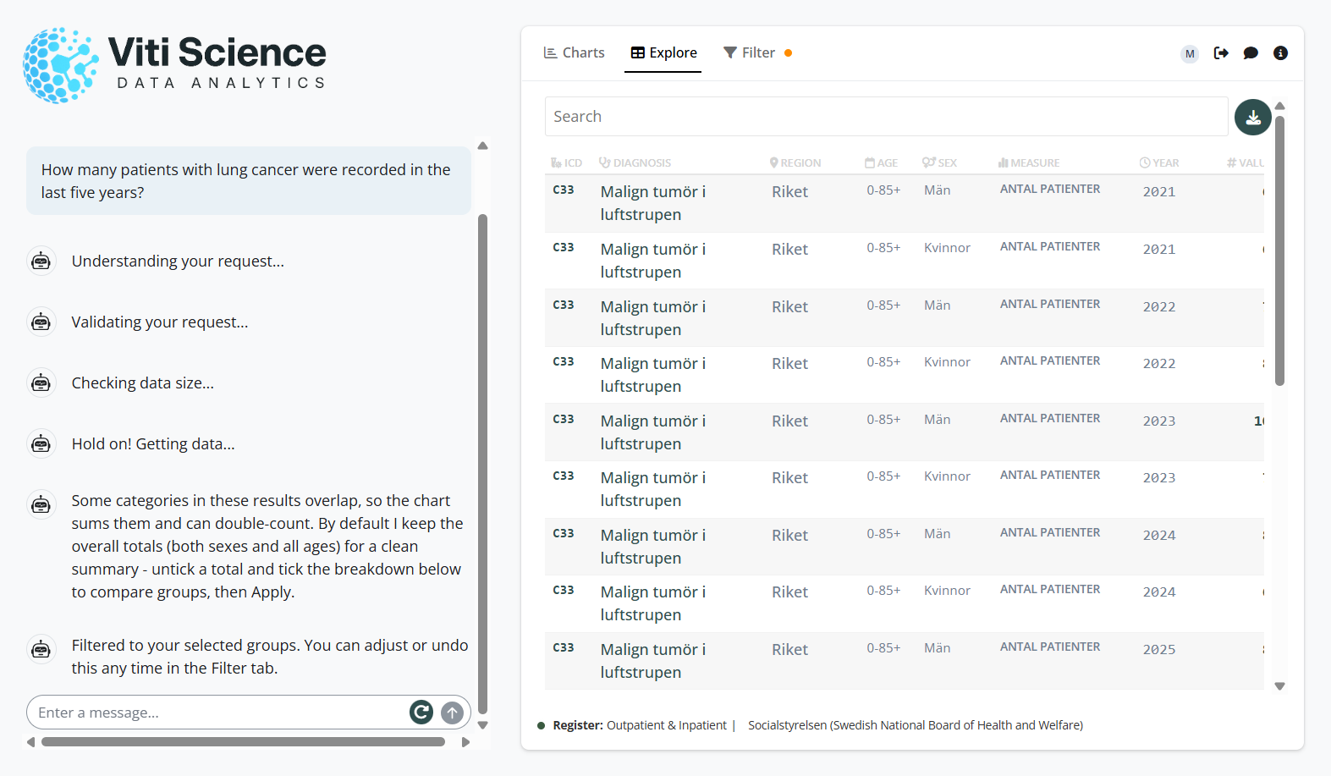

Slide 7
UNDER THE HOOD
FROM QUESTION TO ANSWER
STACK
1
Guardrails
classify intent: data query, reference or chat
Framework & UI
Rhino · box · bslib · shinychat
2
Query breakdown
parse to JSON: diagnosis, region, age, sex, time
LLM
ellmer · GPT-5.1
3
Metadata lookup
local metadata.rds, deterministic
Async
coro · promises · ExtendedTask
4
URI creation
build API calls
5
URI validation
second LLM pass catches hallucinated IDs
Visualisation
echarts4r · reactable
6
Data fetching
parallel pagination with furrr and future
Ops & deployment
Auth0 · Supabase · Posit Connect Cloud
7
Response
charts, tables and a streamed summary

Slide 8

LLM integration in R Shiny can democratize access to public health data without compromising data fidelity.
TAKE-HOME MESSAGE
What's next
The Prescribed Drug Register and further national registers
Richer query capabilities shaped by user feedback
Máté Szilcz · mate.szilcz@vitiscience.se · www.vitiscience.se

