Slide 1
rxsim: Reducing friction in simulating clinical trials using R6 programming.
  Dr. Matthew Valko, Dr. Saumil Shah
  2026-07-07| USER 2026!
  Department of Biostatistics and Data Science, Boehringer Ingelheim Pharma GmbH & Co. KG

Slide 2




Rationale
There are multitude of trial designs in healthcare.
These designs also have multiple parameter that you can change i.e structure, population, timing.
Coding these from scratch is unwieldy.
We used R6 abstraction to make clinical simulations accessible.

Slide 3
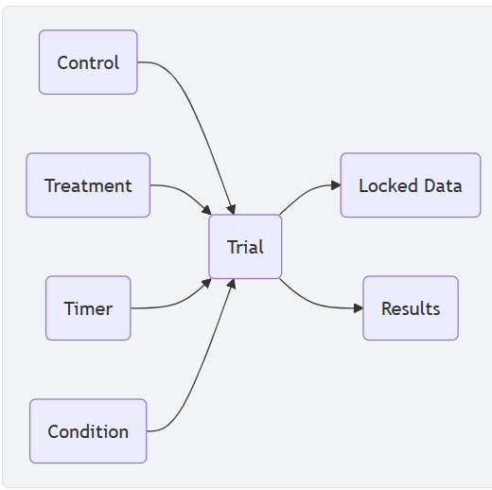
Architecture of Classes
*
*
Trial class: the class that ensures that the other classes are wired correctly.
* Control and treatment are examples of the population class

Slide 4




Population Class: Tracking of Relevant Patient Level Information.
Complete
Enrollment
Dropped
Relevant subject data

Slide 5

Timer Class: Stores Schedule of Events
Operational time
Calendar time

Slide 6

Condition Class: Do what, and when?
What | When
Add arm | At 26 weeks
Terminate study | If a threshold is not met
Analyze patient data | 50% enrollment

Slide 7
Summaries of Simulation Output
Output:
  Locked data for post-hoc analyses
  Results as specified by the user.

Slide 8



Benefits
Fewer lines of code
Ability to change designs at low-level parameters and structure.
Cleaner syntax for reproducibility

Slide 9
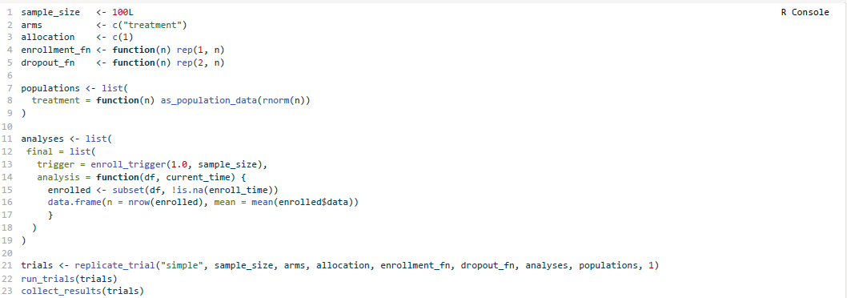
One arm. One analysis. Final look at Full Enrollment.

Slide 10
Acknowledgements
Mitch Thomann, PhD
Colin Longhurst, PhD
Lisa Neums, PhD
Dooti Roy, PhD
Ming Yang, PhD
Brooklyn Hollimon
Our current user base at Boehringer Ingelheim and beyond

Slide 11

Where to go

Slide 12
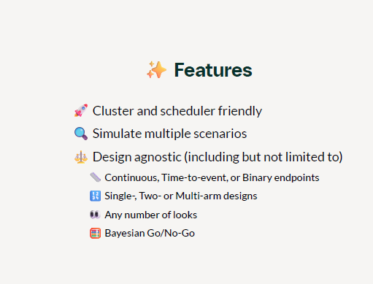
Additional Features

Slide 13
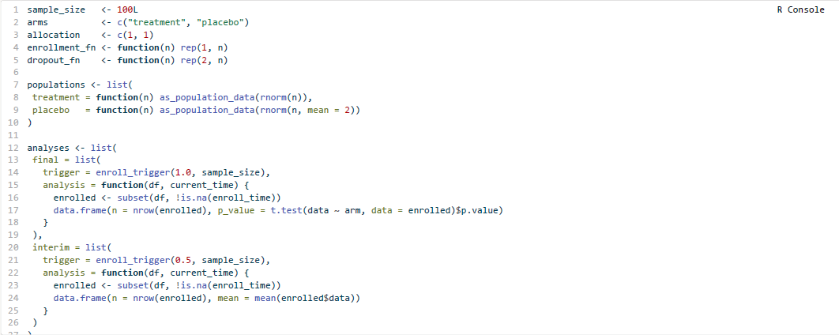
Two arms. One analysis. Two Looks. Only a Handful Lines More Code

