Slide 1

Ensemble Models for missing multi-omics data
Jagoda Głowacka-Walas
useR! 2026

Slide 2
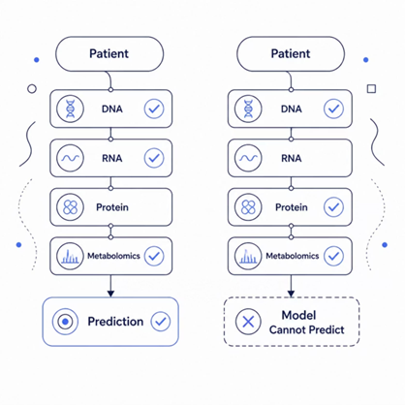



Research Goal
Why Multi-Omics Matters
Why Single Models Fail
Multi-omics data offer a unique opportunity to build accurate and interpretable predictive models by combining complementary biological signals.
A single predictive model often depends on one fixed set of variables. If even one required measurement is missing, the model may no longer produce a prediction.
The Challenge
Goal
In real studies, datasets are rarely complete. Some omics layers may be unavailable because of technical failures, cost, or sample quality issues.
Select a small but diverse group of models that can complement one another when some variables are missing.
Approach
Core Research Question
Instead of relying on one complex model, this work starts from collection of small logistic regression models developed in previous study.
Can several small models work together so that prediction remains possible even when some data are missing?
Large Model ❌
Requires all omics layers — fails when data are missing
Many Small Models ✅
Each uses a different subset of omics features
Voting → Prediction
Models collaborate to reach a final answer

Slide 3
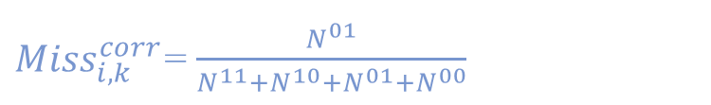

Model Selection Strategies
(Corrected) Miss Metric
Measures how well two models complement each other when data are missing
${Miss}_{i,k}^{corr}$= $\frac{N^{01}}{N^{11}+N^{10}+N^{01}+N^{00}}$
Static Selection
One fixed, diverse team of classifiers for all new cases
N^{11}: both predict , N^{00}: both missing
N^{01}, N^{10}: only one predicts
Dynamic Selection
Combined Score Formula
Model score = prediction quality + diversity
Different team chosen for every new observation based on available data
$S_{i}^{ }$= $λ∙A_{i}^{ norm}+\left(1 −λ\right){∙Miss}_{i,k}^{ norm}$
S_i — combined score for model i
\lambda — weight parameter (0–1), balancing prediction quality vs. Miss metric
A_i^{norm} — normalized quality metric of model i
Miss_{i,k}^{norm} — normalized Miss metric for model pair i, k

Slide 4
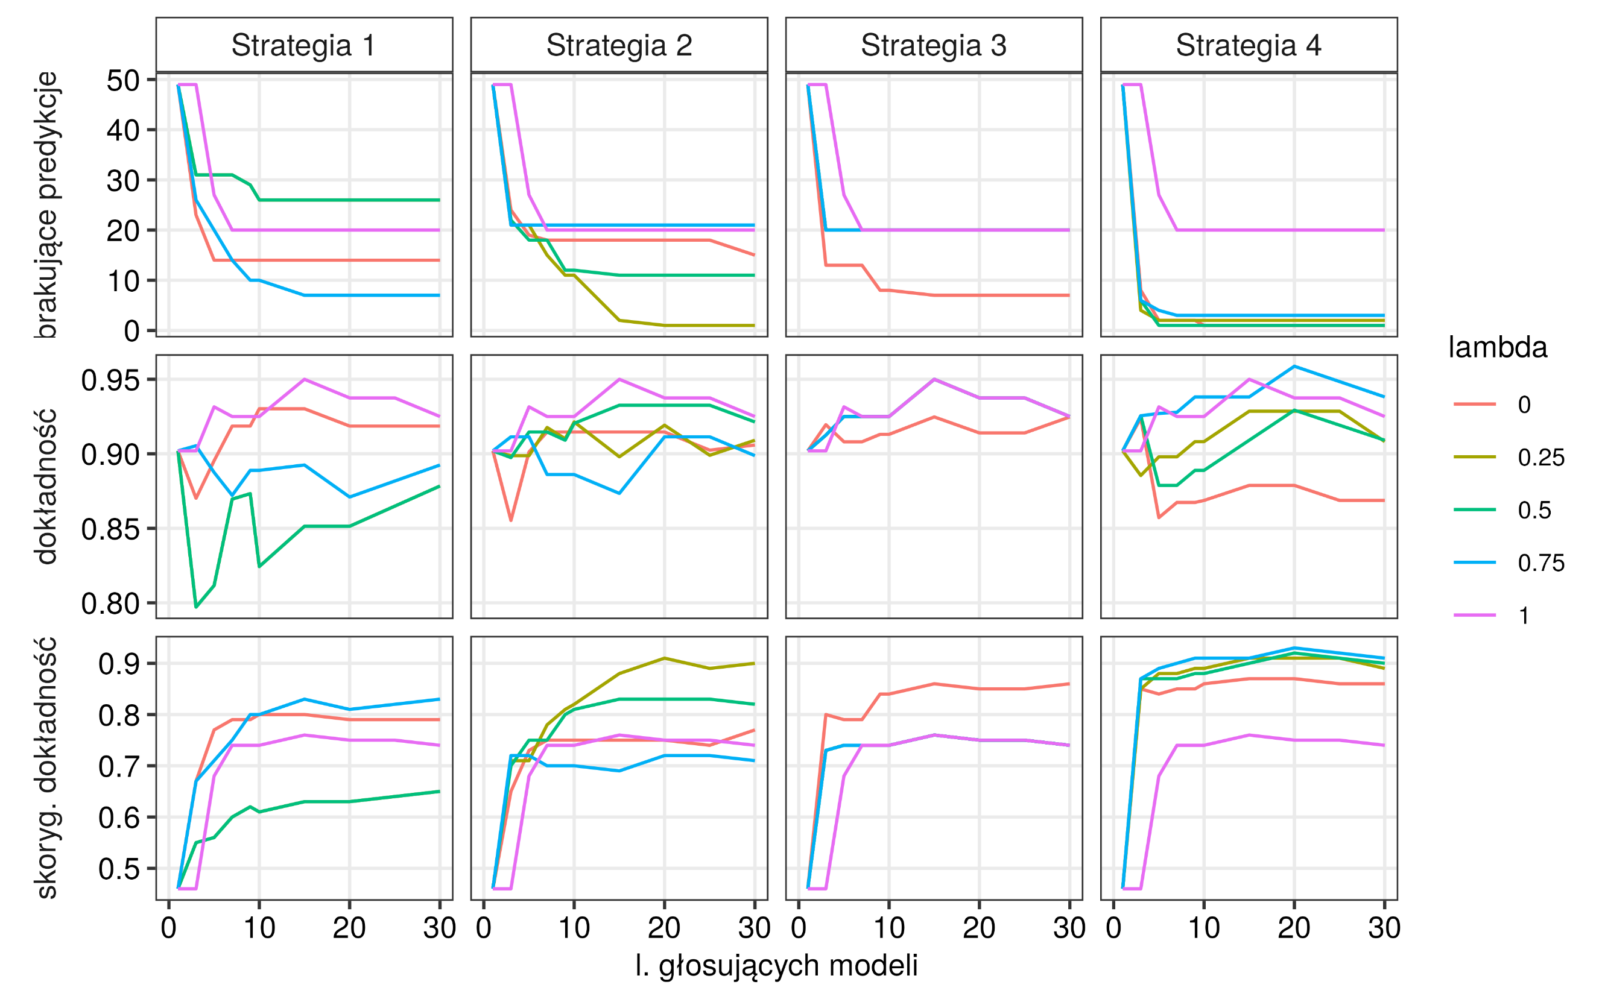
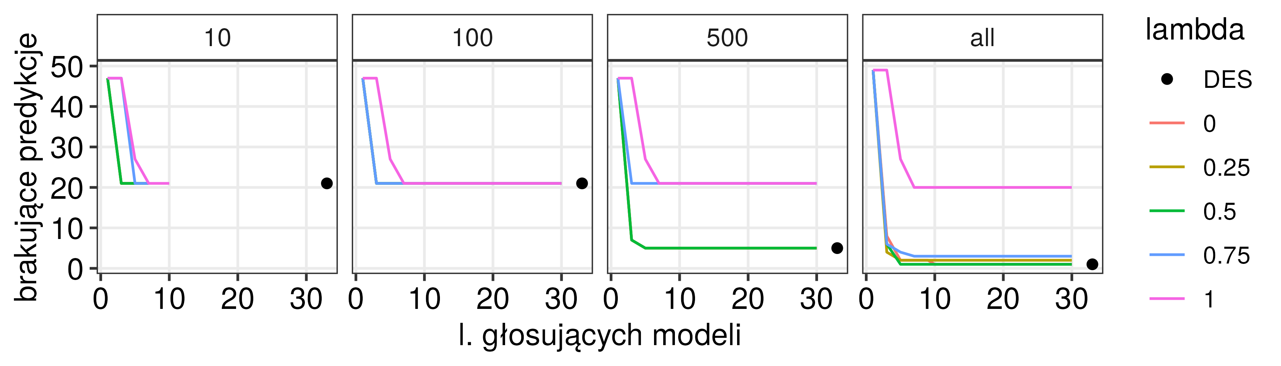
Strategy Comparison — Key Findings
Method | Predicted | Missed
XGBoost unrestricted (1625 trees) | 90 | 10
XGBoost restricted (21 trees) | 90 | 10
Static (λ = 0) | 89 | 10
Static (λ = 0.5) | 92 | 7
Static (λ = 1) | 74 | 6
Dynamic (all models) | 92 | 7
Ensemble learning results. Top: Static ensemble selection. The proposed Miss metric outperformed selection based solely on model quality, reducing the number of missing predictions while requiring only a small ensemble of models. Bottom: Comparison with dynamic ensemble selection. λ = 0 selects models based only on the Miss metric, whereas λ = 1 selects models based only on prediction quality.
Comparison of ensemble selection strategies with XGBoost. Both
static and dynamic outperformed XGBoost. Static selection used 10 models.

Slide 5
Summary
Static Selection
Dynamic Selection
XGBoost
High efficiency; fills gaps fast (3–5 models). Weakness: λ=1 degrades missing-data performance.
Per-case adaptation; high accuracy with full model pool. Weakness: very high complexity (hundreds of models).
Highest real-data accuracy (95%); handles missing values automatically. Weakness: low interpretability.
⭐ Best future direction: Static filtering + Dynamic adaptation — combining both approaches for the best balance of accuracy, robustness, and practical implementation.
Takeaway:
Missing data are unavoidable in multi-omics studies, but they should not prevent reliable prediction.
Selecting diverse and complementary models improves robustness without sacrificing interpretability.
The proposed methodology enables practical deployment of predictive models in real-world biomedical settings.
The complete implementation is available in the open-source R package playOmics.
github.com/JagGlo/playOmics_env
Notes:
Emphasize that ensemble learning is not just about accuracy but also about building more resilient and adaptable systems, crucial for real-world data challenges.
Briefly connect these takeaways to the upcoming sections on specific strategies and their results.

