Slide 1








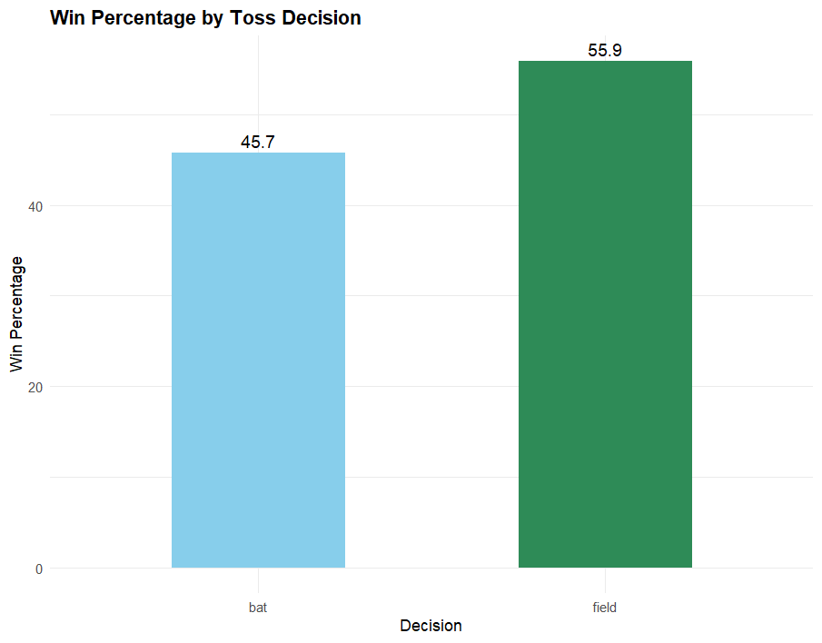




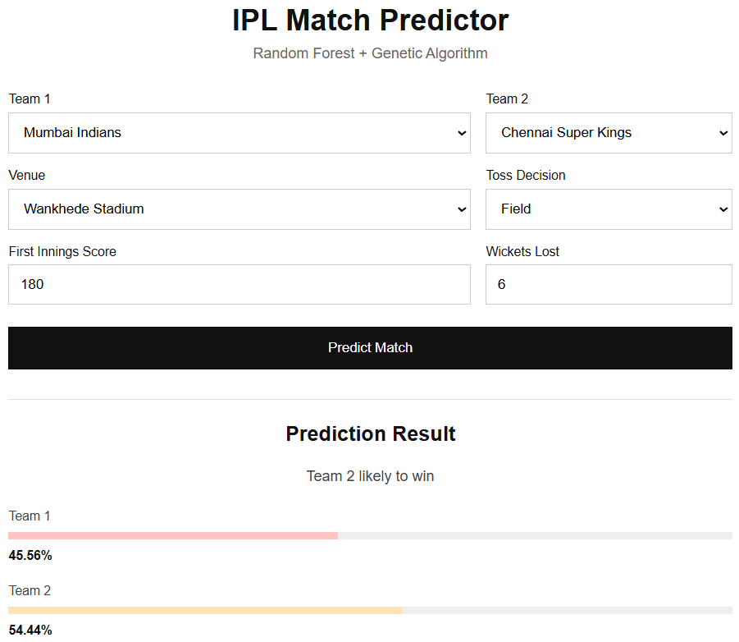






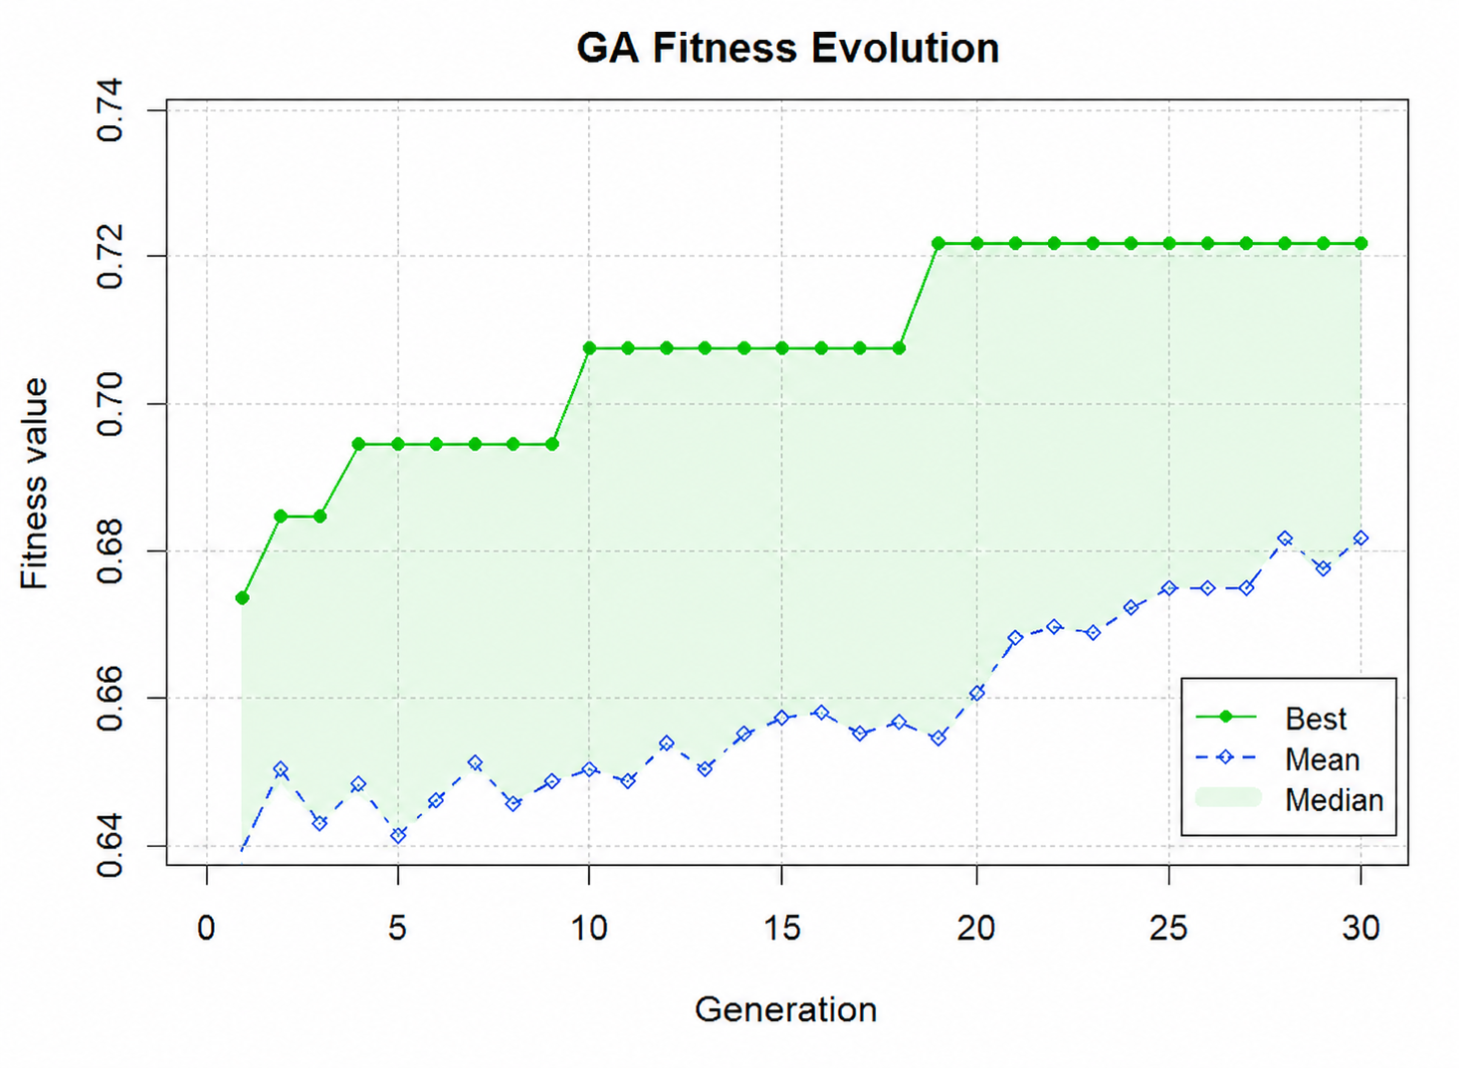
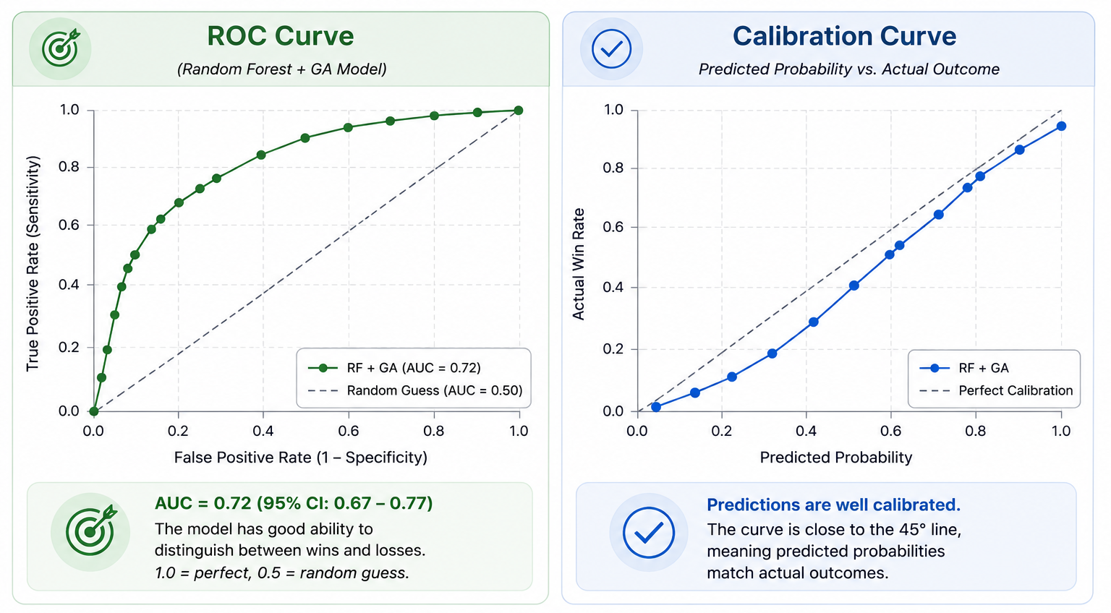


IPL Match Outcome Prediction
2026
Vihan Singh • Dr. Prince Sharma
Indian Institute of Information Technology (IIIT) Una — Department of Computer Science Engineering, Data Science
useR! 2026 - Poster
INTRODUCTION
RESULTS
The growing availability of structured sports data has created new opportunities for predictive modelling in cricket analytics. The IPL provides rich match-level and ball-by-ball records capturing team strength, venue behaviour and in-match momentum. This project builds a match outcome predictor by combining linked datasets through extensive feature engineering, a Random Forest classifier and Genetic Algorithm-based feature selection.
37 → 13
+6.3 pts
+5.2 pts
Features selected by GA
(64.9% reduction)
Accuracy improvement
64.3% → 70.6%
Precision improvement
60.0% → 65.5%
Three Linked Datasets
Model Performance Comparison
Matches
Ball-by-Ball
Teams
Model | Features | Accuracy | Precision | Recall | F1
Random Forest | 37 | 64.3% | 60.0% | 78.3% | 67.9%
RF + GA | 13 | 70.6% | 65.5% | 82.6% | 73.1%
Venue, teams, toss info,
winner & match metadata
Deliver level runs,
wickets & player actions
Team identifiers
and names
Hypothesis Testing: Does the Toss Decide the Match?
Confusion Matrix: Team 2 Win Prediction
Before modelling, we tested whether winning the coin toss predicts the match winner using a chi-square test of independence.
Random Forest (37 features)
Random Forest + GA (13 features)
1187
χ² = 1.281
p = 0.257
 | Actual Lose | Actual Win
Pred. Lose | 90 | 60
Pred. Win | 25 | 63
 | Actual Lose | Actual Win
Pred. Lose | 95 | 50
Pred. Win | 20 | 73
Matches Analysed
Test Statistic (df = 1)
Fail to Reject H₀ (α = 0.05)
Verdict: toss winners won only 52.0% of matches, statistically no better than a coin flip.
Although the coin flip itself doesn't decide the game, the decision to bat or field shows a real gap:
• Field first: 55.9% win rate
• Bat first: 45.7% win rate
Interestingly, the predictive model reached a similar conclusion. The toss decision was an important feature, while the toss winner was not
Correct predictions rose from 153 to 168 matches (out of 238); false negatives fell by 10, meaning fewer successful chases were missed.
Top Predictive Features (by importance)
1
team2_avg_chase_score
2
score_vs_team1_opponent_avg
3
team2_avg_score_at_venue
4
team1_avg_score_at_venue
5
score_pressure
6
team1_avg_defend_score
How a Prediction Is Made
Input Match
Build Features
RF + GA Model
Win Probability
MATERIALS & METHODS
Teams, venue, toss
decision, 1st-innings score
Engineer the 13
GA-selected features
Trained ranger
Random Forest scores it
Output split
e.g. 45.6% / 54.4%
Random Forest (Baseline)
Live Demo: Deployed Predictor
An ensemble of decision trees, each trained on a random subset of data and features. Every tree casts a vote on the outcome; the majority decision becomes the final prediction.
Model served live via a plumber REST API wrapping the trained ranger Random Forest model.
Users enter teams, venue, toss decision and first-innings score to get a live win-probability split between sides.
Win
Win
Lose
Win
Win
Majority Vote
WIN
Genetic Algorithm: Feature Selection
GA searches for the best subset of the 37 engineered features by evolving a population of candidate solutions toward higher predictive accuracy, generation after generation.
1
2
3
4
5
Initialize
Evaluate
Select
Crossover & Mutate
Repeat
1
1
0
1
0
0
1
1
0
1
1
0
Example chromosome: 1 = feature kept, 0 = removed
Best fitness rises sharply in early generations, then converges by ≈ generation 20.
Extending the run from 30 → 60 generations produced
No further improvement was observed, confirming the search had converged on the 13-feature subset.
CONCLUSIONS
Genetic Algorithm feature selection cut the feature space by 64.9% (37 → 13) while improving every evaluation metric
Accuracy rose from 64.3% to 70.6%, with the largest gains in recall (78.3% → 82.6%), fewer missed chases
Toss decision (bat/field), not toss outcome, proved to be the meaningful signal, validated via hypothesis testing before being engineered as a feature
The final 13-feature model is simpler, faster to train, and deployed as a live R-based prediction API
REFERENCES
Breiman, L. (2001). Random Forests. Machine Learning, 45(1), 5–32.
Goldberg, D. E. (1989). Genetic Algorithms in Search, Optimization and Machine Learning.
Cricsheet. IPL Match and Ball-by-Ball Dataset. https://cricsheet.org/
ACKNOWLEDGEMENTS
The author sincerely thanks Dr. Prince Sharma for his mentorship and guidance throughout this research. Appreciation is extended to the developers and maintainers of the R ecosystem, including dplyr, ranger, GA, ggplot2, and plumber, for providing the open-source tools used in this work. AI Agent assistance was used for implementation guidance, deployment support, API integration, and debugging
github.com/vihan015/ipl-predictor
Built in R: dplyr, ranger, GA, plumber
useR! 2026

