Slide 1
Enabling Data Exploration Through a Metadata Layer:
LLM Integration in cohortBuilder
Krystian Igras · Adam Foryś
useR!2026 · Lightning talk

Slide 2
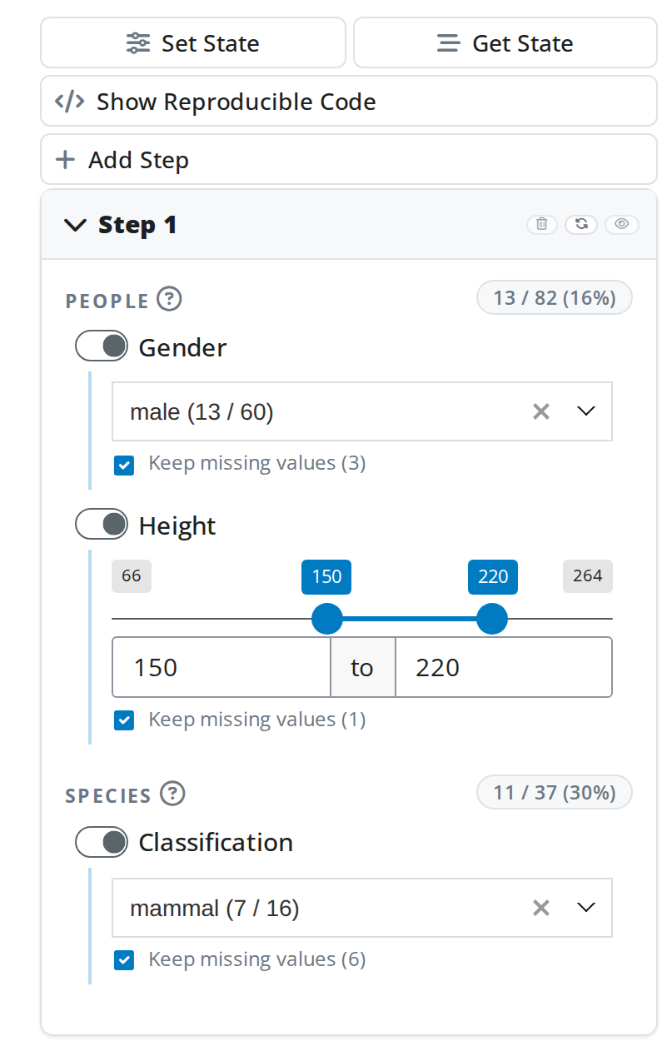
About (shiny)cohortBuilder
shinyCohortBuilder::gui(coh)
library(cohortBuilder)
src <- set_source(
tblist(people = starwars$people,species = starwars$species),
binding_keys = bind_keys(
bind_key(
update = data_key("people", "species_id"),
data_key("species", "id")
)
)
)
coh <- cohort(
src,
filter(
"discrete", dataset = "people", variable = "gender",
name = "Gender", value = "male"
),
filter(
"range", dataset = "people", variable = "height",
name = "Height", range = c(150, 220)
),
filter(
"discrete", dataset = "species", variable = "classification",
name = "Classification", value = "mammal"
)
) |>
run()

Slide 3

The problem
The starwars dataset: 4 tables (people, planets, species, films), 35 columns total.
With that many columns, it's tiresome to even explore them and decide which to filter on.
“…instead, I'll just ask.”

Slide 4
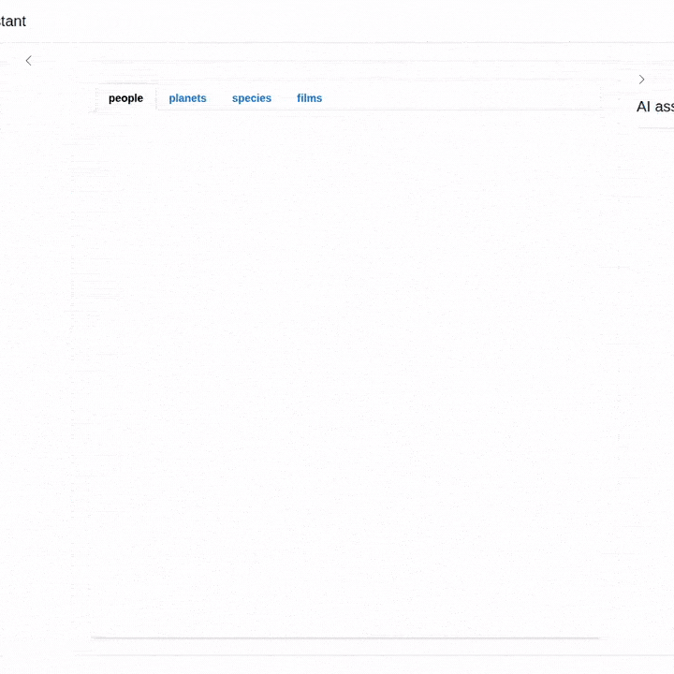
Demo — warm-up
“Keep only female characters.”
One natural-language request → one discrete filter applied on the people table.
The filter appears in the panel and the results refresh instantly.

Slide 5
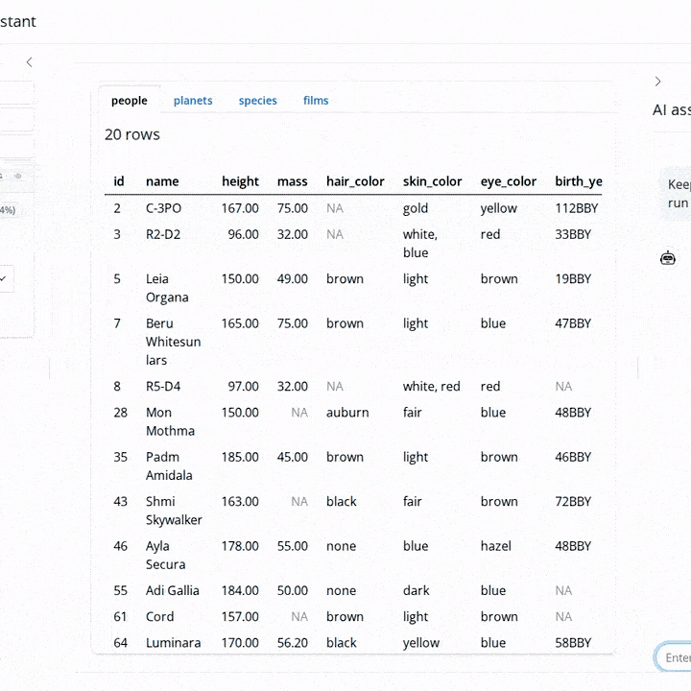
Demo — iterate
“Keep all the mammals that originate from high-temperature planets.”
Multiple conditions across species and planets — resolved in a single step, respecting each column's valid range.

Slide 6
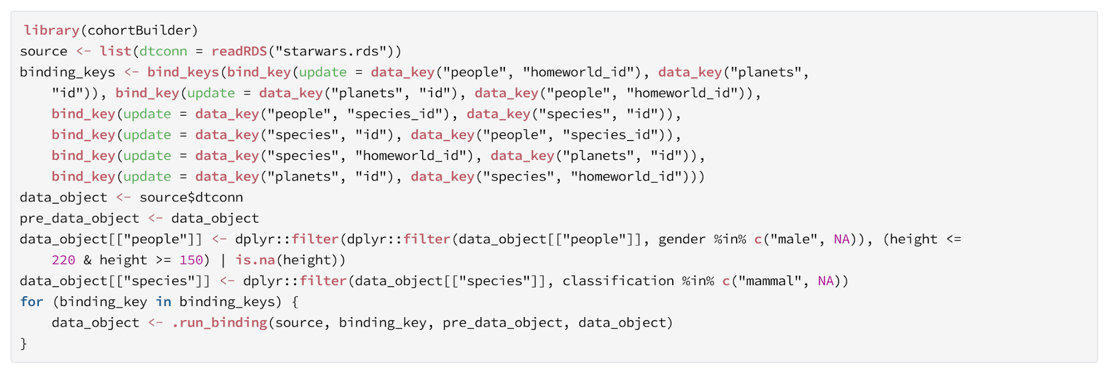
Reproducible code
See exactly how filtering works through reproducible code.
Given the source data, apply it to reproduce the same results and validate every step yourself.

Slide 7
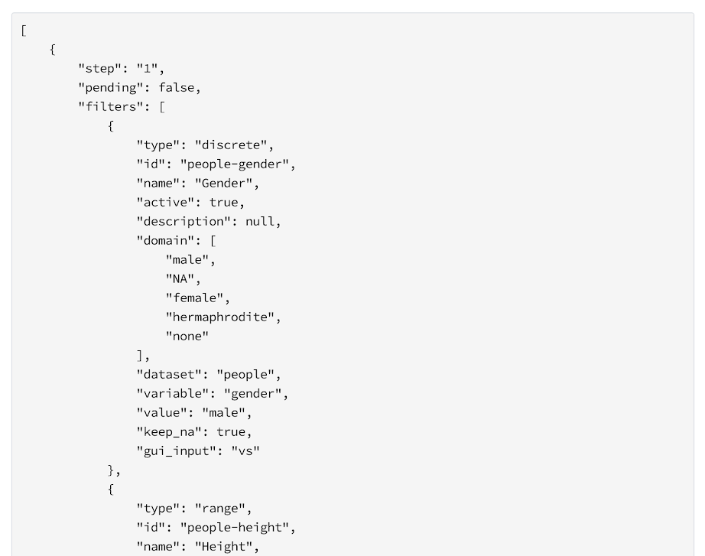
Cohort state
Get State saves your cohort as portable JSON — one file that travels anywhere.
Hand it off, restore it, and pick up right where you left off.

Slide 8
Enabling the LLM assistant
1 Describe the data
Add a description (domains + text the LLM reads) in set_source().
2 Register the tools
Expose the cohort to an ellmer chat with cb_register_tools().
3 Ask in plain language
The LLM discovers filters and applies valid values.
# 1. Describe the data (domains + text the LLM reads)
src <- set_source(
tblist(people = starwars$people, species = starwars$species),
description = list(
people = list(
dataset_ = describe("Star Wars characters."),
gender = describe("Gender (male, female, ...)", label = "Gender")
),
species = list(
classification = describe("Biological class.", label = "Classification")
)
)
) |> autofilter()
coh <- cohort(src) |> run()
# 2. Register cohortBuilder tools on an ellmer chat
chat <- ellmer::chat_anthropic()
chat |> cb_register_tools(coh)
# 3. Ask in natural language
chat$chat("Keep only female characters.")
List of available tools: https://r-world-devs.github.io/cohortBuilder/articles/source-intelligence.html#connecting-a-cohort-to-an-llm

Slide 9
From barrier to FAIR exploration
The barrier
Filtering requires knowing the schema — exact variable names and valid ranges. A high entry threshold even for technical users: the knowledge lives in people's heads, not with the data.
Our proposal
A metadata layer connecting filtering pipelines to LLMs via tool calling. Describe the data once; the app and the LLM discover filters, read constraints, and apply valid values — in natural language or the GUI.
FAIR by design
Findable + Accessible — metadata for humans and machines.
Interoperable — across backends.
Reusable — describe once, reproduce as shareable R code or Shiny bookmarks.

Slide 10
Real-time GUI — and why it matters
The chat drives the GUI
A chat panel lets users talk to the LLM; tool calls mutate the shared Cohort.
Post-action hooks fire an internal “data updated” signal.
The GUI reacts in real time: filters appear, values change, results refresh.
LLM edits and manual clicks are indistinguishable to the app.
Why it matters
A fully metadata-driven solution with reproducible output.
The filtered data is always represented in the UI.
Technical users keep full, precise control of the pipeline.
Describe the data model once — you decide what the LLM can access.

Slide 11
Thank you!
cohortBuilder docs — https://r-world-devs.github.io/cohortBuilder/
shinyCohortBuilder docs — https://r-world-devs.github.io/shinyCohortBuilder/
Krystian Igras · Adam Foryś

