Slide 1


A Connected Set of R Packages for
Regularized Regression based on
Ridge and S-Type Estimators
ridgregextra · Stype.est · Styperidge.reg
Filiz Karadağ¹ · Hakan Savaş Sazak¹ · Olgun Aydın² · Michał Pietrzak²
¹ Department of Statistics, Ege University, İzmir, Türkiye
² Gdańsk University of Technology, Gdańsk, Poland
useR! 2026

Slide 2
Outline
1
Motivation
Multicollinearity & OLS limitations
4
Styperidge.reg
Robust ridge regression combining both
2
ridgregextra
VIF-based automatic ridge parameter k
5
Scaling Up
Steel industry real-world case (n=35,040)
3
Stype.est
S-type robust estimators for linear regression
6
Optimization & CRAN Timeline
~4 hours to ~3 min · package release history
Three connected packages — ridgregextra · Stype.est · Styperidge.reg — one unified workflow
useR! 2026 · Karadağ, Sazak, Aydın & Pietrzak

Slide 3



The Package Ecosystem
Three connected packages — one unified workflow
Styperidge.reg
regstyperidge() Weightedridge.reg()
▼
▼
uses regstype()
uses ridgereg_k()
Stype.est
ridgregextra
regstype() regweighteds()
ridgereg_k() ridge_reg() vif_k()
💡 Optimizing
Stype.est
automatically improves
Styperidge.reg
— no changes needed.
useR! 2026 · Karadağ, Sazak, Aydın & Pietrzak

Slide 4
Motivation
Multicollinearity Problem
Why standard OLS often fails — and what ridge regression does about it
Variance Inflation Factor (VIF)
What is Multicollinearity?
Diagonal elements of the inverse correlation matrix:
Linear dependence among explanatory variables
Inflates variances of LS coefficient estimators
Causes unstable estimates and incorrect signs
VIF > 5 or 10 signals a problem
r⁻¹_{xx} = ( X*X* )⁻¹
or
VIF_{k} = 1 / (1 − R²_{k}) for k = 1, 2, … , p−1
Key Equations
LS : β̂ = (X′X)⁻¹ X′Y
⚠ If VIF_{k} > 5 or 10, multicollinearity is present (Marquaridt (1970))
Ridge : β̂_{r} = (X′X + kI_{p})⁻¹ X′Y, k ≥ 0
Hoerl & Kennard (1970), Technometrics, 12(1), 55–67
⚠ VIF < 1 is mathematically invalid (García et al., 2015)
useR! 2026 · Karadağ,Sazak, Aydın & Pietrzak

Slide 5
ridgregextra — How It Works
4-step automatic VIF-based ridge parameter selection (Kutner et al., 2004)
1
2
3
4
Initialise
Evaluate
Refine
Converge
▶
▶
▶
User supplies [a, b] = [0, 1]
Divide into 10 equal parts
→ 11 candidate k values
Compute VIF for each k
Find smallest k where
all VIF ≥ 1 and closest to 1
Narrow to [k*, k*+step]
Repeat Steps 1–2
within the new interval
After 4 iterations k stabilises
Return k + full ridge
results + diagnostic plots
ridgregextra guarantees VIF ≥ 1
Automatically selects the smallest k
All VIF values remain just above 1
No manual tuning needed
useR! 2026 · Karadağ, Sazak, Aydın & Pietrzak

Slide 6
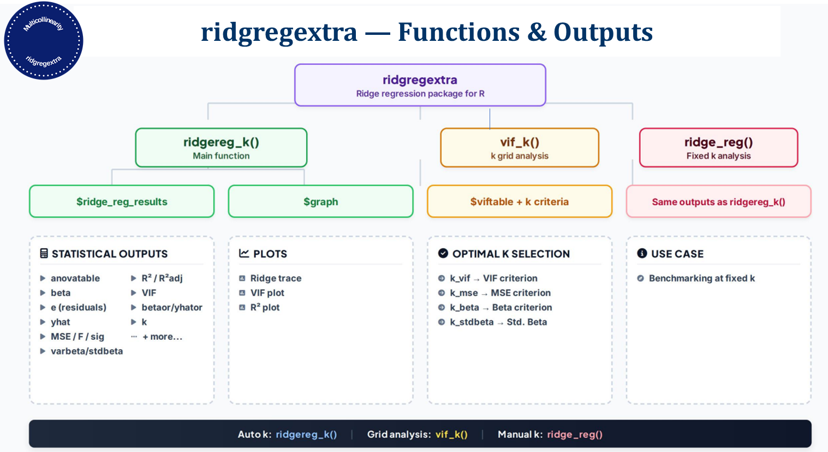
useR! 2026 · Karadağ, Sazak, Aydın & Pietrzak
Karadağ, Sazak & Aydın (2026) · J. Appl. Stat. · CRAN: ridgregextra

Slide 7
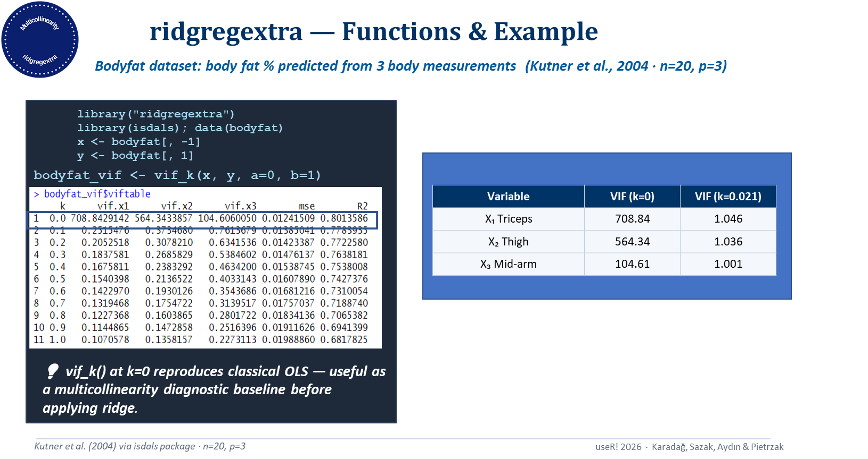

Slide 8
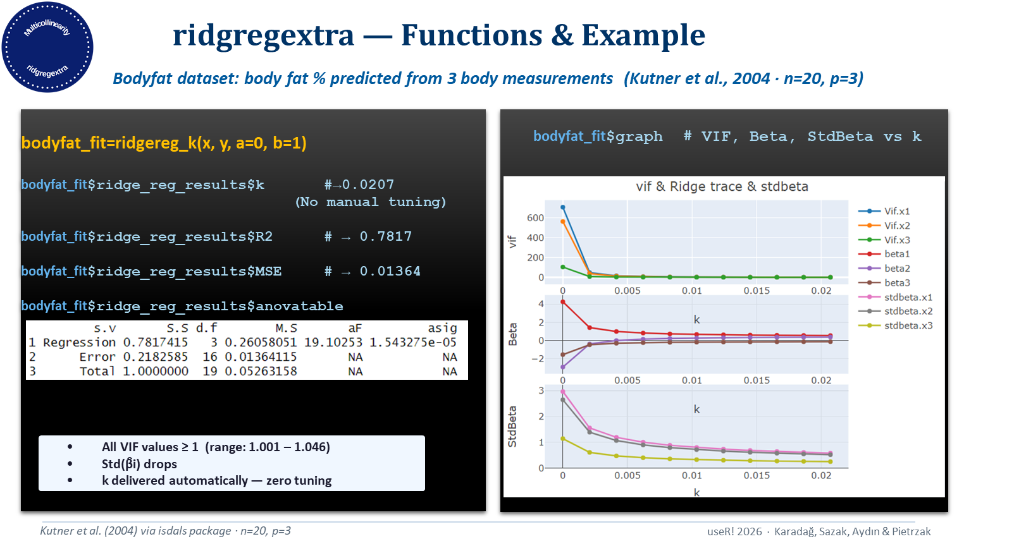

Slide 9
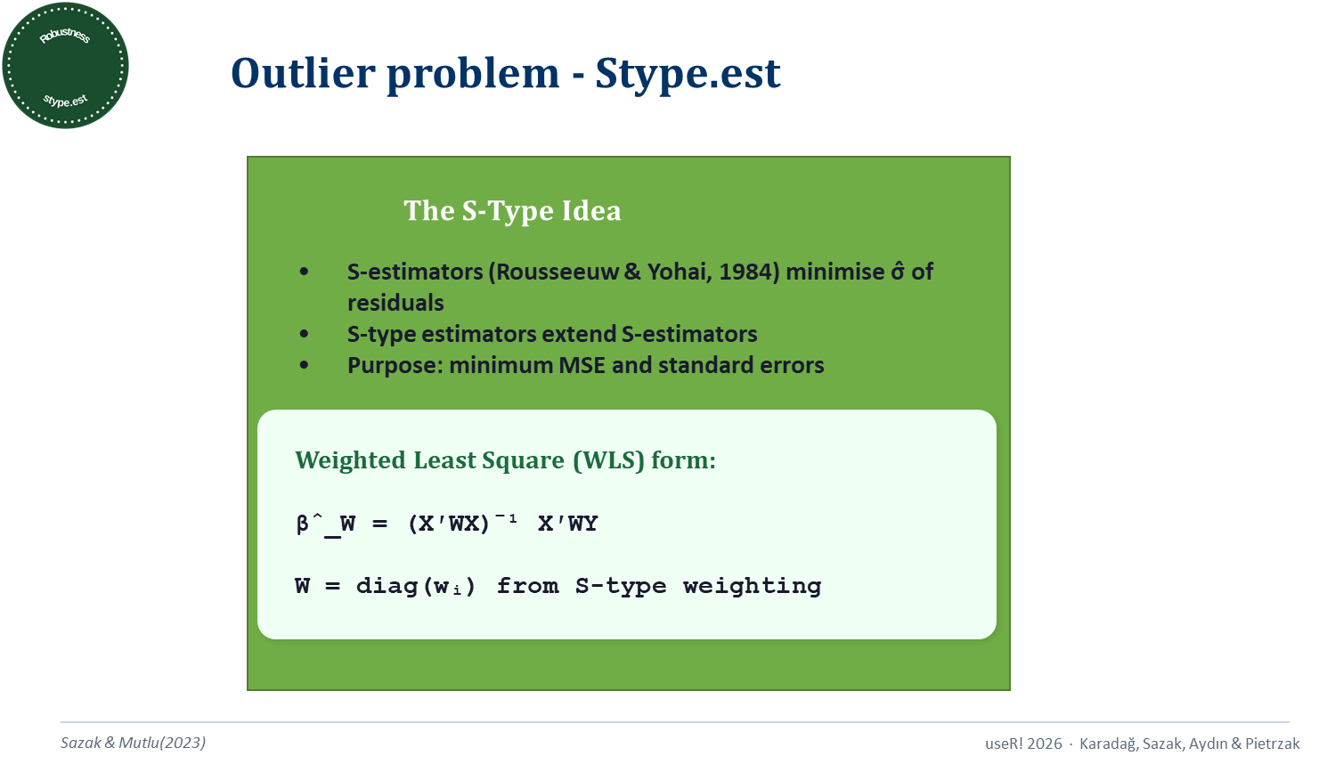

Slide 10
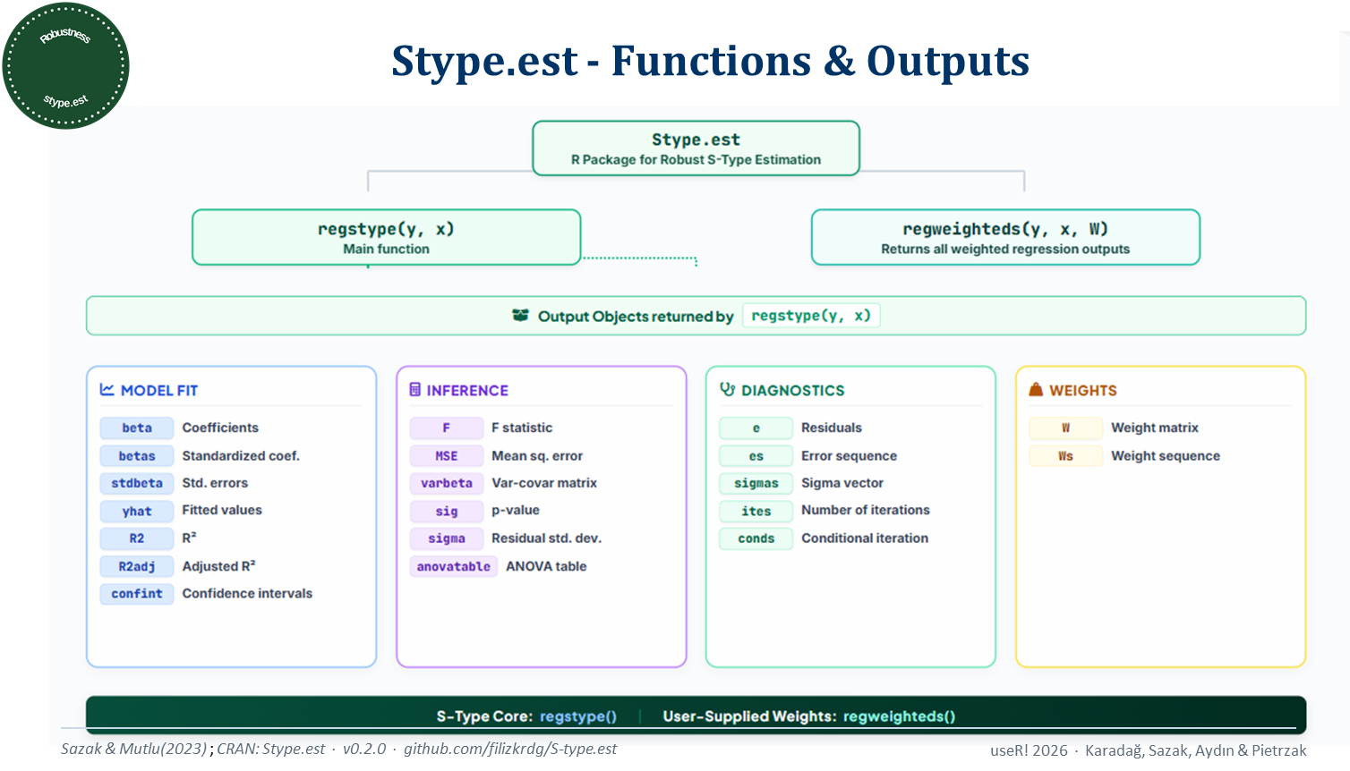

Slide 11
What users get when they call regstype() and regweighteds()
Stype.est — Functions & Example
Example: Airquality Dataset (Ozone · n=111, p=3 · datasets package)
> library(datasets)
> data(airquality)
> x_air=data.frame("X1"=X1,"X2"=X2,"X3"=X3)
> y_air=data.frame("Y"=Y1)
result <- regstype(y, x)
result$beta # coefficients
result$MSE # 58.37-mean squared error
result$R2 # 0.7646-R-squared
result$stdbeta # standard errors
W=runif(111, min = 0, max = 1)
Weighted_fit <- regweighteds(y_air, x_air, W)
Weighted_fit$beta # coefficients
Weighted_fit$MSE # mean squared error
Weighted_fit $R2 # R-squared
Weighted_fit $stdbeta # standard errors

Slide 12
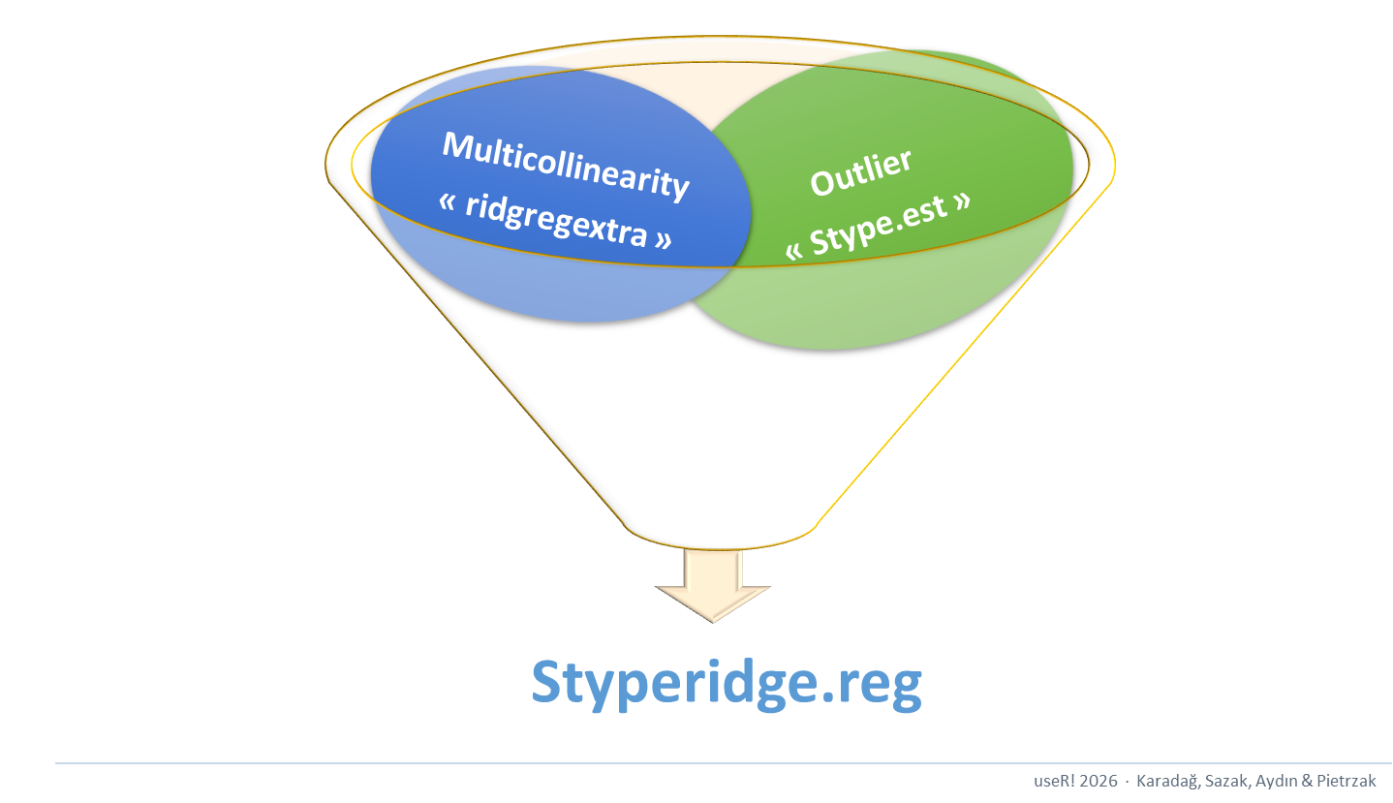

Slide 13



Styperidge.reg — Combining Robustness & Ridge
①
S-type weights
②
Auto ridge k
③
S-type Ridge
▶
▶
wᵢ via Stype.est::regstype()
k via ridgregextra::ridgereg_k()
Styperidge.reg::regstyperidge
Karadağ & Sazak, 2026
Karadağ, Sazak & Aydın, 2026
Holland, 1973
Sazak & Mutlu, 2023
Karadağ, Sazak & Aydın, 2026
useR! 2026 · Karadağ, Sazak, Aydın & Pietrzak
useR! 2026 · Karadağ, Sazak, Aydın & Pietrzak

Slide 14
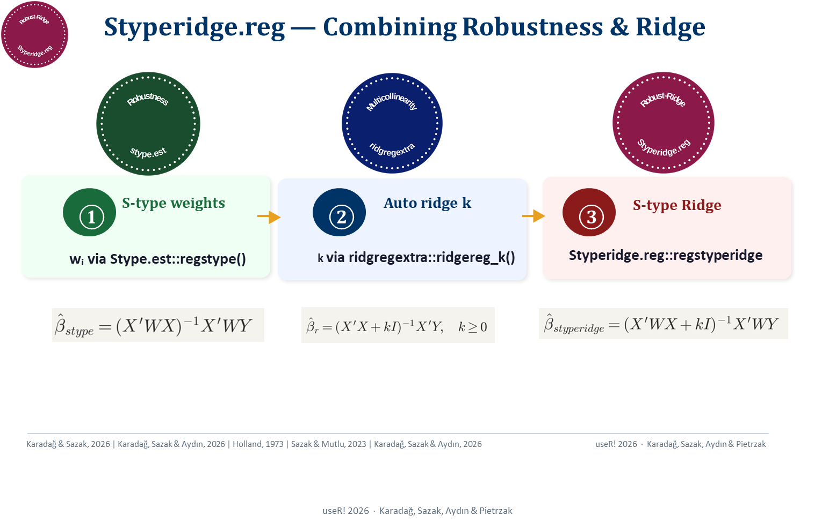

Slide 15
Styperidge.reg — Functions & Outputs
Function | Purpose
regstyperidge(x, y) (main function) | S-type robust ridge regression
Weightedridge.reg(x, y, W) | Weighted ridge regression with user-supplied W
Styperidge.reg package · regstyperidge()
Output objects — steel_styperidgereg$...
MODEL FIT
betaStype
Coef. (standardized)
betaorStype
Coef. (original scale)
INFERENCE
FStype
F statistic
stdbetaStype
Std. errors
yhatStype
Fitted (standardized)
MSEStype
Mean sq. error
yhatwStype
Fitted (weighted std.)
R2Stype
R²
anovatable
ANOVA table
R2adjStype
Adjusted R²
confintStype
Confidence intervals
sigStype
p-value
varbetaStype
Var-covar matrix
RESIDUALS & WEIGHTS & RIDGE PARAMETER
eStype
Residuals (std.)
ewStype
Weighted residuals
weightorStype
Original scale weights
ccStype
Selected ridge param. k
useR! 2026 · Karadağ, Sazak, Aydın & Pietrzak

Slide 16
Styperidge.reg — Functions & Example
Function | Purpose
regstyperidge(x, y) (main function) | S-type robust ridge regression
Weightedridge.reg(x, y, W) | Weighted ridge regression with user-supplied W
Example: Hald Dataset (Portland cement · n=13, p=4 · mctest package)
Hald (1952) — heat evolved during hardening vs. chemical composition of cement
Weighted_ridgereg=Weightedridge.reg(x, y, W)
Weighted_ridgereg$k # 0.0336 - auto-selected ridge parameter
Weighted_ridgereg$MSE # 0.0009074313 - Mean Squared Error
Weighted_ridgereg$R2Stype # 0.9869544 - R-squared
Weighted_ridgereg$betaor # original-scale coefficients
# [,1]
# [1,] 55.2358010
# [2,] 2.0657042
# [3,] 0.3620323
# [4,] -0.2701473
# [5,] -0.5455225
Weighted_ridgereg$stdbeta # standard errors
Weighted_ridgereg$anovatable # full ANOVA table
All weighted ridge regression results with user - supplied W
library("Styperidge.reg")
library("mctest")
x <- Hald[, -1]
y <- Hald[, 1]
fit <- regstyperidge(x, y)
fit$k # 0.0336-outo-selected ridge parameter
fit$MSEStype # 0.0005361965 - Mean Squared Error
fit$R2Stype # 0.9869544 - R-squared
fit$betaorStype # original-scale coefficients
fit$stdbeta # standard errors
fit$anovatable # full ANOVA table
All stype robust ridge regression results.
useR! 2026 · Karadağ, Sazak, Aydın & Pietrzak
Karadağ, Sazak & Aydın (2026) · styperidge.reg cran; Karadağ & Sazak (2026) - J. Stat. Comput. Simul.

Slide 17
Package: Styperidge.reg
➡ Small data worked perfectly.
Can it handle more than 35000 rows?
useR! 2026 · Karadağ, Sazak, Aydın & Pietrzak

Slide 18
Scaling Up: Steel Industry Energy Data
A real-world high-dimensional case study · Sathishkumar et al. (2020) · UCI ML Repository
📊 Dataset Size
📐 Predictors
🎯 Response
📅 Period
n = 35040
observations
p = 6
variables
Usage_kWh
(energy consumption)
2018 · South Korea
steel industry
Predictor Variables (X):
Multicollinearity Diagnostic (k = 0):
X₁ Lagging Current Reactive Power (kVArh)
X₂ Leading Current Reactive Power (kVArh)
X₃ CO₂ emissions (tCO₂)
X₄ Lagging Current Power Factor
X₅ Leading Current Power Factor
X₆ NSM — Number of Seconds from Midnight
Variable | VIF at k=0
X₁ Lag. Reactive | 6.35
X₂ Lead. Reactive | 9.59
X₃ CO₂ | 9.75
X₄ Lag. PF | 3.72
X₅ Lead. PF | 10.61
X₆ NSM | 1.52
➡ We applied regstyperidge() to this dataset — and hit an unexpected performance wall.
VIF > 5 for 3 predictors — multicollinearity confirmed
⏱ Execution time on Steel dataset: ~4 hours
useR! 2026 · Karadağ, Sazak, Aydın & Pietrzak

Slide 19
The Optimization: Stype.est v0.2.0
Hald (n=13) ran in seconds. Steel (n=35040) took ~4 hours. We profiled regstype() and found the bottleneck.
⏱ Execution time on Steel dataset:
~4 hours
→
~3 minutes
regstype() optimization
What changed in regstype():
Before | After
lm() for initial regression fit | lm.fit() for initial regression fit
~40 lines of input handling | 2 lines with as.matrix()
for loops | Vectorized weight computation
Manual normal formula | Built-in dnorm()
regweighteds() called every iteration | Called once at the end
Intermediate variables included in return list | Intermediate variables removed from return list
Once Stype.est was optimized, Styperidge.reg benefited automatically — no further changes needed.
useR! 2026 · Karadağ, Sazak, Aydın & Pietrzak

Slide 20
Steel Industry Data — Results
Steel Industry Data — Results
regstyperidge() applied to n=35,040 observations · p=6 predictors
library("Styperidge.reg")
steel_raw <- read.csv("Steel_industry_data.csv")
y_steel <- steel_raw$Usage_kWh
x_steel <- as.data.frame(steel_raw[, c(
"Lagging_Current_Reactive.Power_kVarh",
"Leading_Current_Reactive_Power_kVarh",
"CO2(tCO2)", "Lagging_Current_Power_Factor",
"Leading_Current_Power_Factor", "NSM")])
fit_steel <- regstyperidge(x_steel, y_steel)
Model Results:
k = 0.129 (auto-selected via S-type VIF criterion)
R² = 0.8762 · Adjusted R² = 0.8762
MSE = 3.703 × 10⁻⁷ (S-type weighted)
Coefficient Estimates (β on original scale):
Std(β) of Coefficients:
Intercept: -1.581 X1: 0.620 X2: -0.094 X3: 719.4 X4: 0.074
X5: 0.034 X6: 2.56e-05
Std(β): X1=0.00139 X2=0.00129 X3=0.00135
X4=0.00113 X5=0.00129 X6=0.00097
ANOVA Table:
 | s.v. | S.S. | d.f. | M.S. | F | sig.
1 | Regression | 0.09180329 | 6 | 1.530055e-02 | 41319.78 | 0
2 | Error | 0.01297258 | 35033 | 3.702959e-07 | NA | NA
3 | Total | 0.10477586 | 35039 | 2.990264e-06 | NA | NA
useR! 2026 · Karadağ, Sazak, Aydın & Pietrzak
Sathishkumar V P et al. (2020) · UCI ML Repository · doi:10.24432/C5PG6D

Slide 21
CRAN Package Release Timeline
Robust ridge regression package family
New package
Initial release
Version update
ridgregextra
v0.1.0
25 Nov
2023
Finds the optimum ridge parameter k by minimising variance
inflation factors (VIF) closest to 1 while keeping them above 1.
Functions: ridgereg_k · ridge_reg · vif_k
Stype.est
v 0.1.0
29 Aug
2025
S-type robust estimators for linear regression; resistant to outliers
and leverage points — robust alternative to classical OLS.
Functions: regstype · regweighteds
version update
Styperidge.reg
v 0.1.0
12 Jan
2026
Combines S-type robust weighting with ridge penalisation to handle
multicollinearity and outliers simultaneously.
Imports: Stype.est · ridgregextra
Functions: regstyperidge · Weightedridge.reg
Stype.est
UPDATE
v 0.2.0
regstype fully optimised
Significantly reduced execution time (more than ~ 4 hours ~ 3 min)
23 Jun
2026
Functions: regstype (optimised) · regweighteds
useR! 2026 · Karadağ, Sazak, Aydın & Pietrzak

Slide 22
References
Karadağ F, Sazak HS, Aydın O (2026). ridgregextra: An Alternative R Package for Ridge Regression. Journal of Applied Statistics. doi:10.1080/02664763.2026.2655681
Karadağ F, Sazak HS (2026). The S-type Ridge Regression Estimators. Journal of Statistical Computation and Simulation. doi:10.1080/00949655.2026.2669772
Sazak HS, Mutlu N (2023). Comparison of the Robust Methods in the General Linear Regression Model. Communications in Statistics – Simulation and Computation. doi:10.1080/03610918.2021.1928196
García C, et al. (2015). Collinearity: Revisiting VIF in Ridge Regression. Journal of Applied Statistics. doi:10.1080/02664763.2014.980789
Kutner MH, Nachtsheim CJ, Neter J, Li W (2004). Applied Linear Statistical Models (5th ed.). McGraw-Hill.
Sathishkumar VP, Park J, Cho Y (2020). Steel Industry Energy Consumption Dataset. UCI Machine Learning Repository. doi:10.24432/C5PG6D
Karadağ F, Sazak HS, Aydın O (2023). ridgregextra R package (v0.1.1). CRAN. https://CRAN.R-project.org/package=ridgregextra
Karadağ F, Sazak HS, Aydın O (2025). Stype.est R package (v0.2.0). CRAN. https://CRAN.R-project.org/package=Stype.est
Karadağ F, Sazak HS, Aydın O (2026). Styperidge.reg R package (v0.1.0). CRAN. https://CRAN.R-project.org/package=Styperidge.reg

Slide 23

useR! 2026 Conference · Warsaw · 6–9 July 2026

