Slide 1


celecx:
Active Learning for
Computer Experiments in R
Martin Binder
LMU Munich
Munich Center for Machine Learning (MCML)

Slide 2

Regression, classification
Model predictions
Performance evaluation
Benchmarking
Hyperparameter optimization
Extensibility

Slide 3

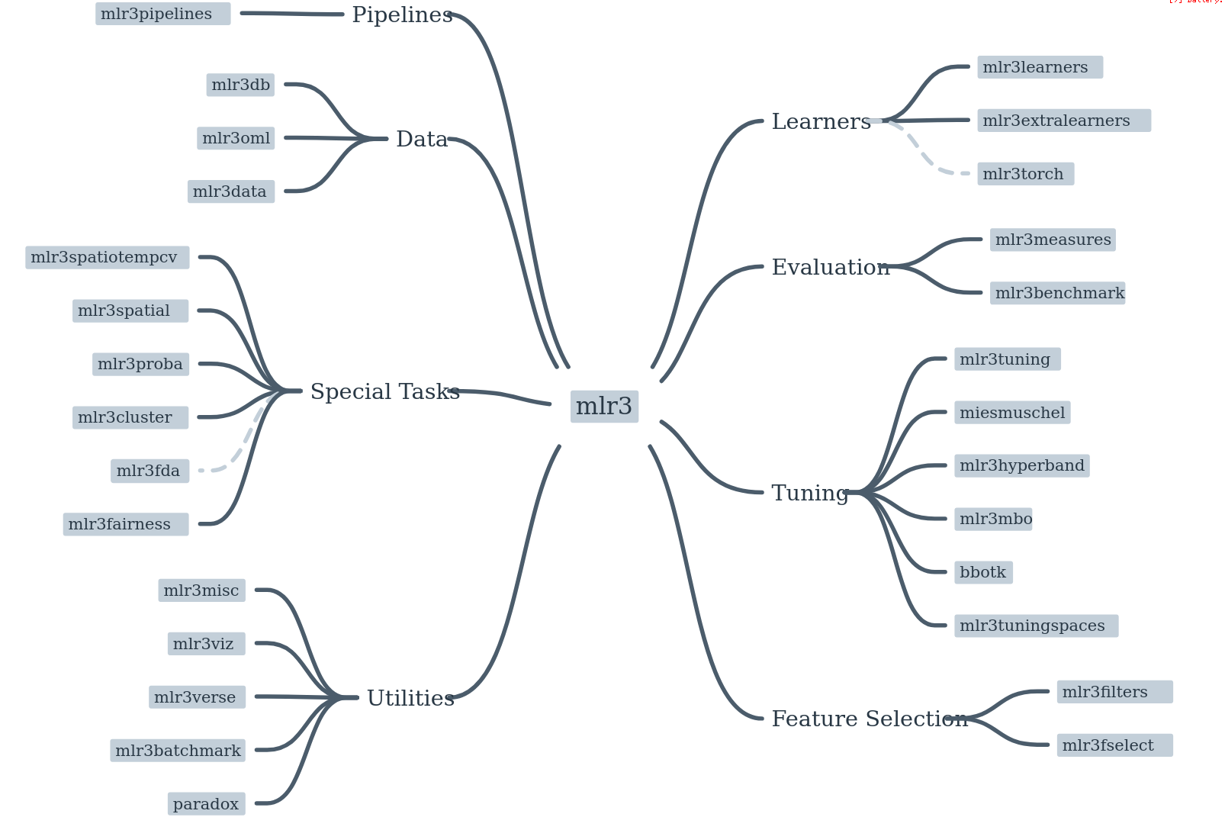

Slide 4
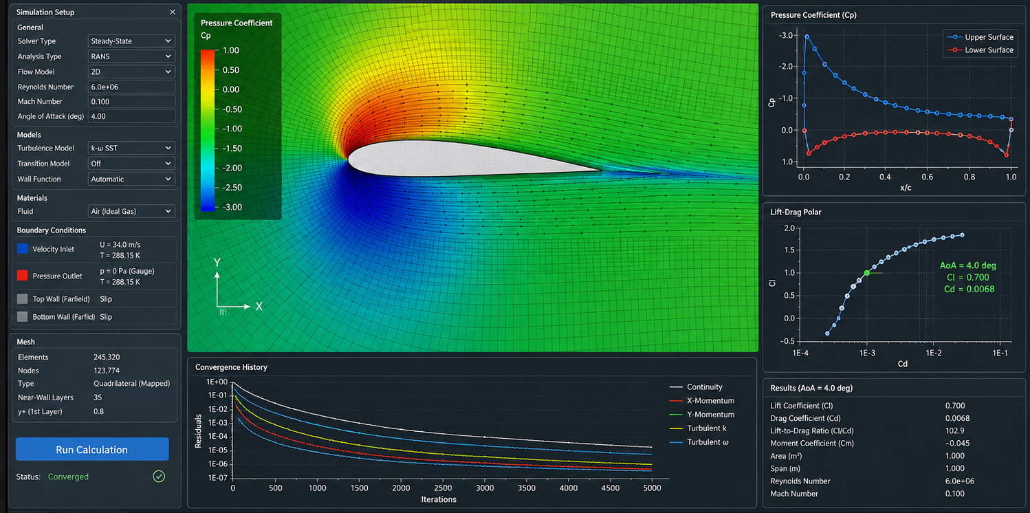
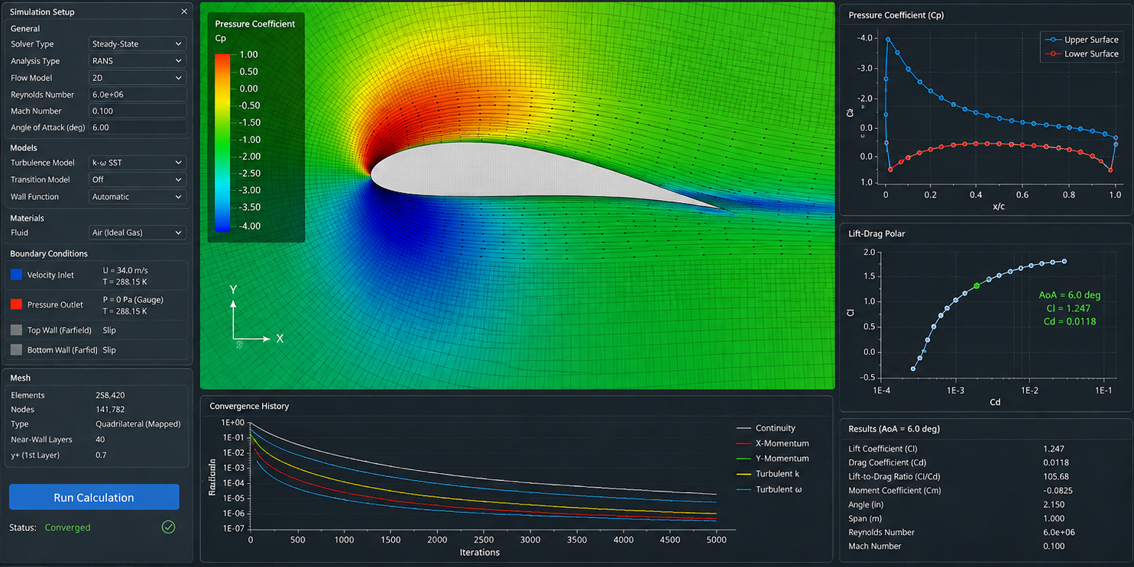
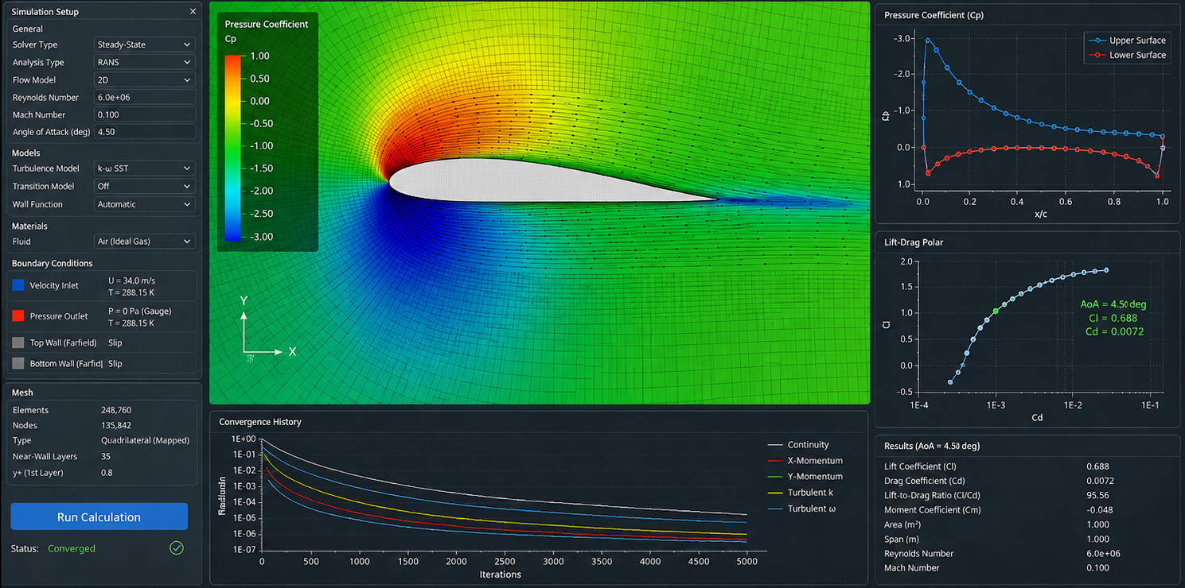
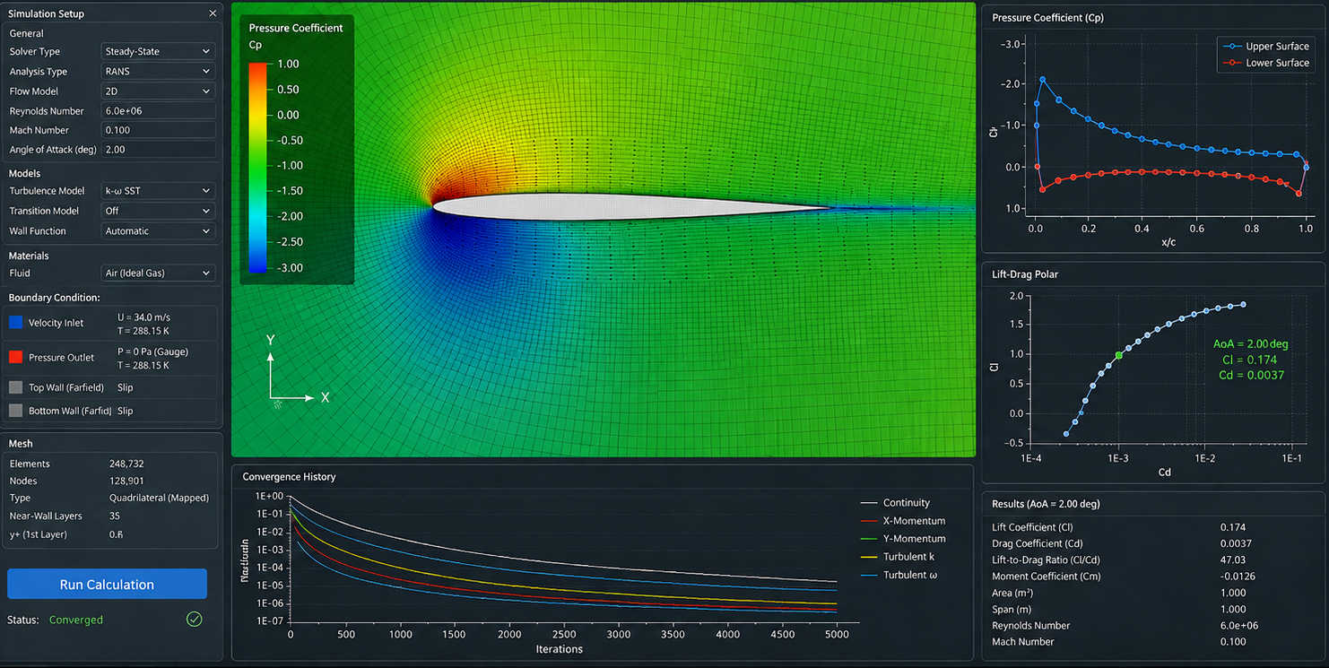
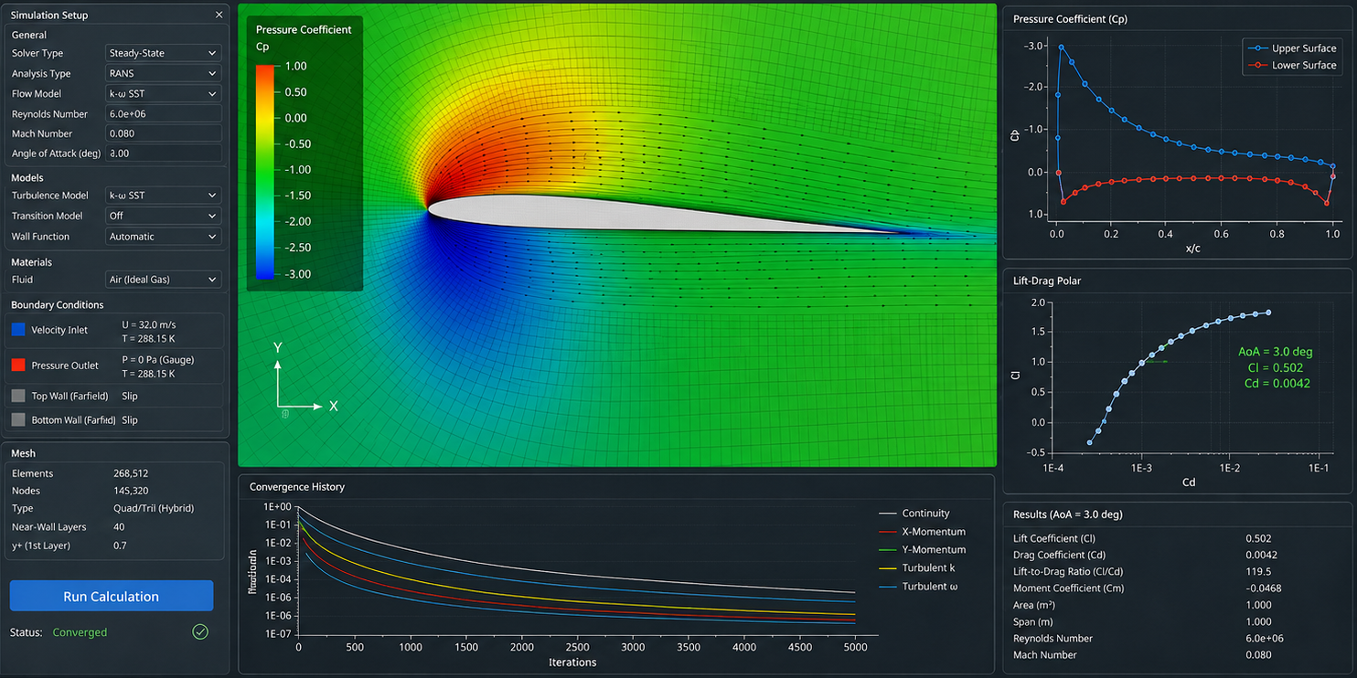
Active Learning | Adaptive Sampling

Slide 5

Active Learning | Adaptive Sampling
?

Slide 6
Active Learning with celecx
Life can be so simple:
objective <- ObjectiveRFun$new(
fun = function(xs) { ... }, # objective function
domain = ps(x1 = p_dbl(0, 2), x2 = p_int(0, 10)), # search space
codomain = ps(y = p_dbl(tags = "learn")) # target value
)
result <- optimize_active(
objective = objective,
n_evals = 24L,
learner = lrn("regr.km", covtype = "matern5_2"),
batch_size = 4L,
n_candidates = 200L
)

Slide 7
Active Learning with celecx
Decisions, decisions...
optimizer <- OptimizerAL$new(
proposer = ALProposerScore$new(
acq_id = "sd",
surrogate_id = "model",
candidate_sampler = clx_sps("lhs"),
n_candidates = 200L
),
surrogates = list(
model = mlr3mbo::srlrn(lrn("regr.km", covtype = "matern5_2"))
),
acq_functions = list(sd = mlr3mbo::acqf("sd")),
init_sampler = clx_sps("uniform")
)
optimizer_manual$param_set$values$batch_size <- 2L

Slide 8
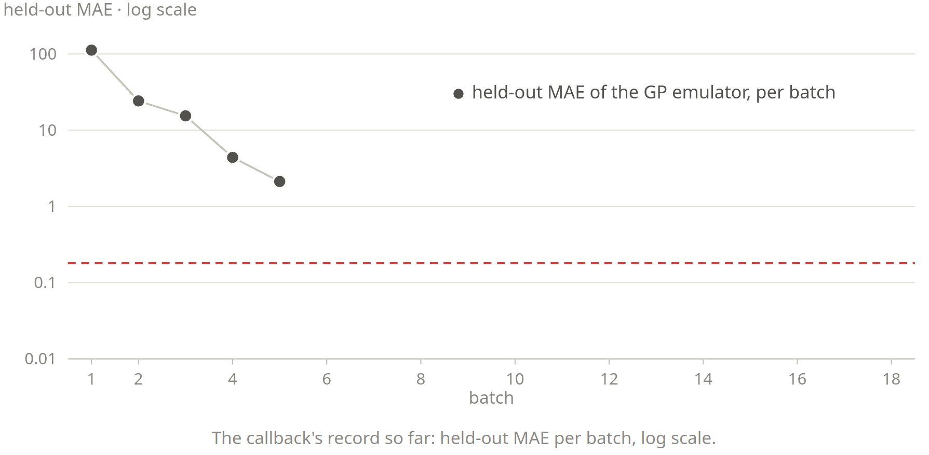
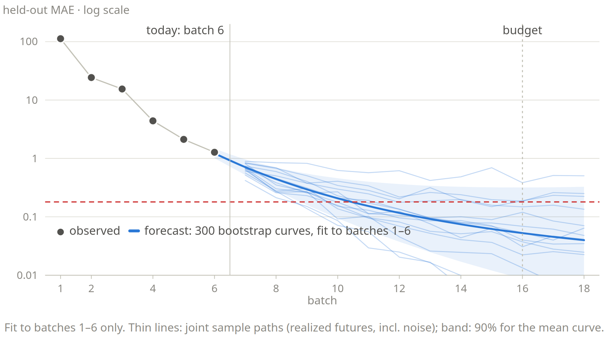
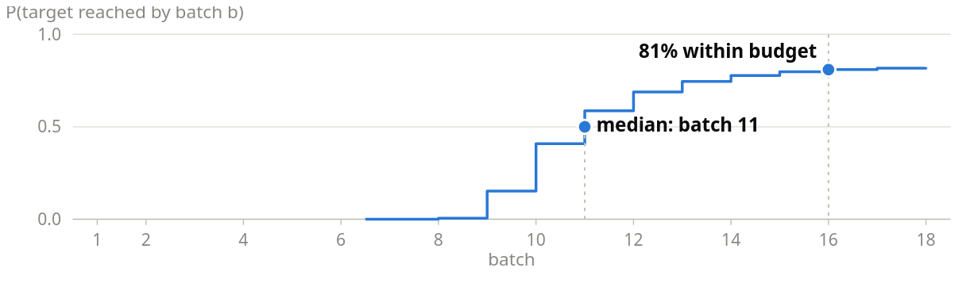
Computer Experiment LEarning Curve Extrapolation
P(target reached by batch b)

Slide 9
Learning Curves as mlr3 Tasks
progress <- clbk("celecx.surrogate_performance",
surrogate_id = "model",
task = testset,
measures = list(mae = msr("regr.mae"))
)
result <- optimize_active(
objective = objective, ...,
callbacks = list(progress)
)
task_lce <- progress$task(link = "log")
You get all of mlr3:
Train different Learners
Make predictions
Evaluate their performance
Run benchmarks
Optimize hyperparameters

Slide 10
remotes::install_packages("mlr-org/celecx")

