Slide 1

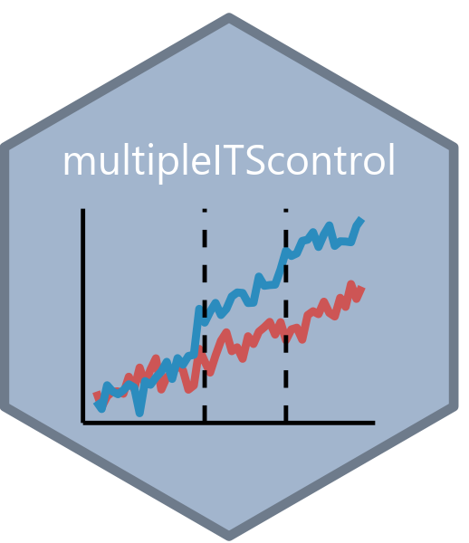


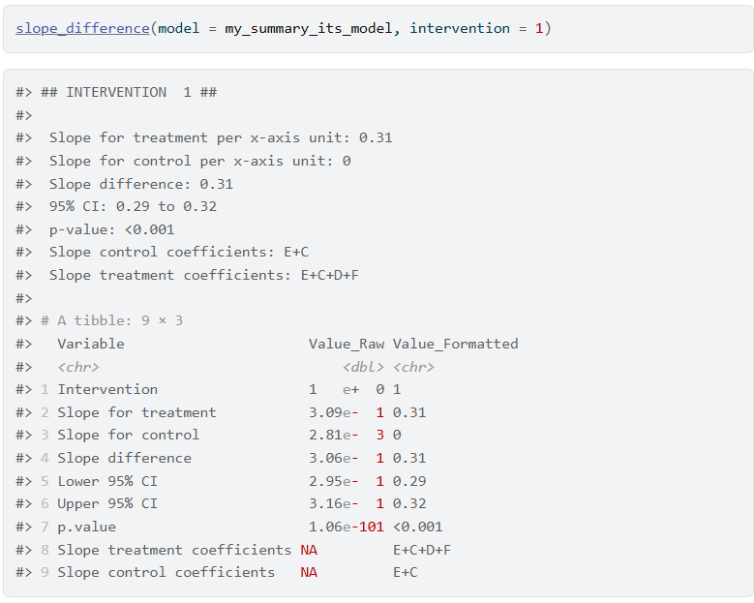
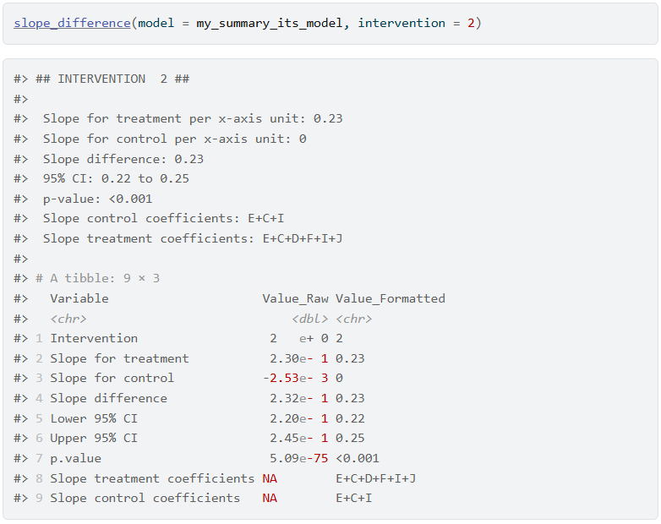
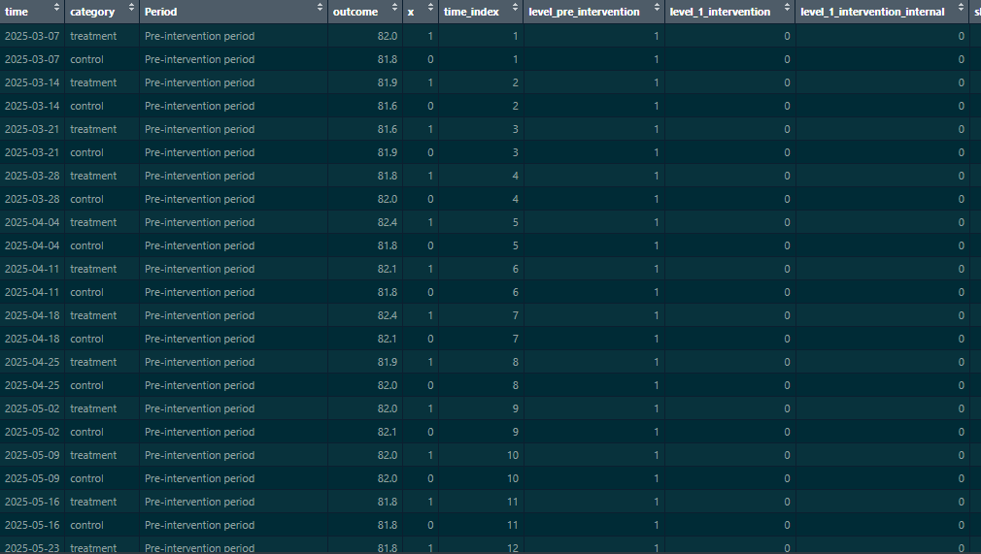
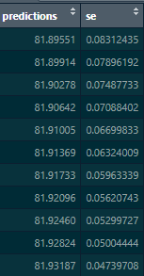
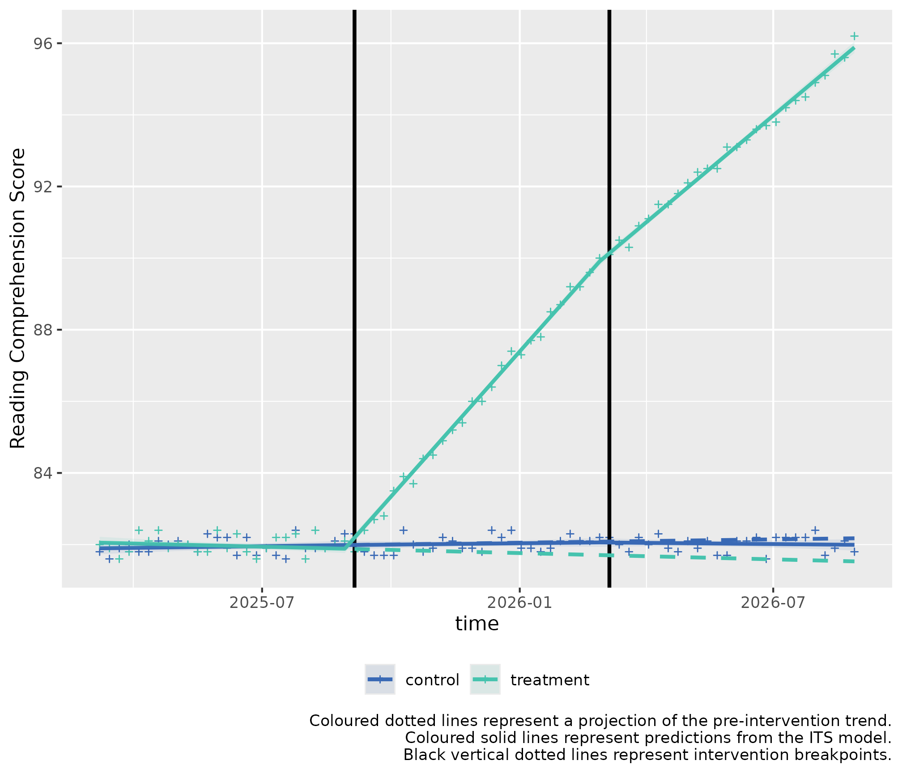
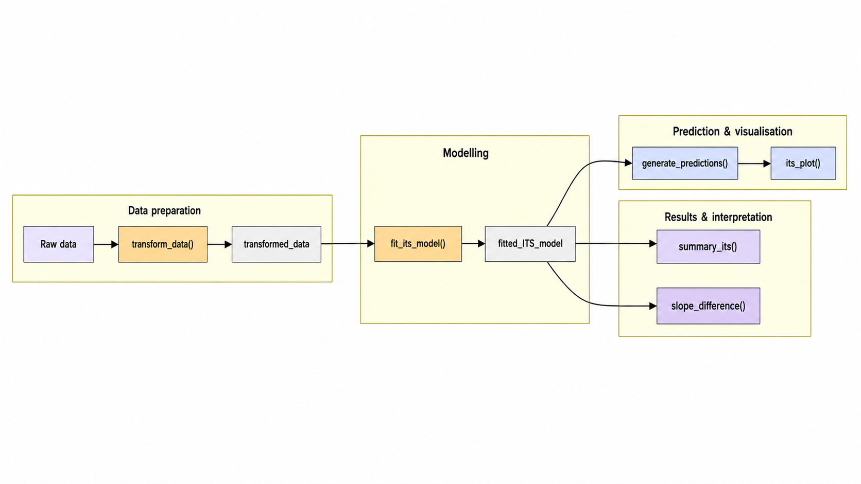
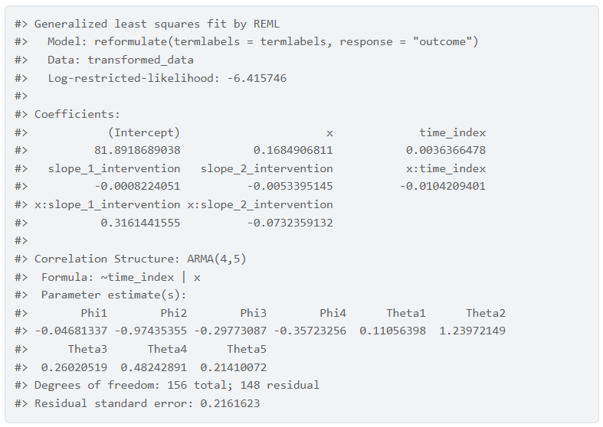
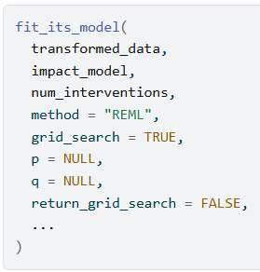
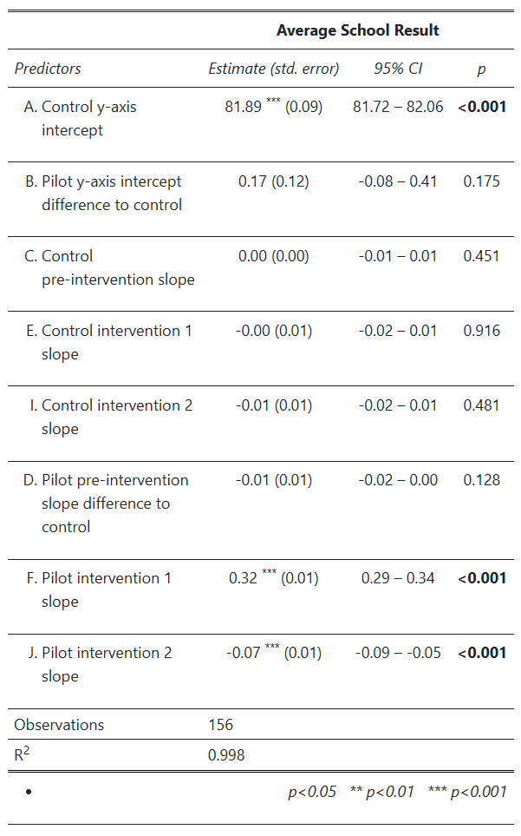
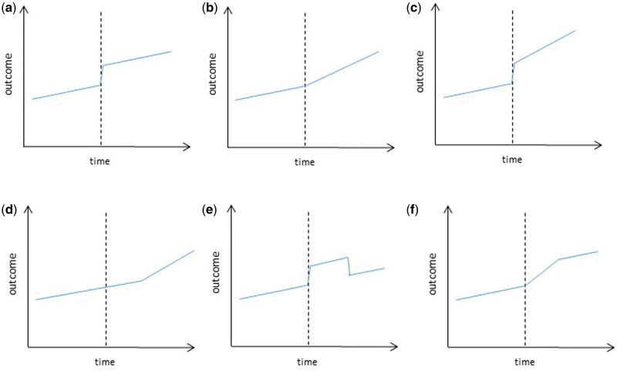
(R23)
A Package for Performing Multiple Interrupted Time Series with Control (multipleITScontrol)
Victor Yu¹, Emily Dickson¹
Epidemiology, Public Health Evidence & Intelligence, Hertfordshire County Council, UK
Interrupted Time Series was used in a project to
ascertain whether there was a
Interrupted Time Series was used in a project to
ascertain whether there was a
Interrupted Time Series was used in a project to
ascertain whether there was a
Abstract
Core Functions (with example)
Background: Alpine Meadow School and Forest Tiger School have similar student demographics, including socioeconomic status, ethnicity, and academic performance. Both schools are part of Clarkson County’s public school district.
Alpine Meadow School wants to trial out two new interventions to improve their school’s reading comprehension score, and to compare post intervention results with the pre-intervention score.
Outcome Measurement: Reading comprehension scores from standardised tests administered weekly.
Objective: Improve reading comprehension and literacy rates among students.
Intervention 1: Implementing a New Reading Programme
Start Date: September 1, 2025
Duration: 6 months
Intervention 2: Introducing Peer Tutoring Sessions
Start Date: March 2, 2026 (immediately after the reading program ends)
Duration: 6 months
slope_difference() - Ascertains whether there is a statistically significant difference in a slope during an intervention period between the pilot group and the control group.
The estimated difference is relative to the control group. Thus, a positive coefficient means the slope of the pilot group is higher than the control group.
The result is functionally equivalent to a two sided t-test.
We identify that the slope difference between the treatment (Alpine Meadow School) and the control (Forest Tiger School) for the first intervention (Reading Programme) has a slope difference of 0.31 (95% CI: 0.29 - 0.32) per x-axis unit, with a p-value below 0.05, indicating statistical significance.
generate_predictions() - Generate Predictions from a Transformed Dataset and a Model
We can fit predictions with the created model which project the pre-intervention period into the post-intervention period by using the model coefficients
its_plot() - Plotting the results
We can use the predicted values and plot the segmented regression lines which compare whether an intervention had a statistically significant effect.
Interrupted Time Series (ITS) is a robust quasi-experimental design which can assess an intervention’s effect on the level or slope of an outcome’s trend over time after a clearly defined time point (the interruption).
Multiple Interrupted Time Series with Control extends this method by allowing the possibility to compare pre- and post-intervention trends while controlling for external factors, to account for independent secular and periodic changes, and for successive interventions.
This R package was developed to streamline and simplify performing interrupted time-series analysis with control across successive interventions (up to 3).
Figure 7 Output from slope_difference() evaluating the first intervention
About the Package
The code for the package is based on a prior analysis where we compared the effect of two successive behavioural interventions designed to improve the uptake of a COVID-19 booster amongst immunosuppressed patients at several primary care practices within Hertfordshire, and from an rpub article¹ detailing the methodology by Chrissy Roberts at London School of Hygiene and Tropical Medicine.
Functions in the package greatly streamline the process for the end user where each step of performing multiple ITS with control is guided in a step-by-step manner (see figure 1), from wrangling, modelling, and data visualisation, to interpretation and key coefficient statistical significance testing.
Current impact models available are a) level change b) slope change and c) combined level and slope change (see figure 2). A level change represents an immediate step change in the outcome variable. A slope change indicators a gradient shift in the outcome variable.
Figure 8 Output from slope_difference() evaluating the second intervention
For the second intervention, the slope difference between the treatment and the control has a slope difference of 0.23 (95% CI: 0.22 - 0.25) per x-axis unit, with a p-value below 0.05, indicating statistical significance. The effect has been attenuated compared to the first intervention.
transform_data() - Transforms a data frame ready for input into fit_its_model(), creating relevant columns to model slope and level effects of interventions.
fit_its_model() - Fits an interrupted time series model using the nlme package, defaulting to an autocorrelation-moving average correlation structure of order (p, q).
Parameters for p and q are selected automatically via grid search, but the user can specify their own values if desired.
summary_its() - Summarises and Rename Coefficients for an ITS Model
We can call the package’s internal summary_its() which modifies the summary output by renaming the coefficients to make them easier to interpret in the context of interrupted time series (ITS) analysis.
Figure 3 Example data frame
Figure 8 Columns created from generate_predictions()
Figure 1 Flow diagram of functions inside multipleITScontrol R package
Figure 4 Generated columns from
transform_data()
Pre-requisites
Future Extensions
Figure 9 Example plot from its_plot()
Data must be collected at a consistent time interval before and after the intervention, which must be implemented at a defined point in time
Minimum of 3 equal interval time points in each intervention period and in the pre-intervention period are needed
Defined impact model(s) a priori
Calculations to ensure sufficient statistical power, but this is beyond the scope of the package and should be performed independently
Addition of impact models d) slope change following a lag e) temporary level change and f) temporary slope change leading to a level change)
S3 implementation of modified output result
Function outputting formulae of ITS model (LaTeX output?)
Seasonality adjustment
Independent impact models for different interventions
Auto-fitted model coefficients on plot
Figure 6 Model output from fit_its_model()
Figure 5 Arguments in fit_its_model()
References
Roberts, C. (2023). A pragmatic Introduction to Interrupted Time Series. [online] rpubs.com. Available at: https://rpubs.com/chrissyhroberts/1006858.
Lopez Bernal, J., Cummins, S. and Gasparrini, A. (2016). Interrupted time series regression for the evaluation of public health interventions: a tutorial. International Journal of Epidemiology, [online] 46(1), p.dyw098. doi:https://doi.org/10.1093/ije/dyw098.
Figure 2) Examples of impact models used in ITS (Lopez Bernal et al, 2016)
Figure 7 Output from summary_its()

