Slide 1
icsp2
Another interval censoring semi-parametric survival modelling package
Isaac Gravestock

Slide 2
What’s Interval Censoring all about?
Time

Slide 3
Semi-Parametric Interval Censored Models
Cox type model, eg non-parametric baseline with proportional hazards
Non-parametric interval censored baseline
Time

Slide 4
Requirements and Prior Art
Feature Wishlist:
Semi-parametric fit
Profile likelihood SEs
Fast and robust for N=100~1000
Stratified baseline
Log rank type test
R:
IcenReg
interval
Icens
ICsurv
IntCens
Intcox
coxinterval
SAS: ICPHREG
Stata: stintcox
❌
❌
❌
❌
❌
❌
❌
❌
❌

Slide 5
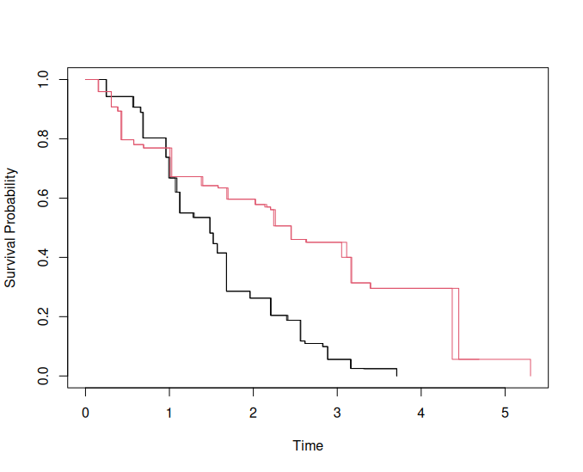
icsp2
Builds on icenReg’s C++ algorithm (Thanks Clifford Bergman-Anderson!)
Adds stratified baseline and profile likelihood calculations in C++
Small performance improvements
Stripped down R side implementation

Slide 6
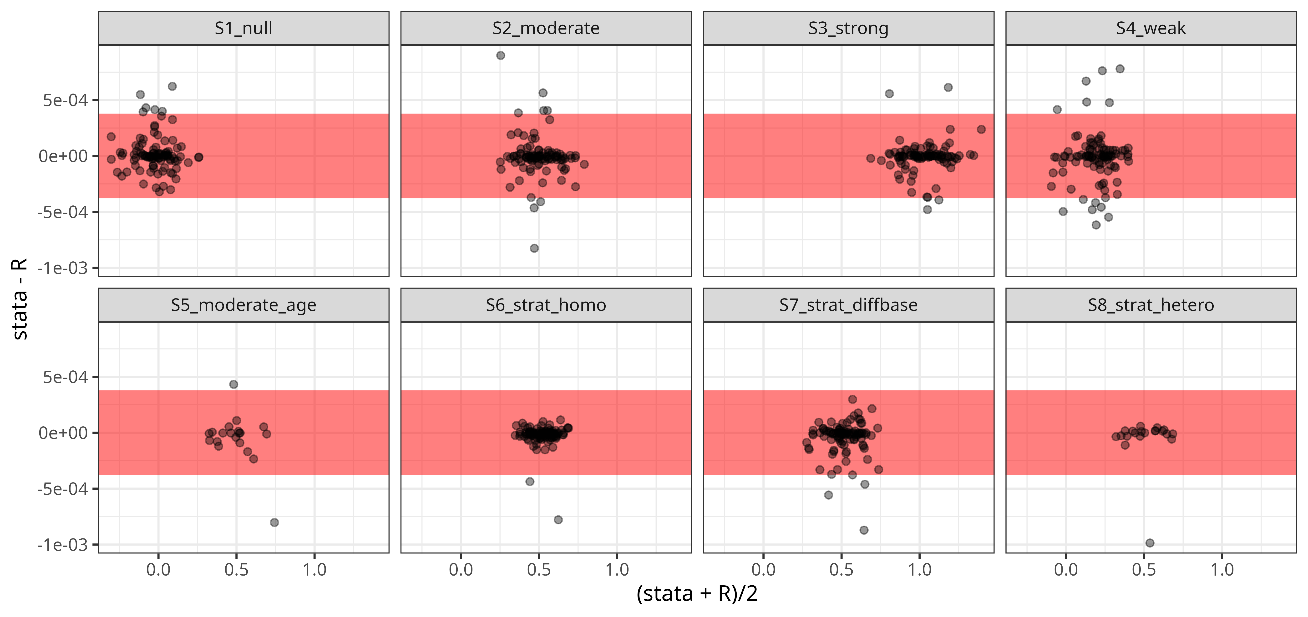
Hazard Ratios (vs Stata stintcox)
Time for 100 fits:
icsp2: ~1s vs stata: 51 mins
Notes:
Here I compare the Cox type model fit with Stata’s stintcox method.
That uses an EM algorithm which is quite inefficient.
For stata, I used 10k iterations (vs default 5k).
It didn’t always reach convergence criteria 1e-7 for likelihood, which is much looser than R.
I compare the HR estimates of the treatment group.

Slide 7
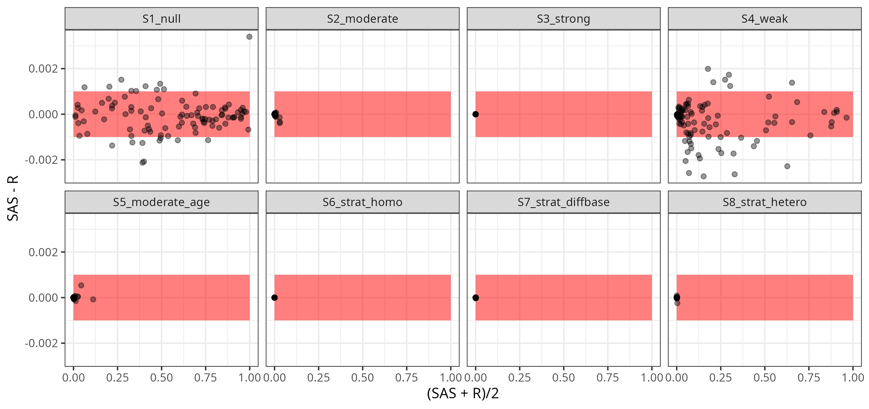
Log-Rank Test (vs SAS ICLIFETEST)
Notes:
I have implemented the same test that SAS does with ICLIFETEST.
This is a kind of log rank test, based on Sun’s formulation from 1996 and Huang, Lee, & Yu, H. sampling.
SAS had an error in their documentation, which I pointed out to them, so that should be fixed now.
Here I am showing bland altman plots, based on 10k samples.
In the null scenario, there is some disagreement. I made the mistake of exporting only the data from SAS with only 4 digits, so I can’t rule out some numerical noise.
I believe with larger samples this should disappear.
In other cases the agreement is excellent.

Slide 8
Outlook
Continue validation
  Example datasets welcome!
  Figure out Stata variance calculation differences
CRAN
github.com/igrave/icsp2

