Slide 1


Statistical Analysis & Visualization on Indian Development using R
“Using R to uncover patterns of development, inequality, and future challenges across Indian states.”
Prakhar Srivastava
Indian Institute of Information Technology, Una

Slide 2






R Ecosystem & Analytical Toolkit
Wrangling
Exploration
Grouping
Utilized ggplot2 alongside packages like corrplot and ggbeeswarm to isolate correlations and map critical development parameters.
Segmented deep structural differences across territories using K-Means clustering frameworks with dimensionality reduction via FactoMineR.
Leveraged dplyr and tidyr libraries to ingest, clean, and reshape multi-period state records from Census 2011, MoSPI, and Reserve Bank of India files.
METHODOLOGY & TOOLKIT
SLIDE 2

Slide 3
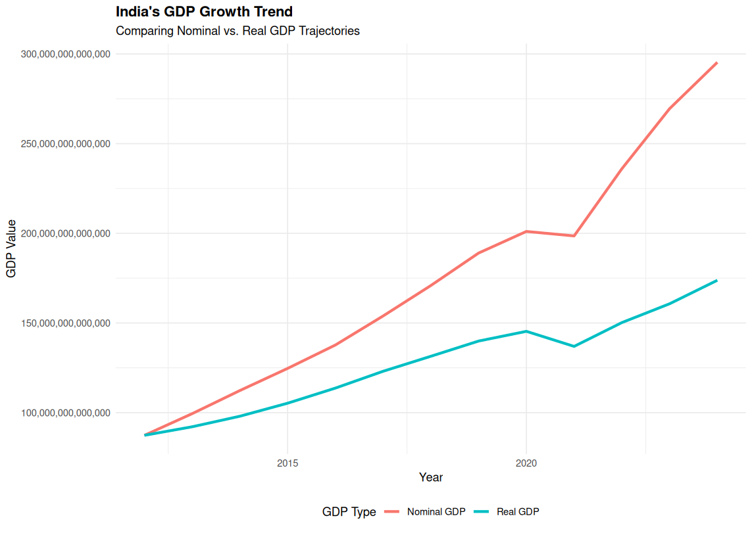
Macroeconomic Trajectory: Nominal vs. Real GDP Growth
Widening Nominal-Real Gap: While both trajectories display strong upward momentum, the widening gap between Nominal and Real GDP highlights the compounding impact of inflation over the decade.
2020 Shock and Recovery: Both metrics vividly capture the sharp economic contraction around the year 2020, followed by a remarkably steep, parallel post-crisis recovery.
GDP TRENDS
SLIDE 3

Slide 4
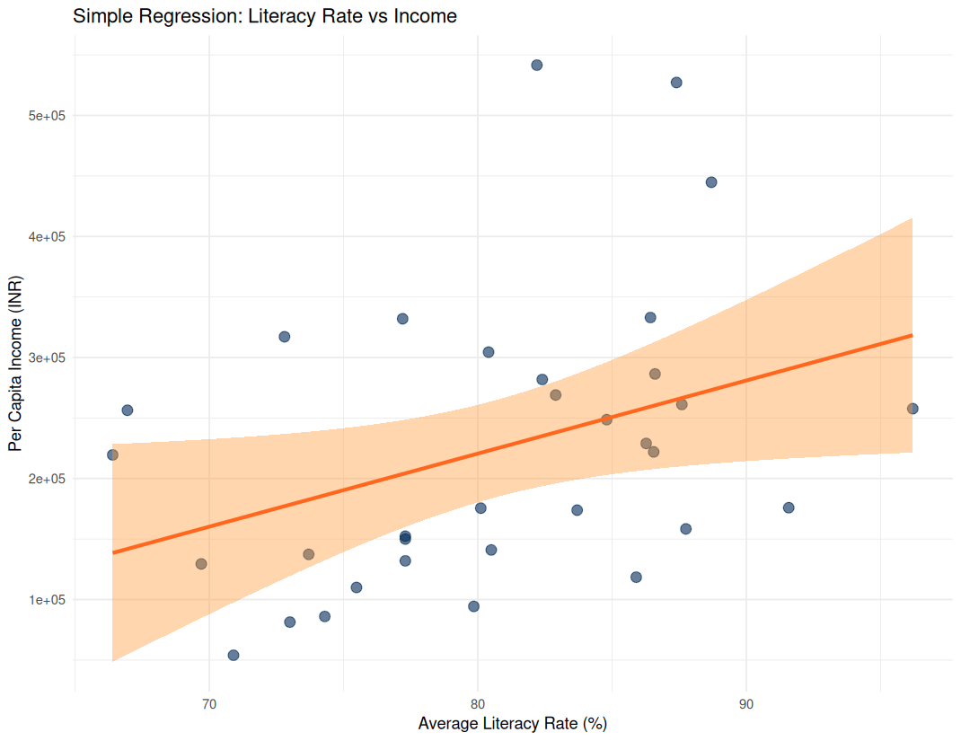
Economic Impact: Literacy Rate vs. Per Capita Income
Significant Predictor: The analysis confirms a statistically reliable positive relationship (p = 0.0375), where a 1% increase in the average literacy rate is associated with an estimated increase of Rs. 6,037 in per capita income.
R² = 13.23%: While literacy is a significant driver, the model account for roughly 13% of the total variance, indicating that the vast majority of income variation is driven by other external, multivariate factors.
REGRESSION ANALYSIS
SLIDE 4

Slide 5
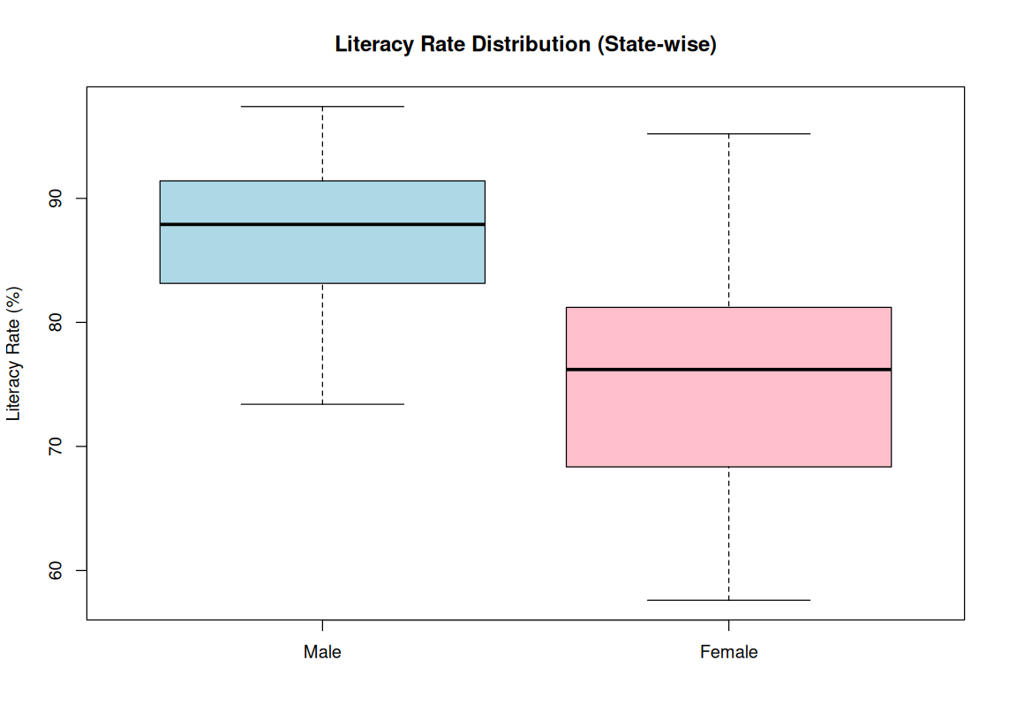
Economic Impact: Literacy Rate vs. Per Capita Income
Persistent Median Gender Gap: The median male literacy rate sits substantially higher at nearly 88%, creating a stark baseline disparity against the female median of roughly 76%.
Higher Volatility in Female Literacy: Female literacy displays a much wider spread and a significantly lower floor, indicating severe state-to-state inequality in regional educational access.
LITERACY TREND
SLIDE 5

Slide 6
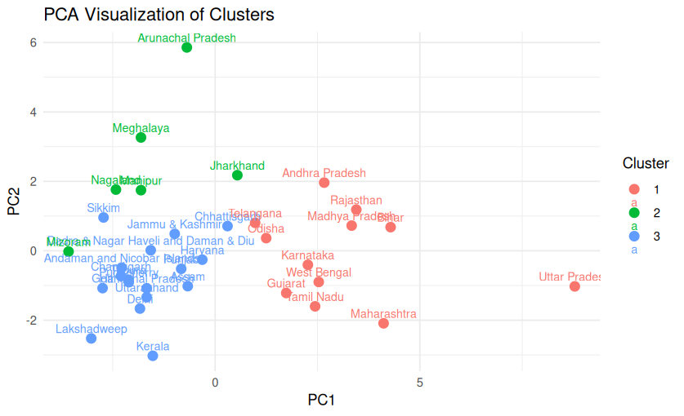
Socio-Economic Profiles: Regional Development Clusters
Cluster Segment | Characteristics | Key States
1. Macro Giants | Demographic and economic giants; massive scale acting as the backbone of the aggregate economy with a high total GDP. | UP, Maharashtra
2. Hilly & Northeast | Regional and cultural homogeneity; characterized by unique religious distributions and hilly terrains. | Northeastern states (e.g., Arunachal Pradesh, Meghalaya, Nagaland, Manipur, Mizoram), Jharkhand
3. Social Leaders | High human development and urban centers; characterized by high literacy rates, superior sex ratios, and a reliance on the service economy rather than large-scale agriculture. | Kerala, Delhi
SOCIO-ECONOMIC CLUSTERING
SLIDE 6

Slide 7
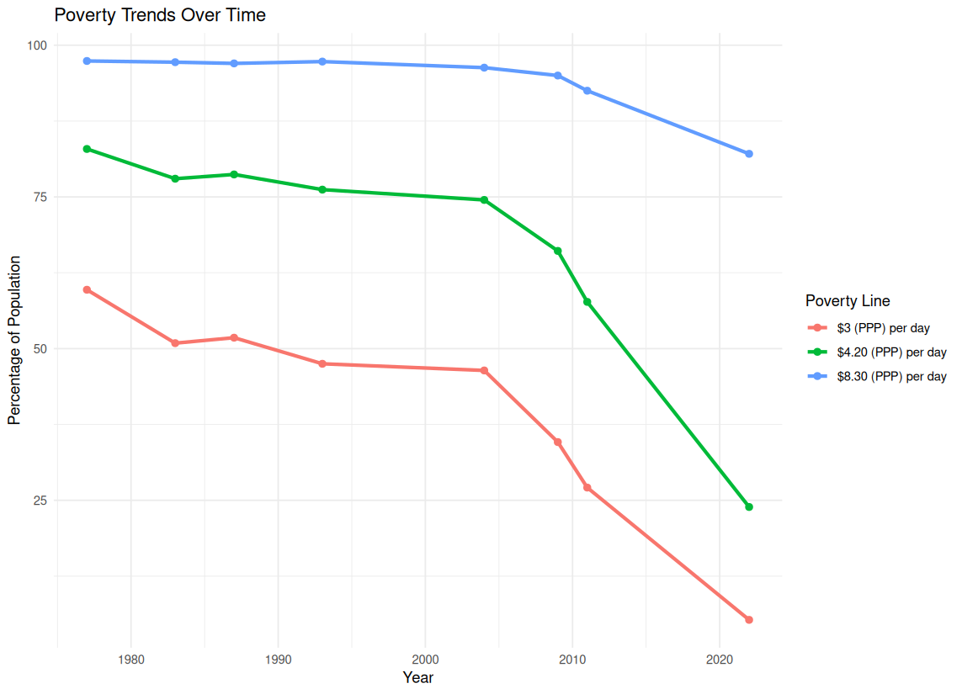
Historical Shifts: Poverty Reduction Trends Over Time
Rapid Fall in Extreme Poverty: The percentage of the population living under the lowest threshold ($3 per day) experienced a massive drop, falling from around 60% in the late 1970s to less than 10% by the 2020s, with the steepest decline occurring after 2004.
The $8.30 Resilience Threshold: Conversely, the $8.30 threshold remained frozen near 95% for decades, only beginning its downward shift in the most recent years.
TEMPORAL TREND ANALYSIS
SLIDE 7

Slide 8
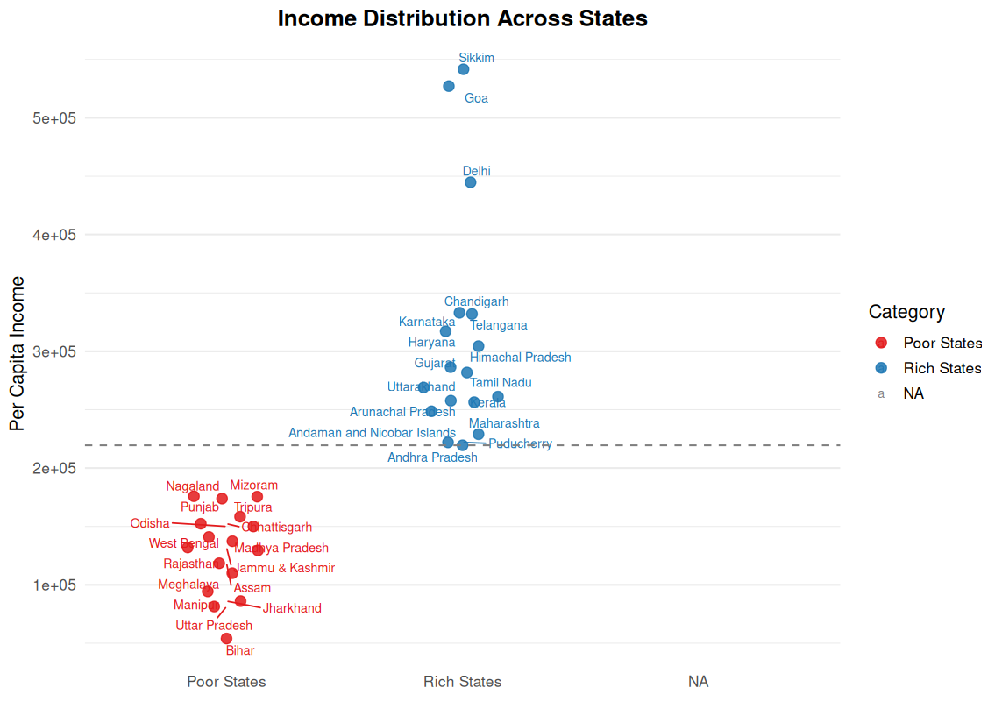
Economic Stratification: Per Capita Income Across States
Threshold Segregation: The data reveals a sharp economic divide at the Rs. 2.2 Lakh threshold, cleanly separating the lower-income clusters from the higher-performing state economies.
High-Income Outliers: Within the upper tier, an elite group of regions—specifically Sikkim, Goa, and Delhi—significantly outpace the rest of the country, soaring well above the Rs. 4.5 Lakh mark.
INCOME DISTRIBUTION
SLIDE 8

Slide 9
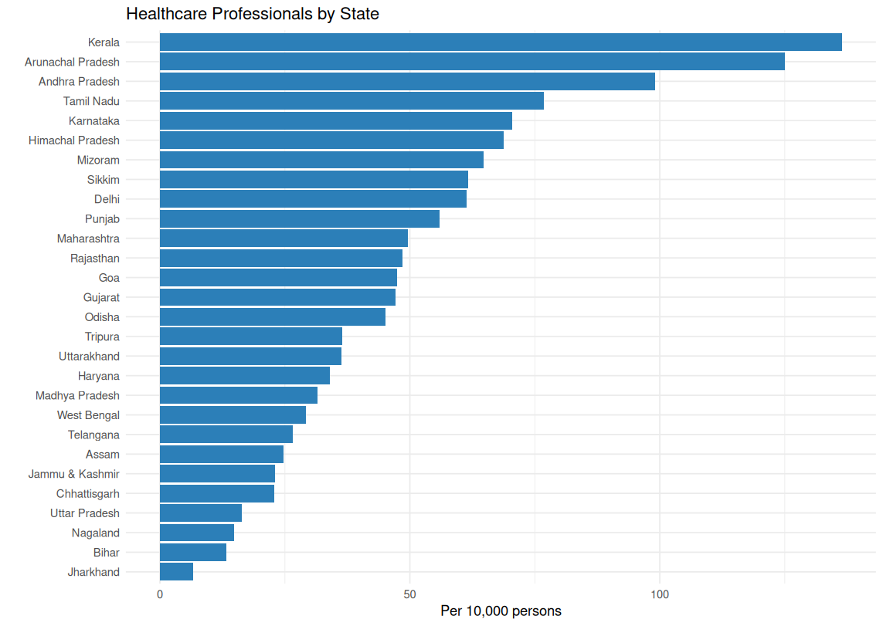
State-wise Distribution of Healthcare Professionals in India
High Workforce Concentration: Kerala leads with the highest healthcare professional density (~140 per 10,000 persons).Arunachal Pradesh and Andhra Pradesh also report relatively high workforce availability.
Regional Disparities: Low healthcare workforce density in states like Jharkhand, Bihar, and Uttar Pradesh underscores regional disparities.
HEALTHCARE PROFESSIONALS
SLIDE 9

Slide 10
Conclusion & Strategic Outlook
Economic Growth & Inequality: Even with massive national GDP growth and a historic drop in extreme poverty, progress slows down at higher income brackets, showing that wealth remains concentrated in specific regions.
Education & Economic Development: Education drives economic progress, but persistent gender and regional literacy gaps highlight the need for targeted investments in female education and underserved states.
Healthcare Workforce Distribution: Healthcare capacity remains uneven across states, emphasizing the need for equitable workforce distribution and stronger healthcare infrastructure in underserved regions.
CONCLUSION & FUTURE WORK
SLIDE 10

Slide 11
Thank You

