Slide 1

Data Workflows
for All
Reproducible data analysis in the age of AI
Olajoke Oladipo, R Software Developer · useR! 2026, Warsaw

Slide 2
THE ARGUMENT EVERY DATA TEAM IS HAVING
Both sides are right.
“Let the AI do it.”
“Not so fast.”
Ask in plain language, get an answer fast, and move on.
If I can’t see how the number was made, I can’t trust it, and I can’t reproduce it.
And you shouldn’t have to choose.

Slide 3
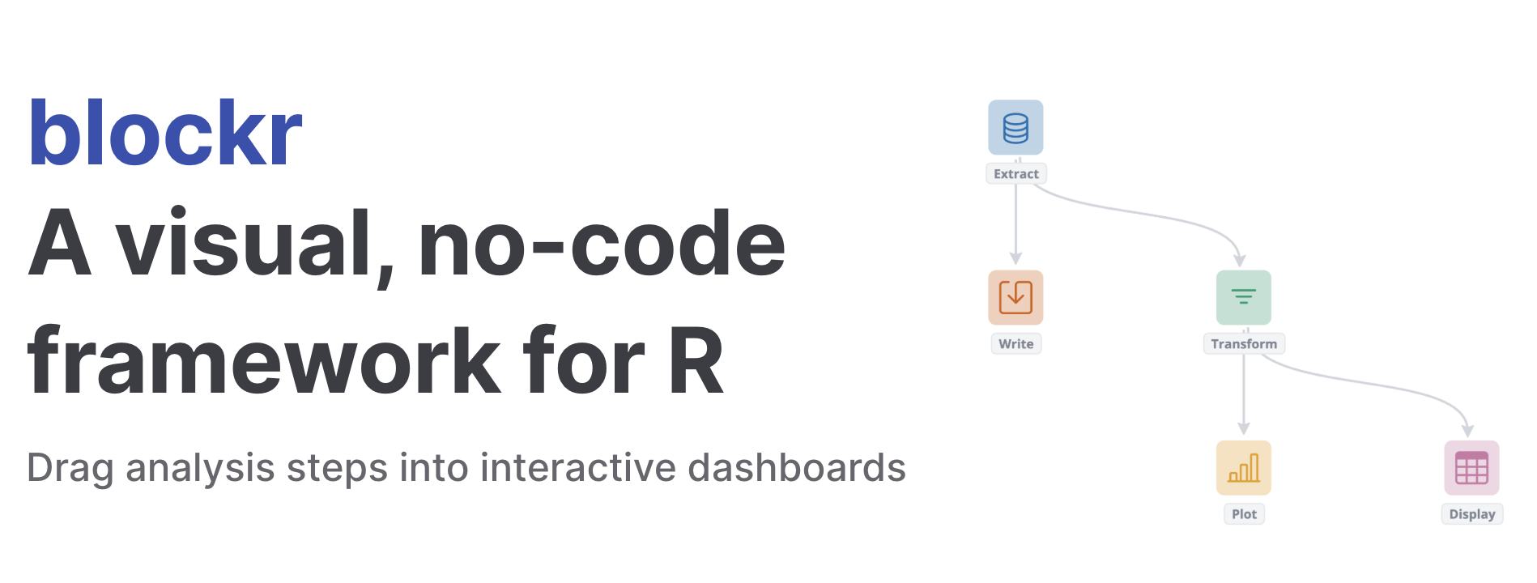

Slide 4
THE IDEA
Compose your analysis. Don’t script it.
Load data
Filter
Chart
Under every block is real R code. blockr is not a black box on top of your data. It is your pipeline.

Slide 5
WHERE AI COMES IN
AI builds the blocks for you.
YOU SAY
BLOCKR BUILDS
“Load the sales data, keep this year, and show revenue by region.”
Data
Filter
Chart
A pipeline you can inspect, fix, and rerun tomorrow for the same result.

Slide 6
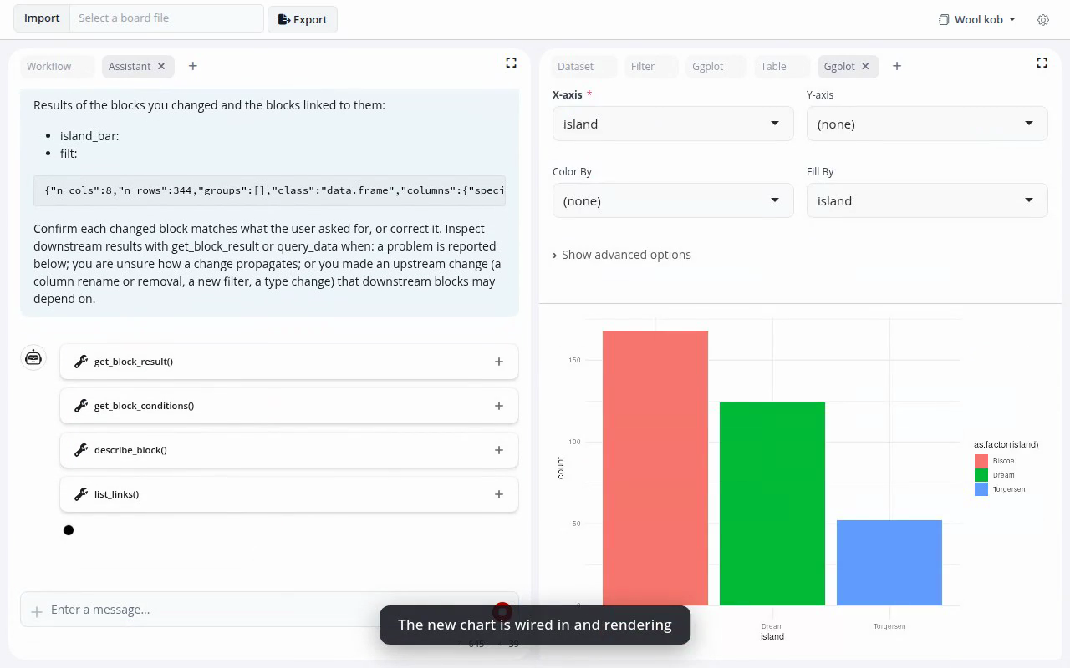
DEMO

Slide 7
WHY THIS MATTERS
Nobody gives anything up.
The domain expert
The developer
Knows the data, but doesn’t write R all day. Builds a real analysis simply by asking.
Keeps it all: reproducible code, version control, and extend blockr.
It’s not AI instead of your workflow, it’s AI that builds a workflow you can trust.

Slide 8
MODULAR BY DESIGN
One core, many blocks.
Each block is its own package, even the one you write yourself.
blockr.core
boards · blocks · links
blockr.dock
docking layout
blockr.dplyr
dplyr blocks
blockr.ggplot
plots
blockr.ai
LLM assistant
blockr.io
read / write
blockr.dag
graph view
blockr.yourcustom
custom analysis block

Slide 9
CYNKRA & THE ECOSYSTEM
Built by cynkra. Open source by design.
We are a Swiss data science company, and we have been part of the R community for years: CRAN packages, the R Journal, consulting for teams whose analysis has to hold up.
R

Slide 10

Come build a pipeline
with us.
Speak in plain language, and walk away with the code.
blockr.site

Slide 11
Data workflows for all.
Just by composing, and by asking. Whoever you are, still get your code.
Come find us at the booth.
Thank you.

