Slide 1

Views
R is people
How the R Consortium supports the future of R
useR! 2026 sponsor session
Warsaw, Poland
Mike K. Smith, Chair, R Consortium; Senior Director, Pfizer R&D UK Ltd
Opinions and views presented here are those of the presenter acting as chair of the R Consortium (UseR! 2026 sponsor) and not necessarily those of his company.

Slide 2
R’s enduring value – a foundational environment
Statistical rigor
Trusted methods
R was built for statistical computing and graphics.
Peer review, and domain expertise support serious work. Large user-base means problems can be trapped quickly.
Reproducibility
Mature ecosystem
R workflows make analytical work reviewable, shareable, and repeatable.
Packages, documentation, examples, communities, and teaching materials compound over time.
This is the bedrock on which we build.
useR! 2026 sponsor session Mike K. Smith
05
Notes:
R has been built on really strong foundations. The human checks and balances matter. I was really delighted to hear that the Rousseeuw Award has been awarded to the R-Project because I think it recognizes the hard work of the founders and custodians of this language over the last 30+ years to put in place that solid bedrock so that future work can start from a place of strength and rigour. These are the attributes of a quality language for statistical programming…

Slide 3
R has always been more than “just” a language.
Build
Maintain
package authors
R Core contributors
infrastructure teams
reviewers
organizers
documenters
Teach
Use
academics
mentors
community leaders
researchers
analysts
industry teams
PEOPLE are at the heart of R…
useR! 2026 sponsor session Mike K. Smith
05
Notes:
But behind those attributes lie people doing work. There’s a legacy of work over the last 30 years, but there’s also individuals and communities that continue that work, build on the foundations and advance the language. There are also many different roles where individuals bring their knowledge and expertise to the R language, its packages, documentation, training material. It’s amazing (and slightly daunting!) when you being R and you find that there’s SO MUCH and SO MANY PLACES where you can find instructive material and documentation. And it’s freely available.

Slide 4
The moment we’re in
AI is changing how people write code, draft analysis, search documentation, and prototype ideas.
The key question
Is AI grounded in high-enough quality content? How do we prevent “slop”?
• It’s faster to prototype.
• Code can be produced with less friction.
• It’s a force-multiplier for our day-to-day work.
The R answer
Statistical rigor, reproducibility, mature methods, maintainable packages, and human review.
i.e. We already have it! But we need to protect that and continue to support…
useR! 2026 sponsor session Mike K. Smith
04
Notes:
Acknowledge AI as important and exciting. The point is that AI depends on the quality of the code, methods, documentation, examples, and human judgment it draws from.

Slide 5
The AI doom spiral
People devolve “thinking” and “doing” to AI systems
Code produces the “correct” result, but brittle.
AI appears to be working…
Faster timelines, reduced resource
If all that matters is speed and cost…
Impacts are insidious…
We won’t know the full impact until it all goes wrong…
useR! 2026 sponsor session Mike K. Smith
08
Notes:
There’s a tension when we add AI into how we work with R. One view is that AI will degrade quality, force people out of jobs, and we won’t see what has broken until it’s too late and we don’t have the expertise or resources to fix it.

Slide 6
From doom spiral to virtuous cycle
Invest in people and infrastructure
Better tools and documentation
Stronger contributors and maintainers
Better outcomes and adoption
The R Consortium’s role is to help the community invest in the inputs that make better outputs possible.
AI can accelerate this cycle but we rely on people to keep foundational aspects strong.
useR! 2026 sponsor session Mike K. Smith
08
Notes:
On the other hand, AI *could* help accelerate development IFF we keep a strong hand on the rudder and invest in people with the knowledge and skill to use AI to make things better for people, rather than purely better for a company’s bottom line.

Slide 7
What the R Consortium does
Grants
Events
Funds infrastructure and community projects through the ISC.
Builds opportunities for learning, exchange, visibility, and connection, online and in-person.
Working Groups
Ecosystem support
Working together to solve challenges that can’t easily be done individually.
Supports the R Foundation, R Core priorities, and global community infrastructure.
The R Consortium helps longevity of R and its community.
useR! 2026 sponsor session Mike K. Smith
05
Notes:
It’s this focus on the people who use and build with R where R Consortium can help. We have a number of ways in which we’re supporting the wider community of R users and developers; bringing together people to solve challenges that are difficult to solve individually; sharing ideas and experiences.

Slide 8
Supporting the R Foundation and R Core
Sovereign Tech Fund work
Research Software Maintenance Fund
EUCRA readiness
Support projects that strengthen sustainability, security, infrastructure, and maintainability for R.
Support maintenance, mentorship, and contributor capacity for research software that the ecosystem relies on.
Improve documentation, attestation, security posture, and maintainability for the regulatory environment ahead.
Put a human face on the work.
• Show who maintains the language and why the work matters.
• Create visible pathways from user to contributor.
• Coordinate support without taking credit away from the people doing the work.
useR! 2026 sponsor session Mike K. Smith
10
Notes:
We’re working with R Foundation and R Core to ensure that R has longevity – I want to see R being a vibrant and viable language for statistical programming for another 30 years. R Consortium bridges between the people developing R *as a language* and the user community who are using in production to bring data insights to decision making, policy and research.

Slide 9
Industry has a role
If your organization depends on R, it has a stake in R’s future.
Fund
Contribute
Share
Advocate
membership
grants
event support
employee time
working groups
review
use cases
requirements
lessons learned
internal support
executive awareness
long-term planning
Sustainability does not happen by accident. It takes internal champions who can connect business value to community investment.
useR! 2026 sponsor session Mike K. Smith
15
Notes:
With more and more usage of R across industry we need to encourage managers in organisations to fund and resource this work of “keeping R going”. Money helps, of course, but having resource to discuss, plan, shape, contribute, maintain and advocate for the “behind the scenes” work is also key. There’s no license fee for using R, but R doesn’t come “for free”.

Slide 10
What you can do next
Contribute
Mentor
Join
Fix docs, file issues, review code, submit PRs.
Help a new contributor make their first useful contribution.
Participate in a working group or help start one.
Apply
Attend
Advocate
Bring forward infrastructure ideas for grant consideration.
Use events to connect, learn, and share work.
Make the case for organizational membership and employee time.
The next step does not have to be large. It just has to be real.
If you can do it person to person, so much the better.
useR! 2026 sponsor session Mike K. Smith
16
Notes:
There are so many ways that people in this room could help keep R alive for the next 30 years. I encourage all of you to consider lending your expertise and effort to help us ensure that happens.

Slide 11

The future of R
is built together.
Join us. Contribute with us. Help expand the circle.
r-consortium.org
useR! 2026 sponsor session Mike K. Smith
Notes:
The future of R will not be built by tools alone. It will be built by people who contribute, review, document, teach, mentor, maintain, and advocate. Invite the audience to join R Consortium work and take the message back to their organizations.

Slide 12
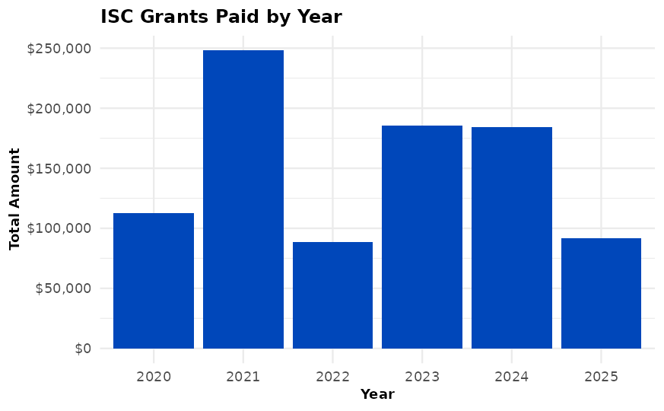
FUNDING SHARED INFRASTRUCTURE
Grants and community investment
ISC grants turn community needs into funded infrastructure work.
ISC Grant totals vary with our overall budget, but typically ~$100K to $250K each year.
We’re seeing an increase in the number of grants each period (twice per year)
ISC Grant Program committee awards go to projects that have a broad impact on the R Community, well focused goals, low to medium risk.
useR! 2026 sponsor session • Draft for Mike K. Smith
12

Slide 13
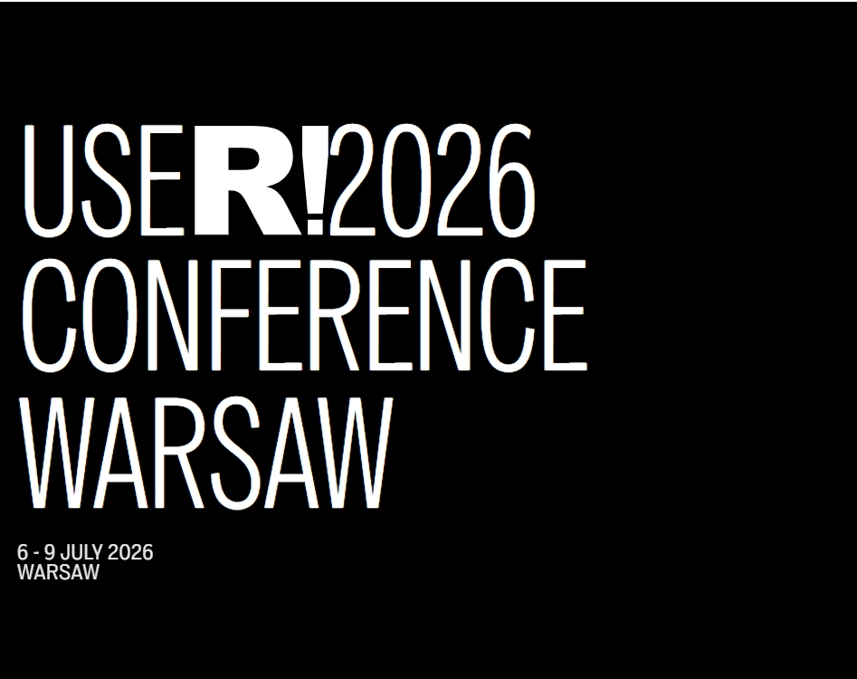
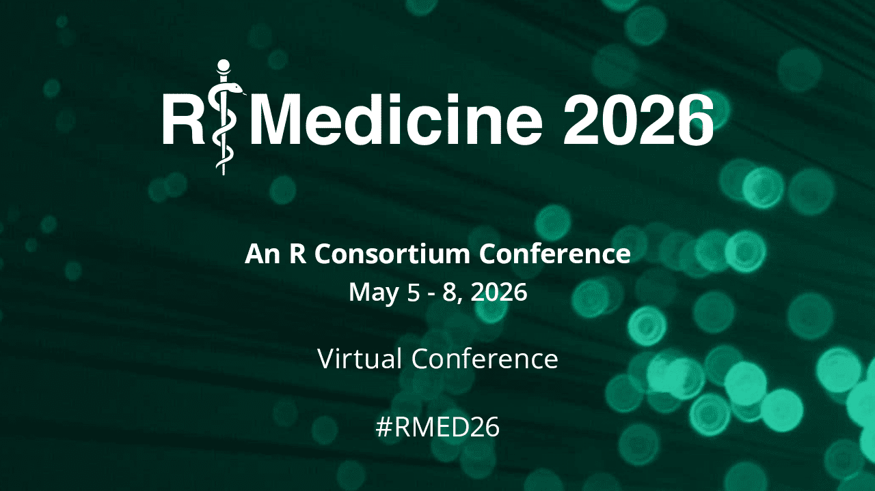
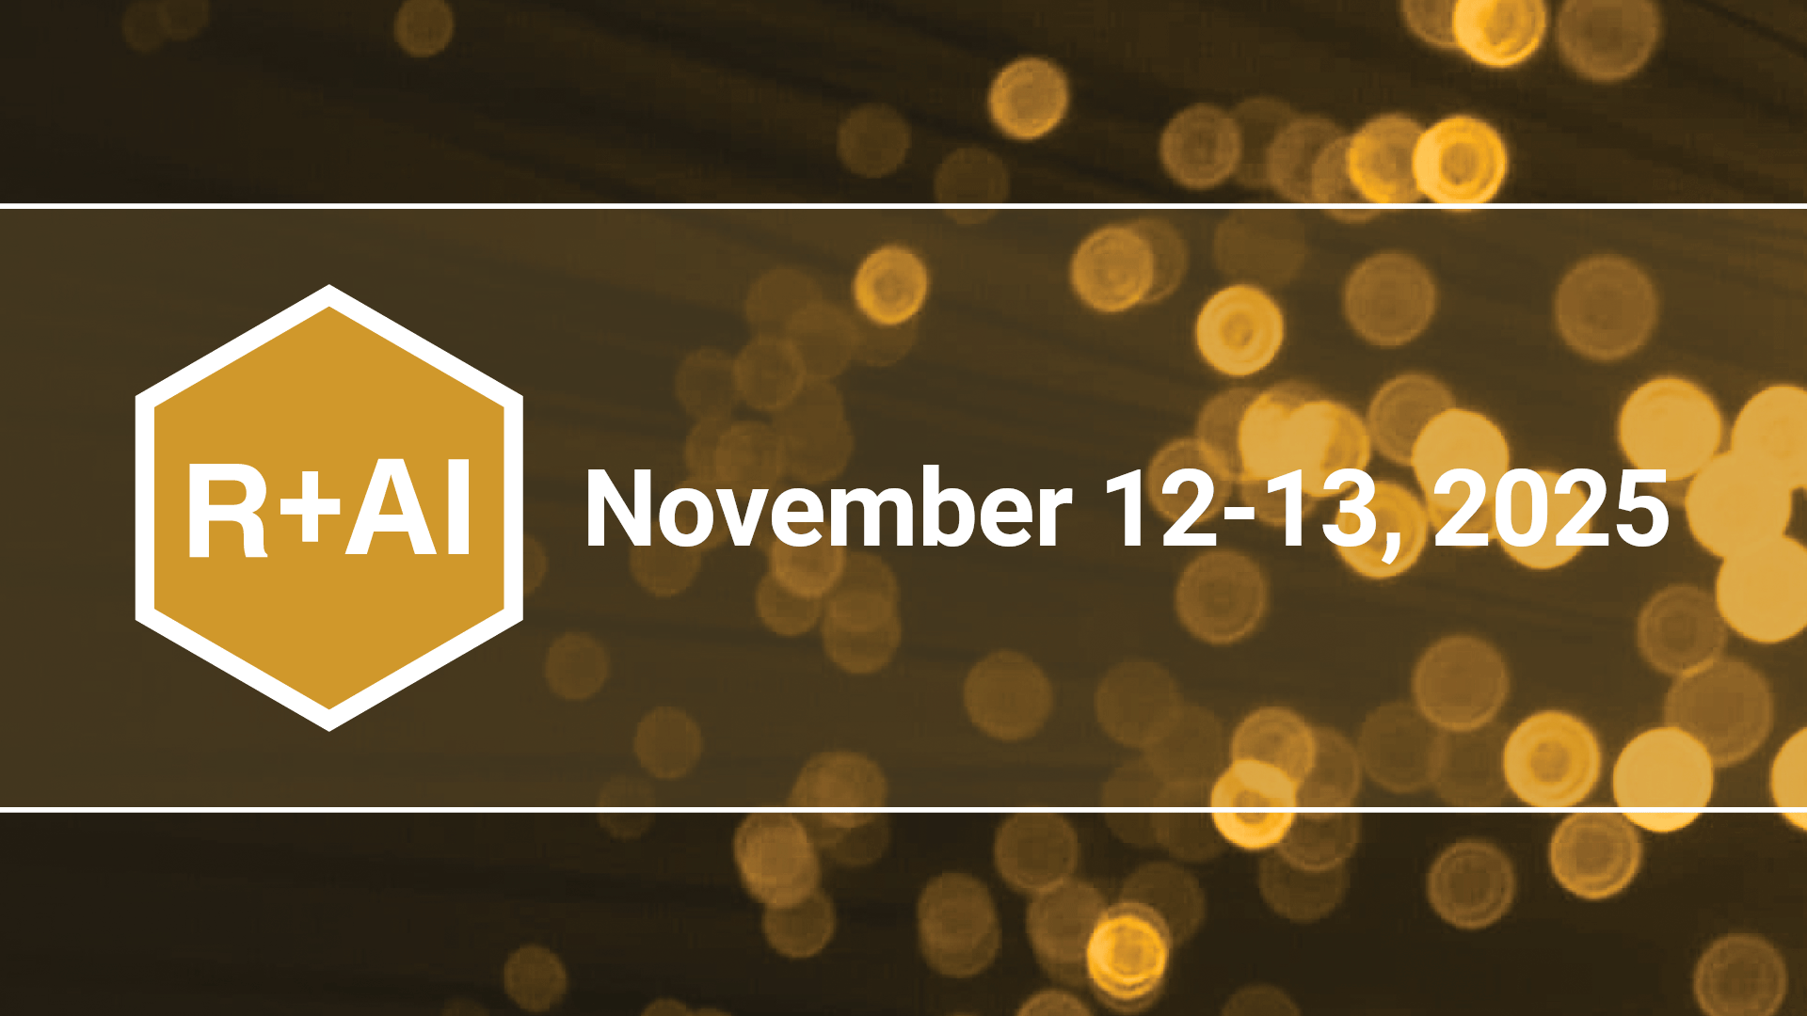
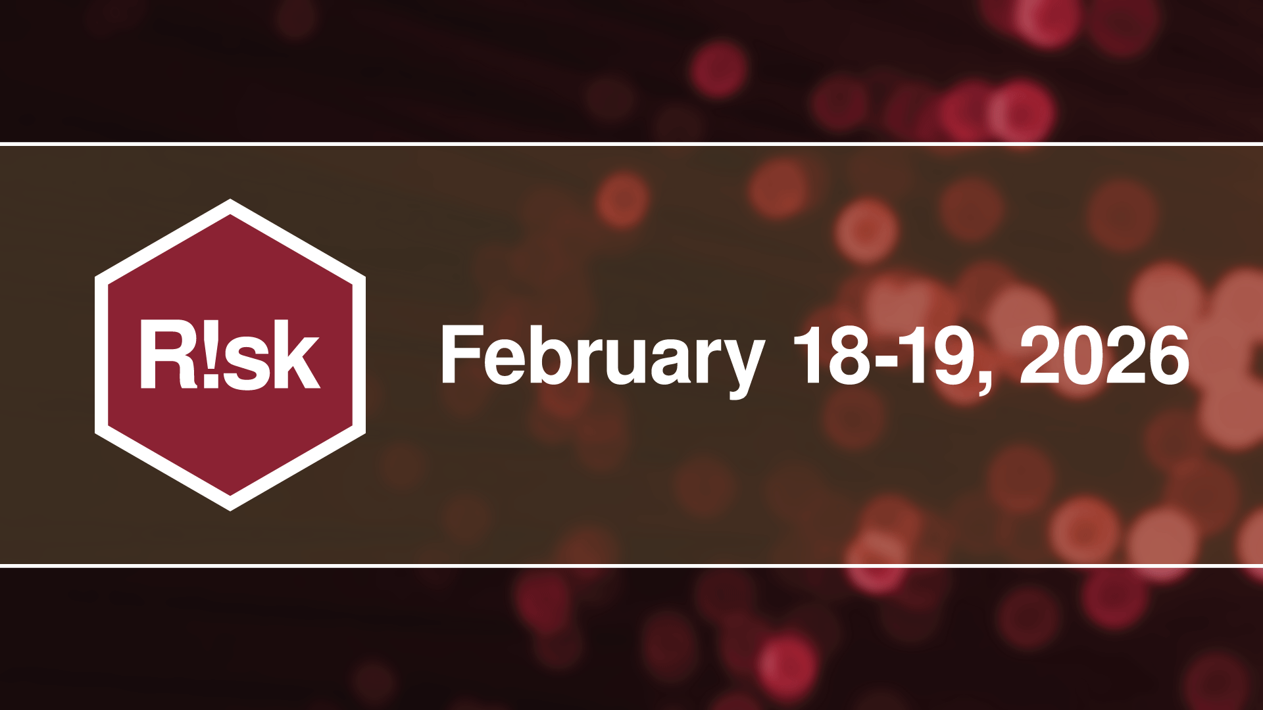
WHERE CONNECTION BECOMES MOMENTUM
Events as community infrastructure
Regulated research
clinical analytics
pharma community
New tools
practical workflows
responsible adoption
Finance, insurance
risk modeling
industry exchange
Global community
teaching
core ecosystem
Events are not just programming. They are reusable infrastructure for learning, visibility, contributor discovery, and cross-sector collaboration.
Catch up with presentations at R Consortium YouTube channel
useR! 2026 sponsor session • Draft for Mike K. Smith
13

Slide 14
JOIN ONE. START ONE. BUILD WITH OTHERS.
Working groups: where the work happens
Working groups create a durable home for shared problems that are too large, too important, or too cross-cutting for one person or one company to solve alone.
Technical infrastructure
Industry needs
Community programs
Shared tooling, package systems, documentation, and reproducibility.
Pharma, finance, risk, geospatial, and other communities of practice.
Training, user groups, mentorship, and contributor onboarding.
Call to action: bring a problem, a project, or people who want to help.
useR! 2026 sponsor session • Draft for Mike K. Smith
14

Slide 15
WHERE SECTORS MEET
R Consortium as a platform
Academia
Industry
methods
teaching
research
use cases
funding
scale
R Consortium
Government
Community
public benefit
standards
trust
contributors
events
working groups
A shared language needs shared stewardship. The Consortium gives that stewardship a place to happen.
useR! 2026 sponsor session • Draft for Mike K. Smith
09

Slide 16
MAKE CONTRIBUTION VISIBLE AND POSSIBLE
Building the contributor pipeline
User
Participant
Contributor
Maintainer
Core pathway
learns
relies on R
joins events
asks questions
files issues
submits PRs
reviews
releases
mentors
long-term
stewardship
R’s future depends on lowering the friction between using R and contributing to R.
useR! 2026 sponsor session • Draft for Mike K. Smith
11

Slide 17
HUMAN JUDGMENT STILL MATTERS
AI needs stronger foundational work and human intervention
AI-generated work still needs:
Speed without stewardship creates technical debt.
Stewardship turns speed into durable progress.
Stewardship alongside AI can tackle problems that were too big or too onerous to do by yourself.
✓
Statistical validation
✓
Code review
Human-centred documentation
✓
Maintainability
✓
✓
Security thinking
✓
Domain expertise
Systems (integration) thinking
✓
Architectural thinking
✓
useR! 2026 sponsor session • Draft for Mike K. Smith
06
Notes:
This slide turns the AI discussion into a quality discussion. Human review, documentation, maintainability, and v
The question is not whether AI can help. The question is whether the ecosystem remains strong enough for AI-assisted work to be useful, correct, and sustainable.
Validation are not optional extras. They are the difference between quick output and durable software.

Slide 18
WHAT KEEPS R RELIABLE
We still need PEOPLE at the heart of things…
Maintainers
Reviewers
Package authors
Release discipline
Compatibility
Backlog triage
Code quality
Security checks
Method validation
Domain experts
User-centric workflows
Documentation
Community organizers
Industry practitioners
Researchers & teachers
Training
Meetups
Human-human interaction
Use cases
R in Production
Sustained funding
New methods
New users
Scientific rigor
Open source works because people do the work. R Consortium exists to support those people and give their work structure, visibility, and resources.
useR! 2026 sponsor session • Draft for Mike K. Smith
07
Notes:
Humanize the ecosystem. Mention maintainers, reviewers, package authors, community organizers, working groups, researchers, and industry practitioners. This is the part of open source that is too often invisible.

